Slide 1
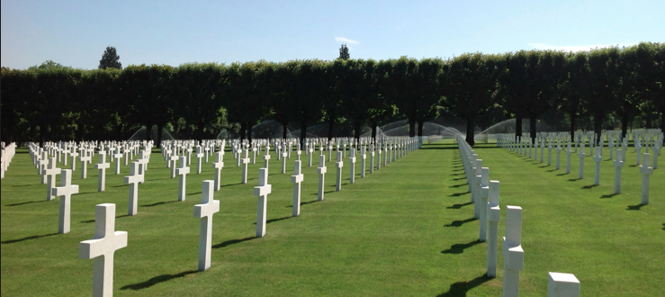
Human Connection:
Connect with a Soldier of the First Great War.

Slide 2
Private R. E. Weiler

Slide 3
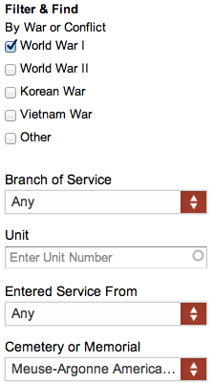
Find Your Soldier
1
2

Slide 4
Cheers to you! Tell us about your soldier!

