Slide 1
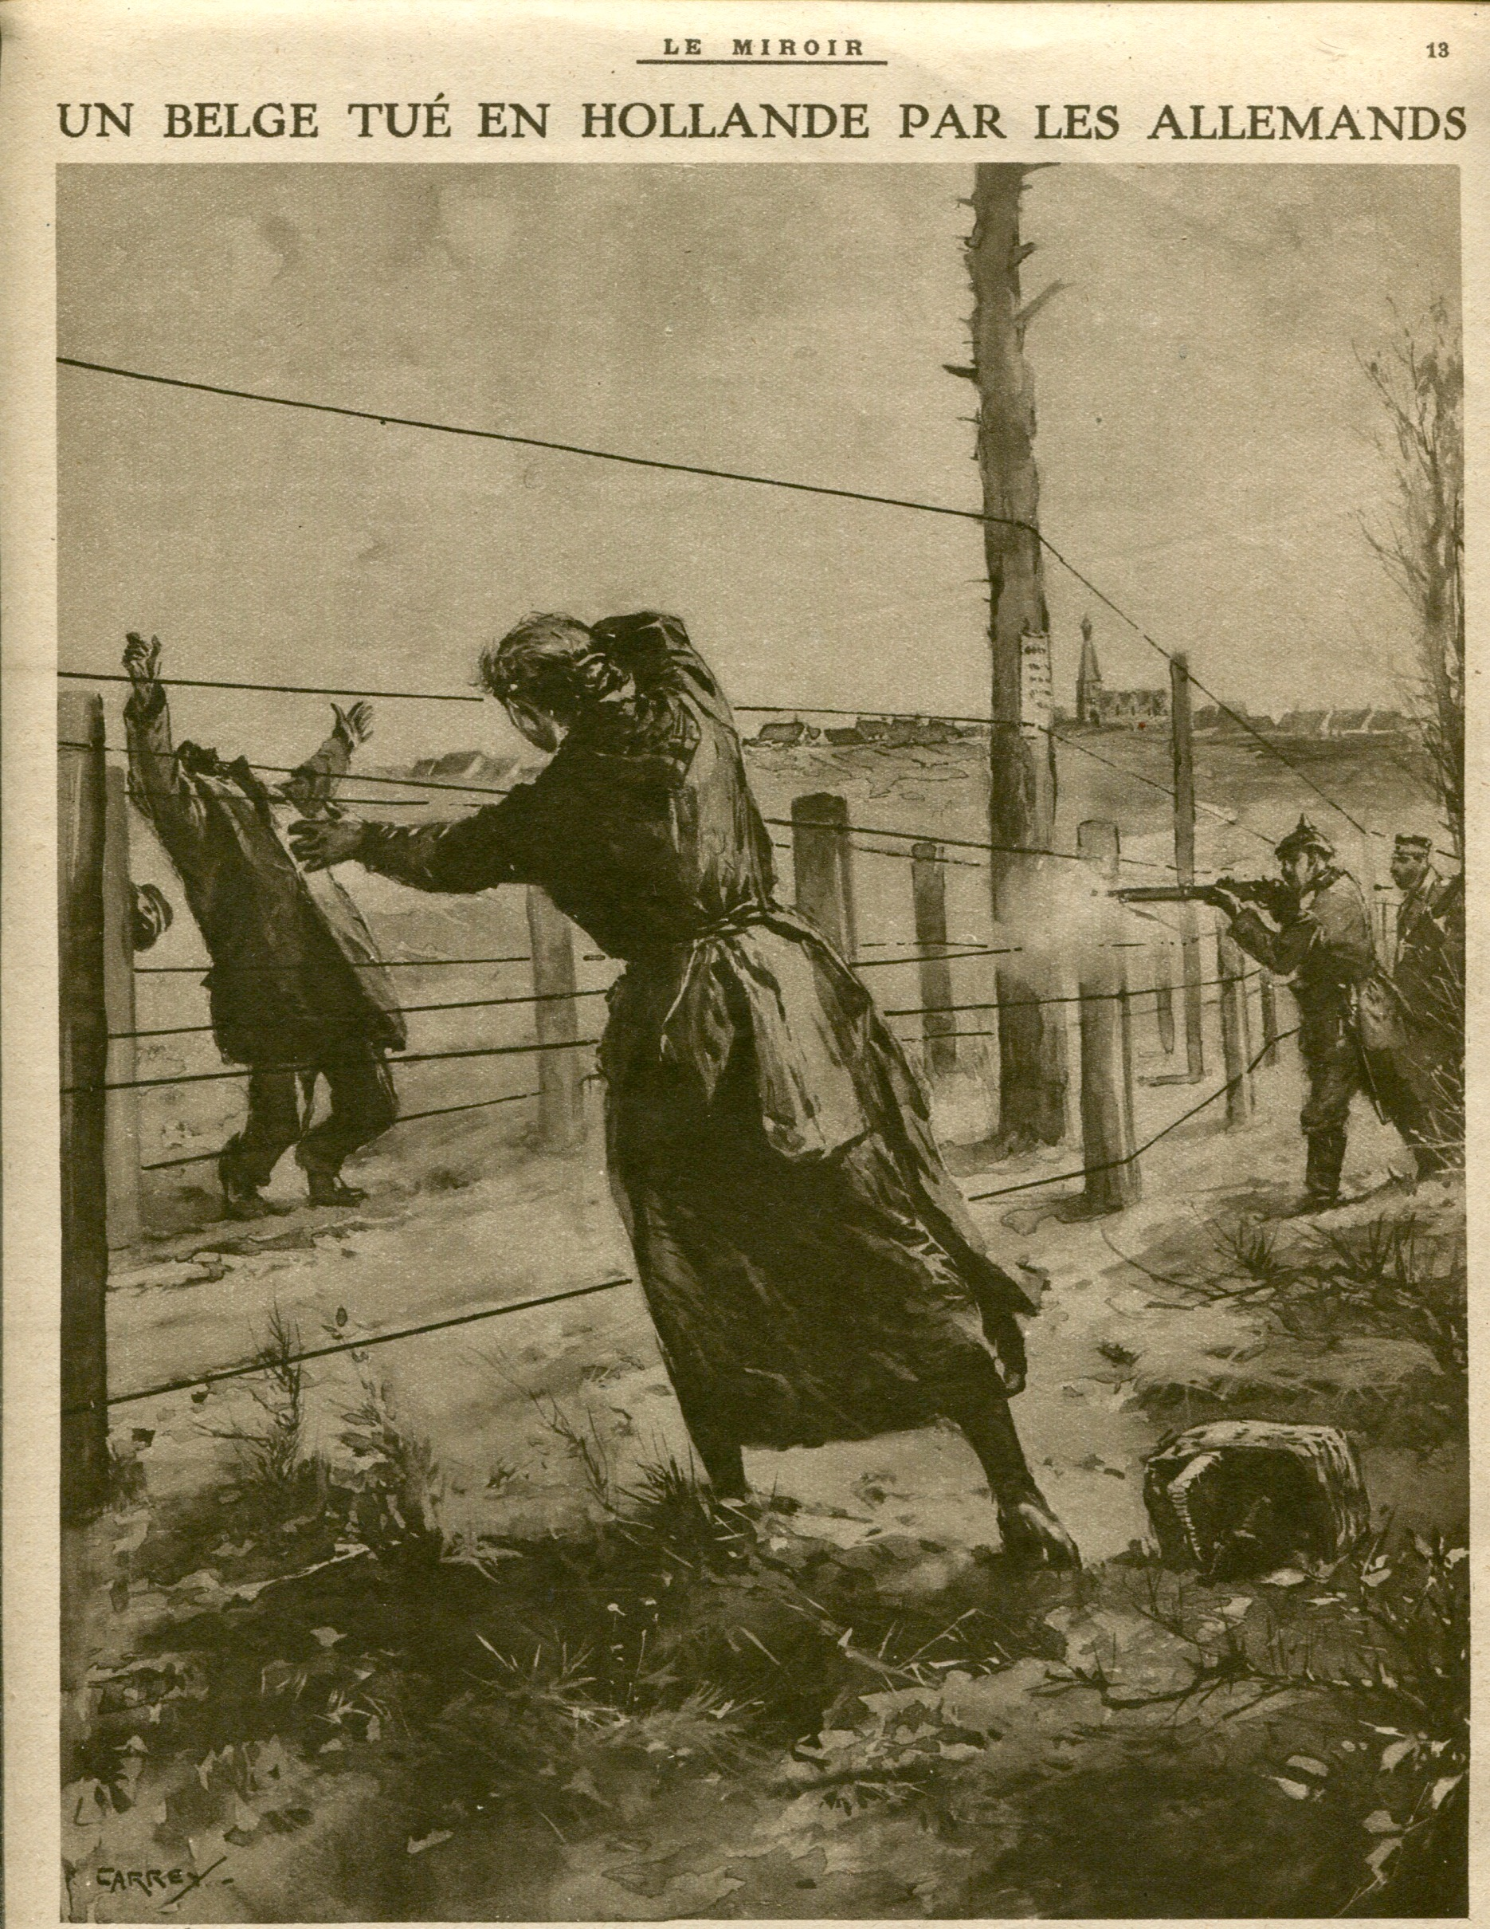
: “A Belgian Man Killed by the Germans” – a drawing in a 1916 French magazine. Source: Lisa Pennington

Slide 2
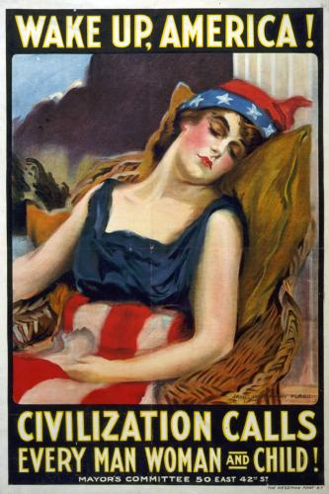
An American World War I poster. James Montgomery Flagg, “Wake Up, America!” World War I Propaganda Posters, LEARN NC. 2009. Web. July 29, 2014 http://www.learnnc.org/lp/editions/ww1posters/

Slide 3
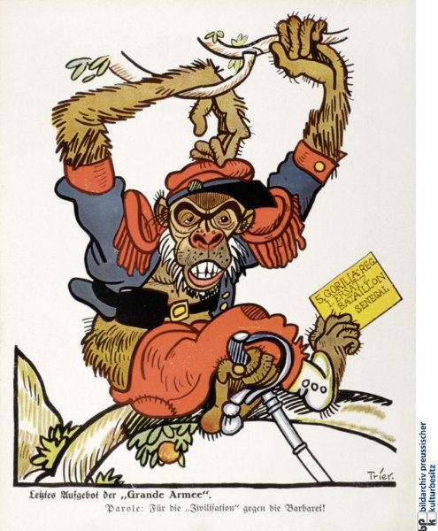
“Last Stand of the ‚Grand Armee‘. Code-word: For the “civilization” against the Barbarians.” Racist mockery – this propaganda poster mocks the French army by stating that the last standing battalion of the French is from Senegal and fighting for the French “civilization” against the German “barbarians.” “Last Stand of the ‚Grand Armee‘,” Spiegel Online. Web. July 28, 2014 http://www.spiegel.de/fotostrecke/film-und-zeitungspropaganda-im-ersten-weltkrieg-fotostrecke-115930-3.html

