Slide 1
Section 5, Gallery 5
The Monroe Journal

Slide 2
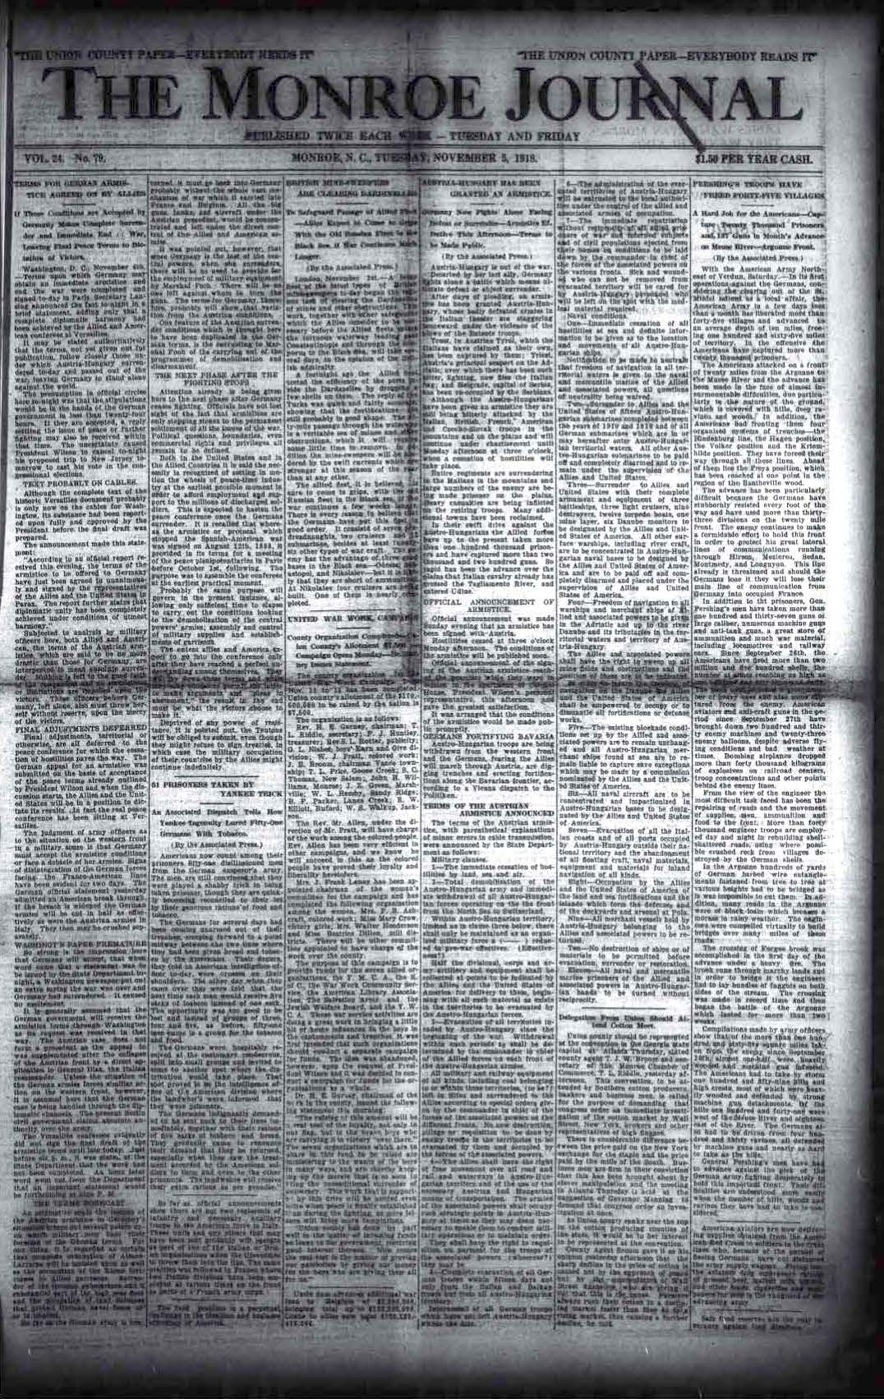
November 5, 1918 - Armistice

Slide 3
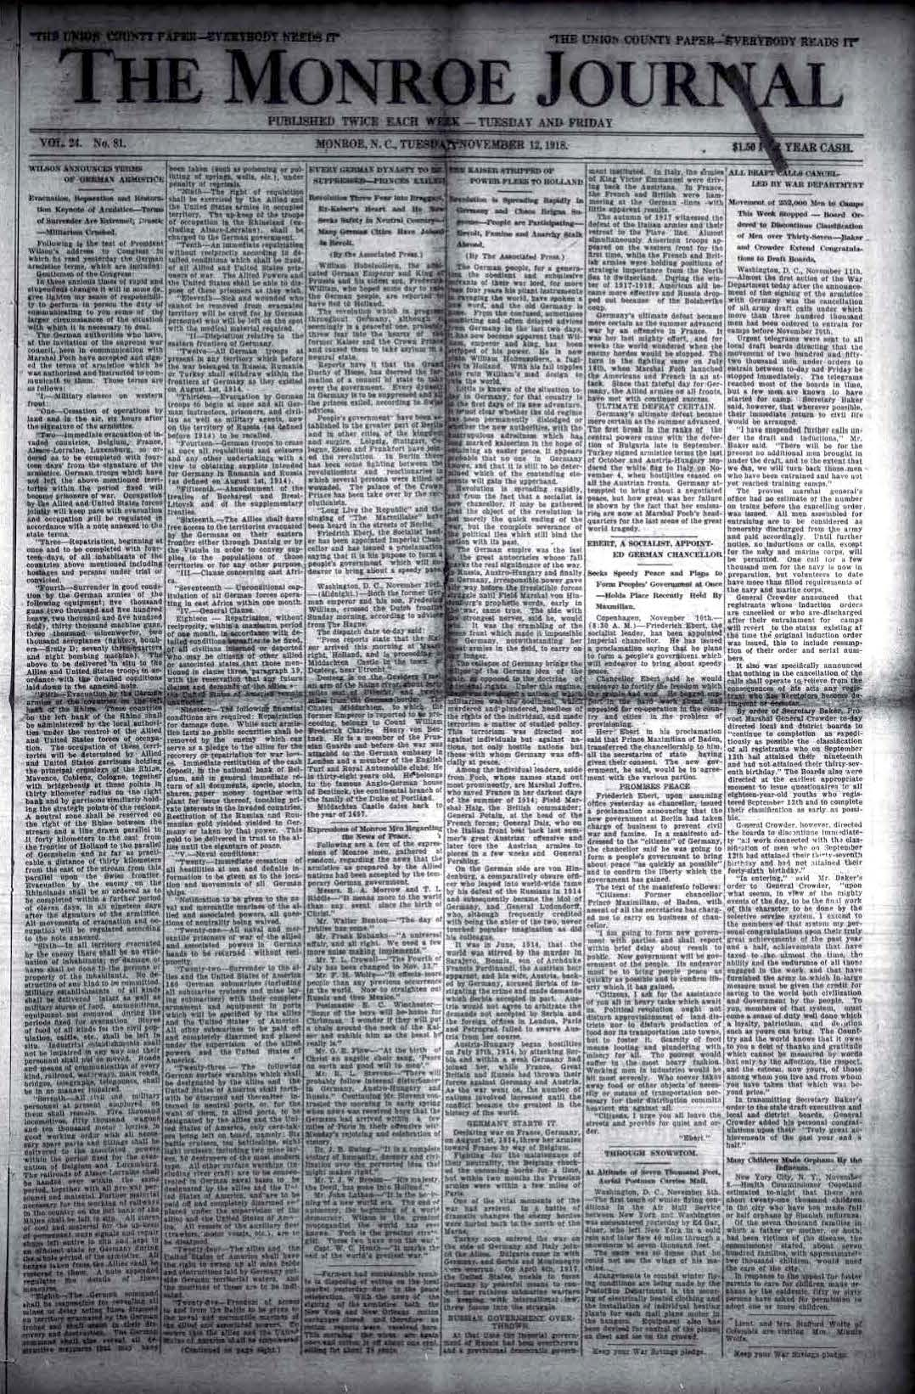
November 12, 1918 - Armistice

