Slide 1
Section 5, Gallery 9
Reflections

Slide 2
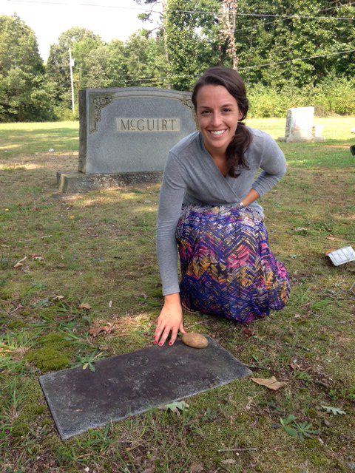
Placing a Potato at the Grave

Slide 3
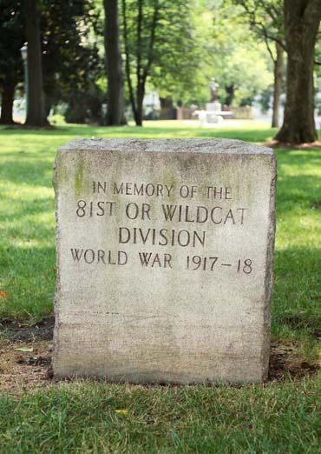
WWI Wildcat Memorial

