Slide 1
Section 5, Gallery 7
Life After War

Slide 2
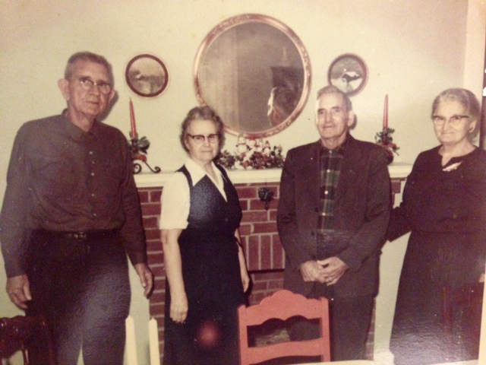
Married Life

Slide 3
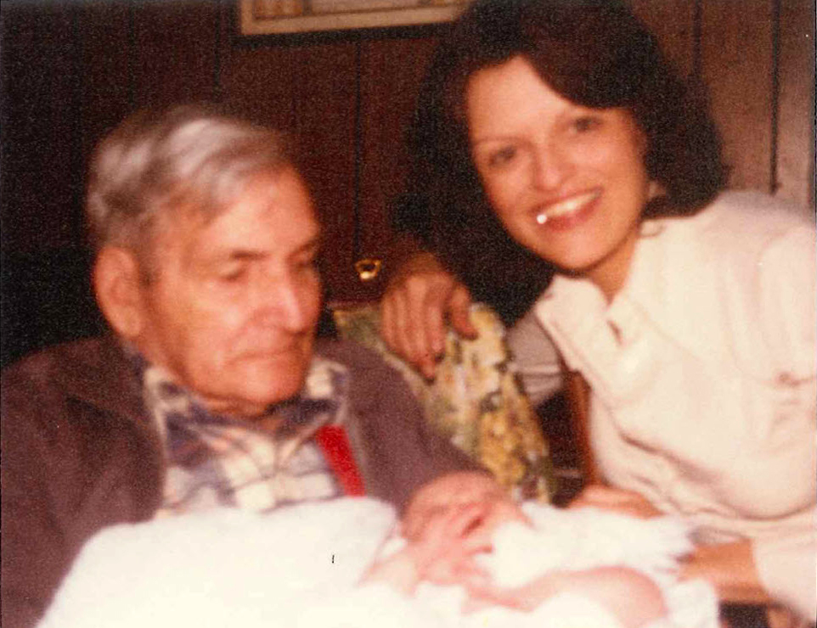
Will McGuirt with Two Generations

Slide 4
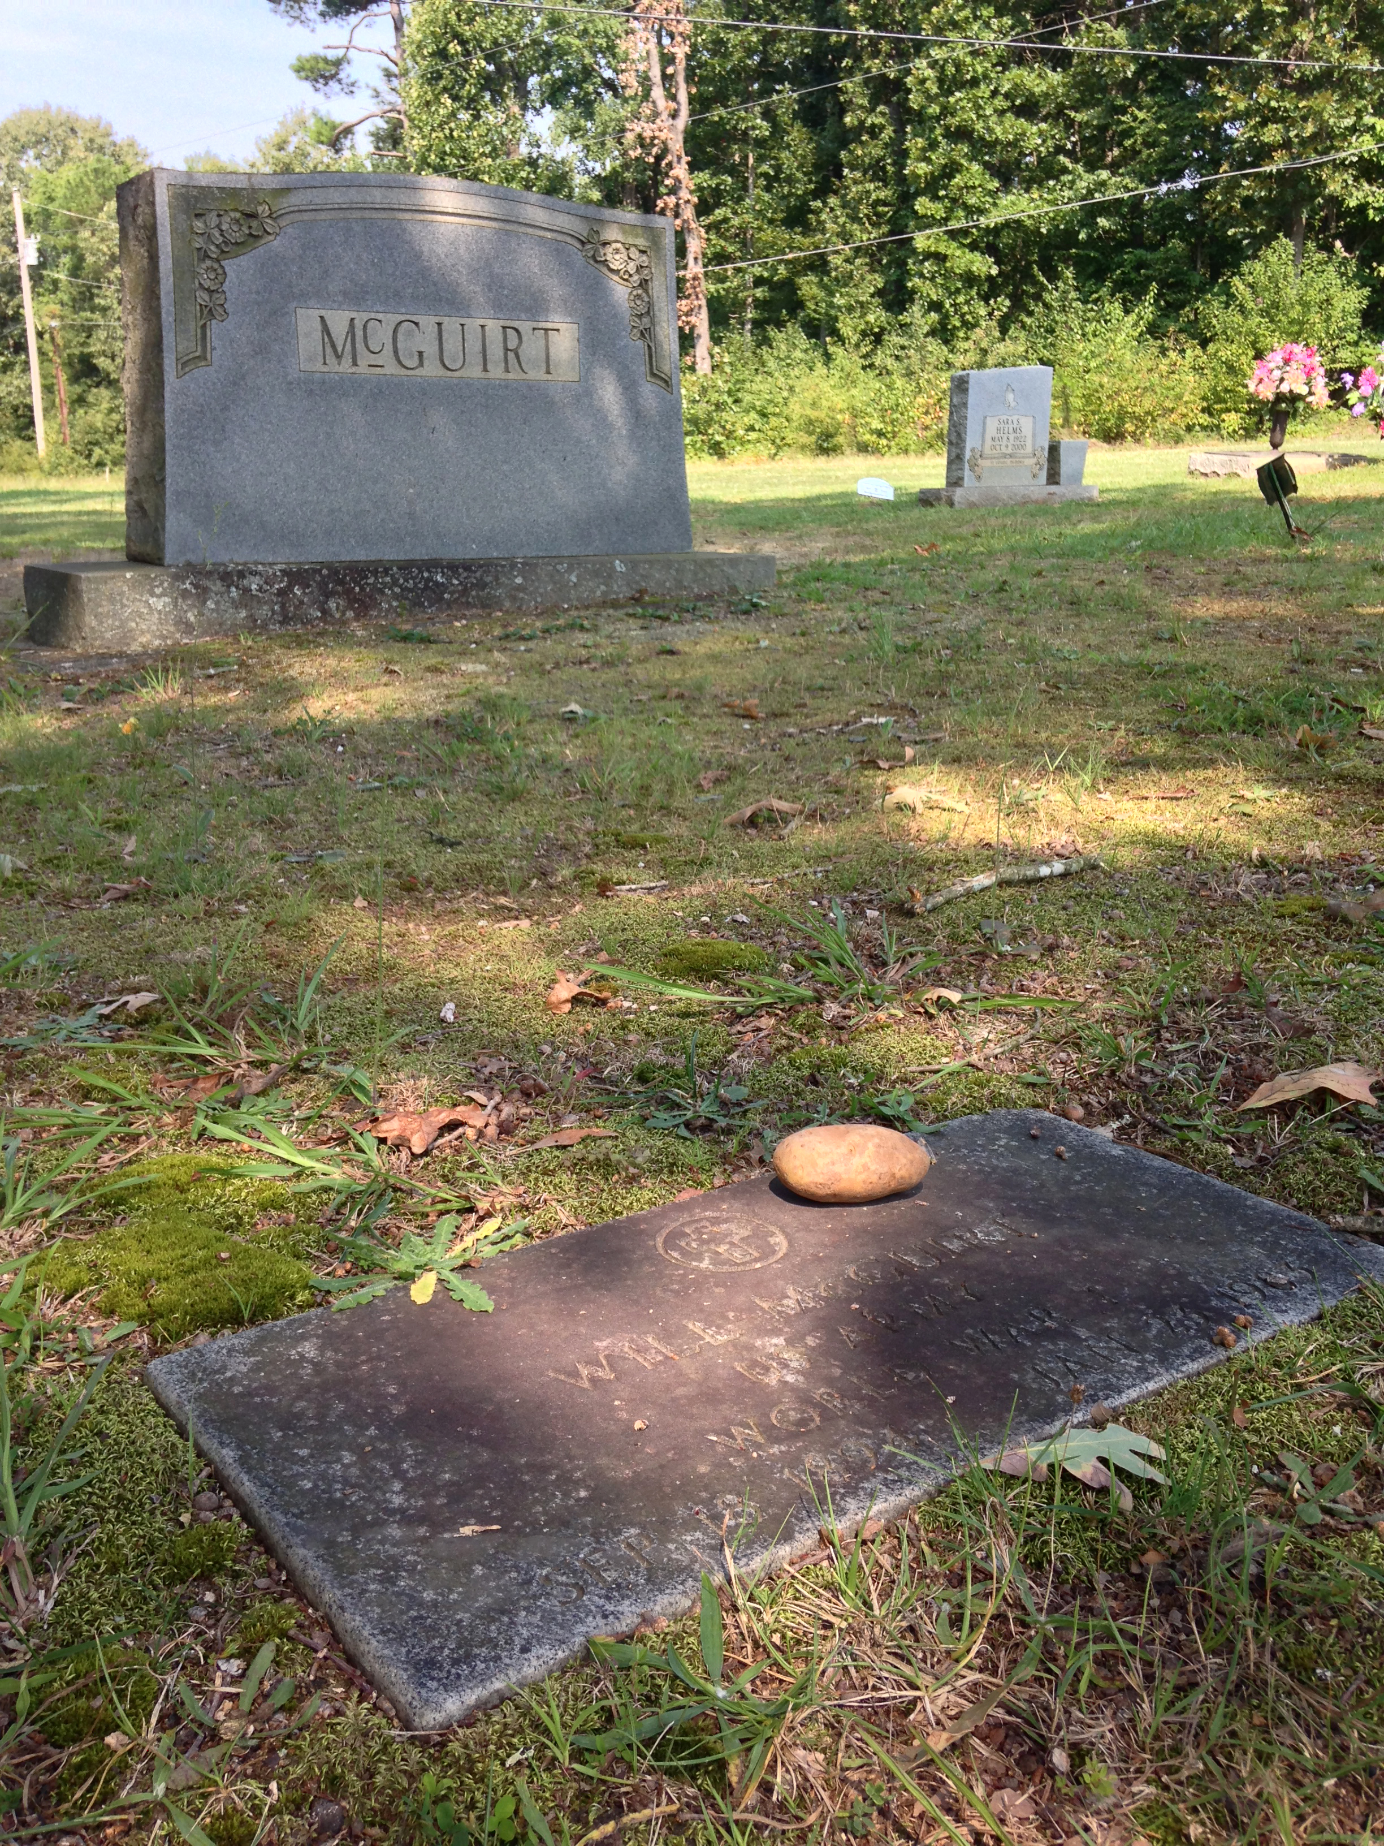
Headstone

Slide 5
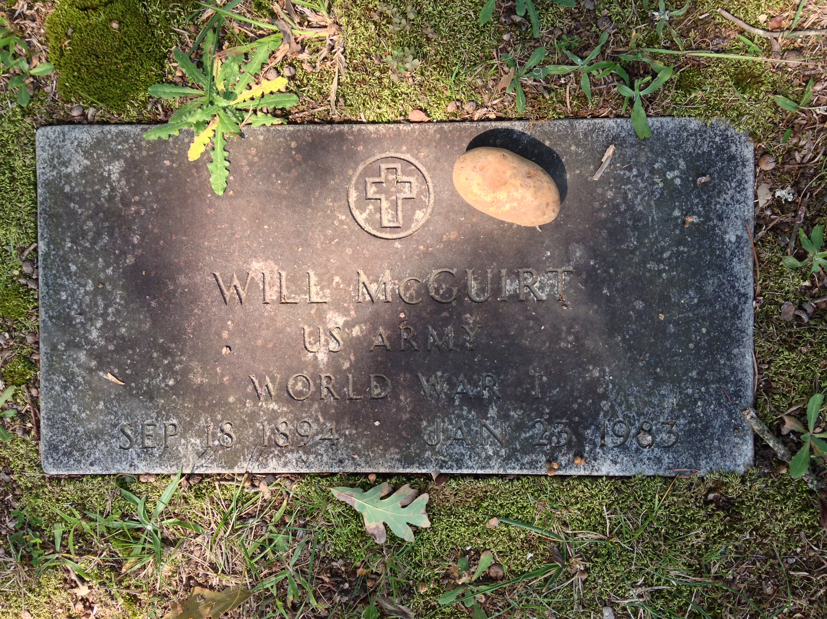
Headstone

Slide 6
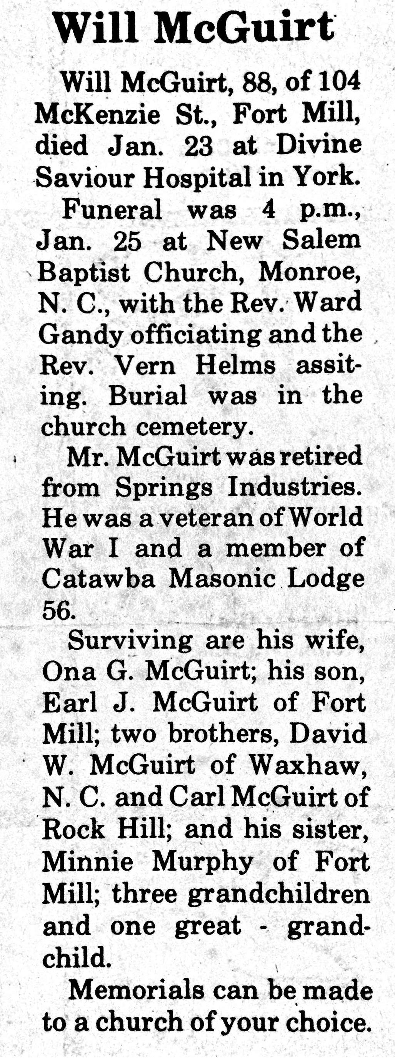
Obituary 1

Slide 7
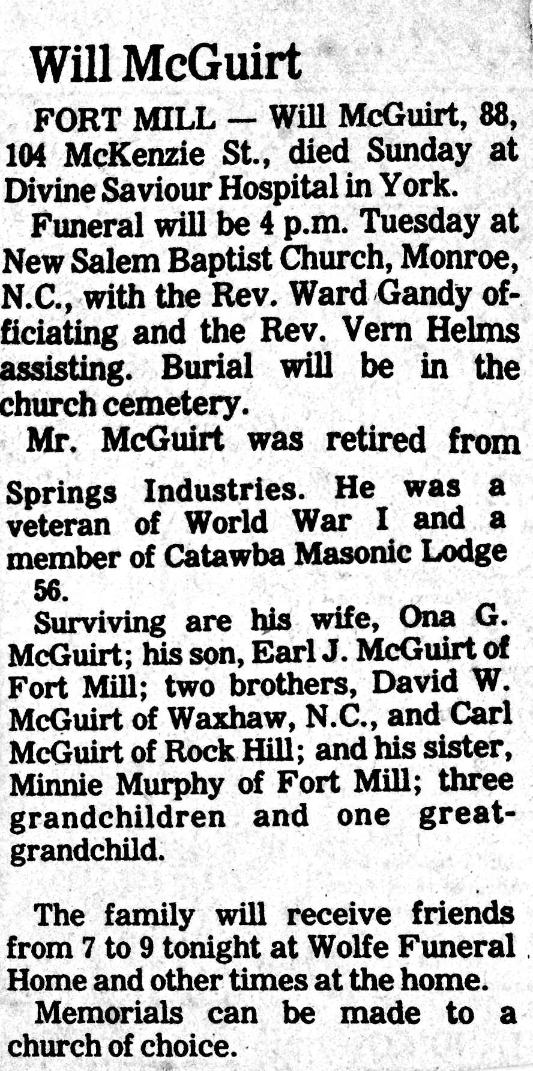
Obituary 2

