Slide 1
Field Orders Issued on November 10, 1918, the day before the armistice. (American Battle Commission 1944)
Section 5, Gallery 4

Slide 2
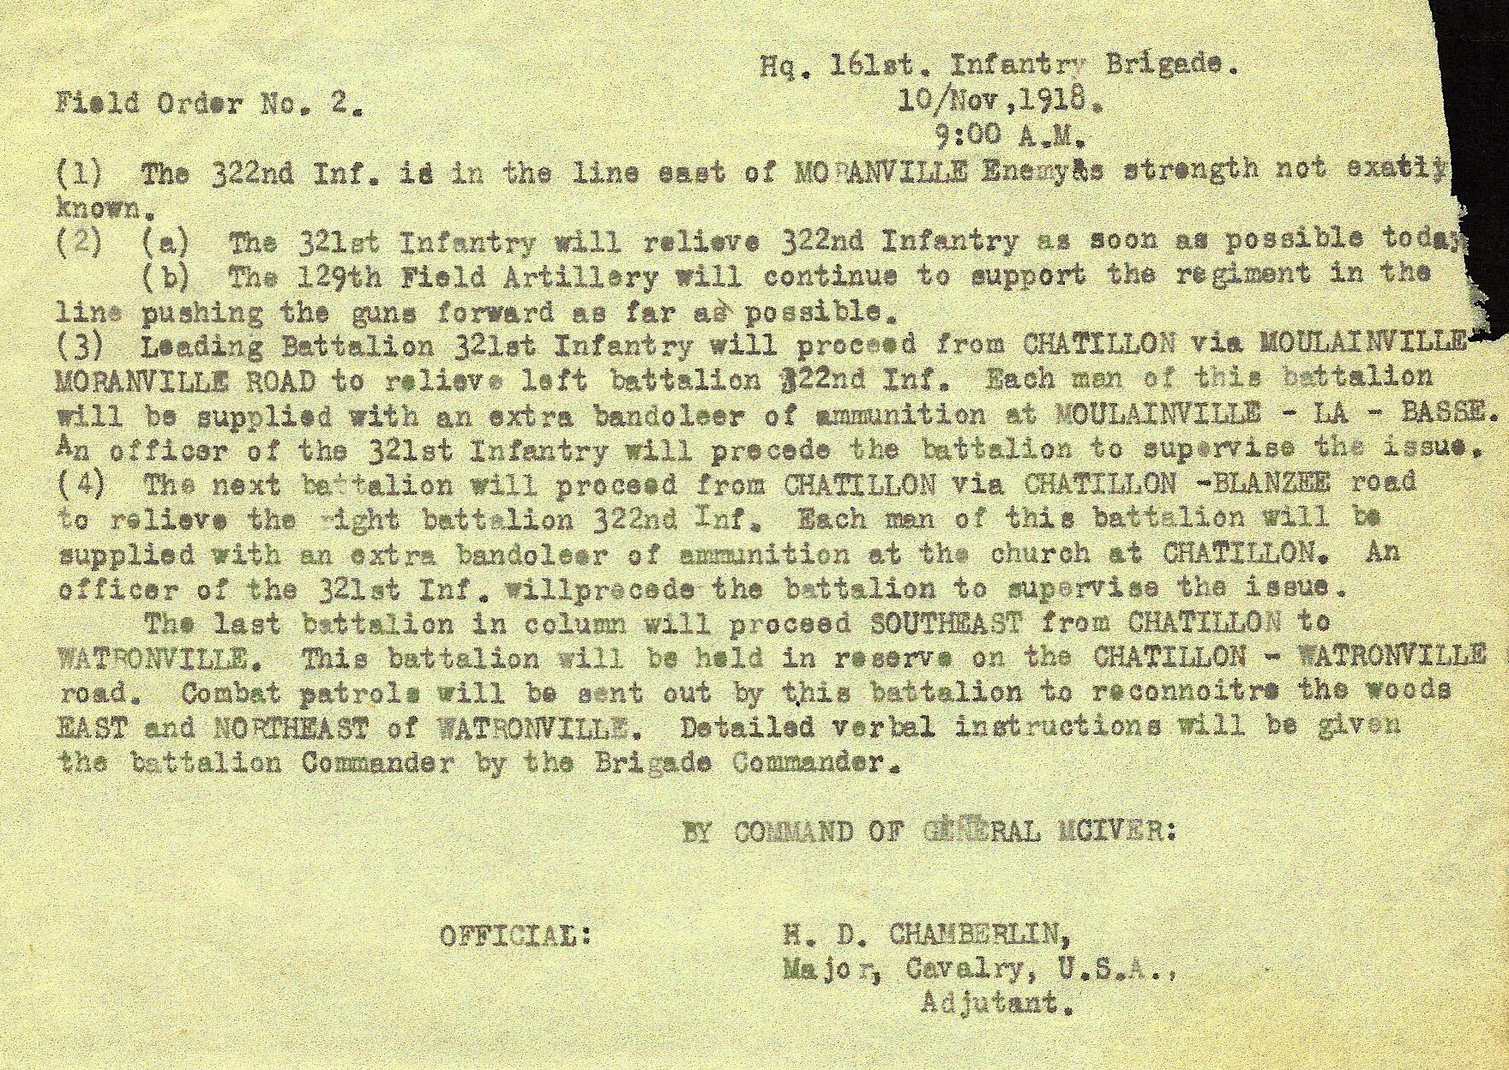

Slide 3
