Slide 1
Section 5, Gallery 8
Communication

Slide 2
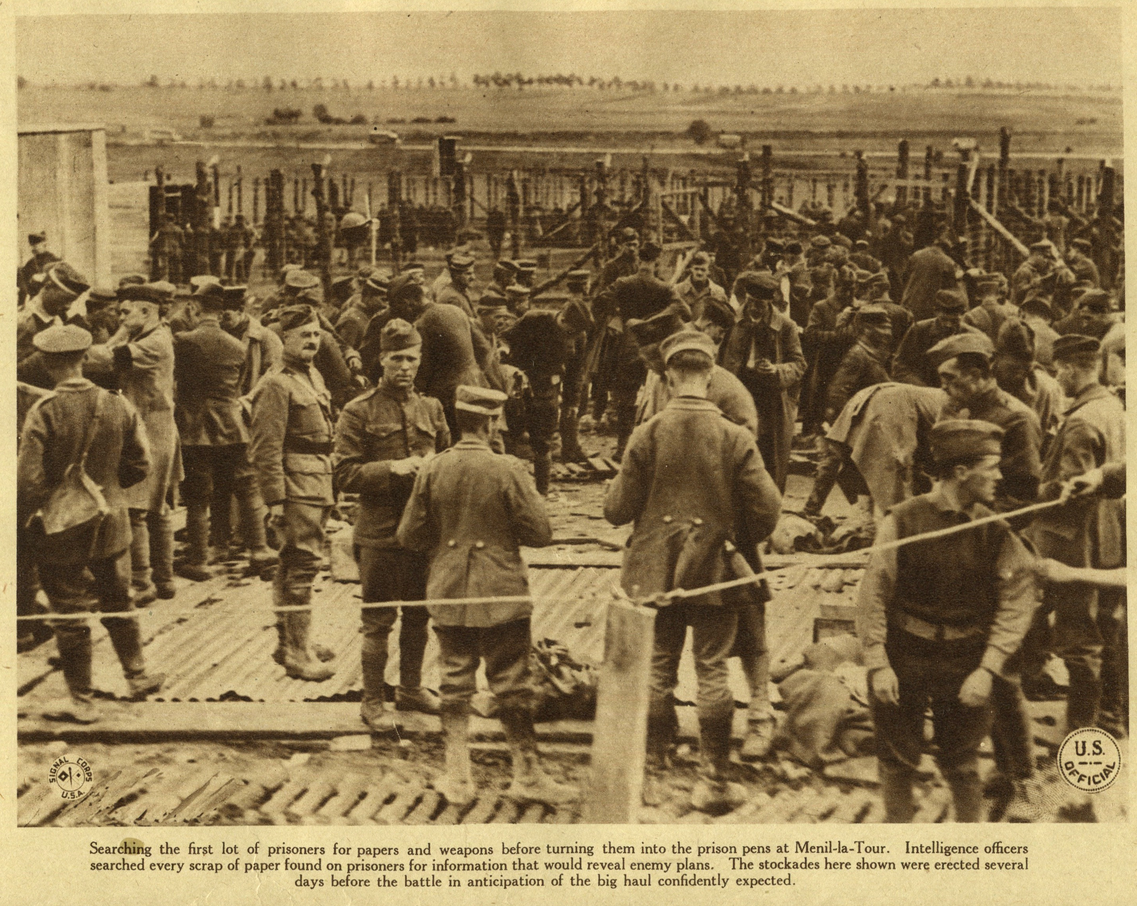
Soldiers Search for Enemy Plans

Slide 3
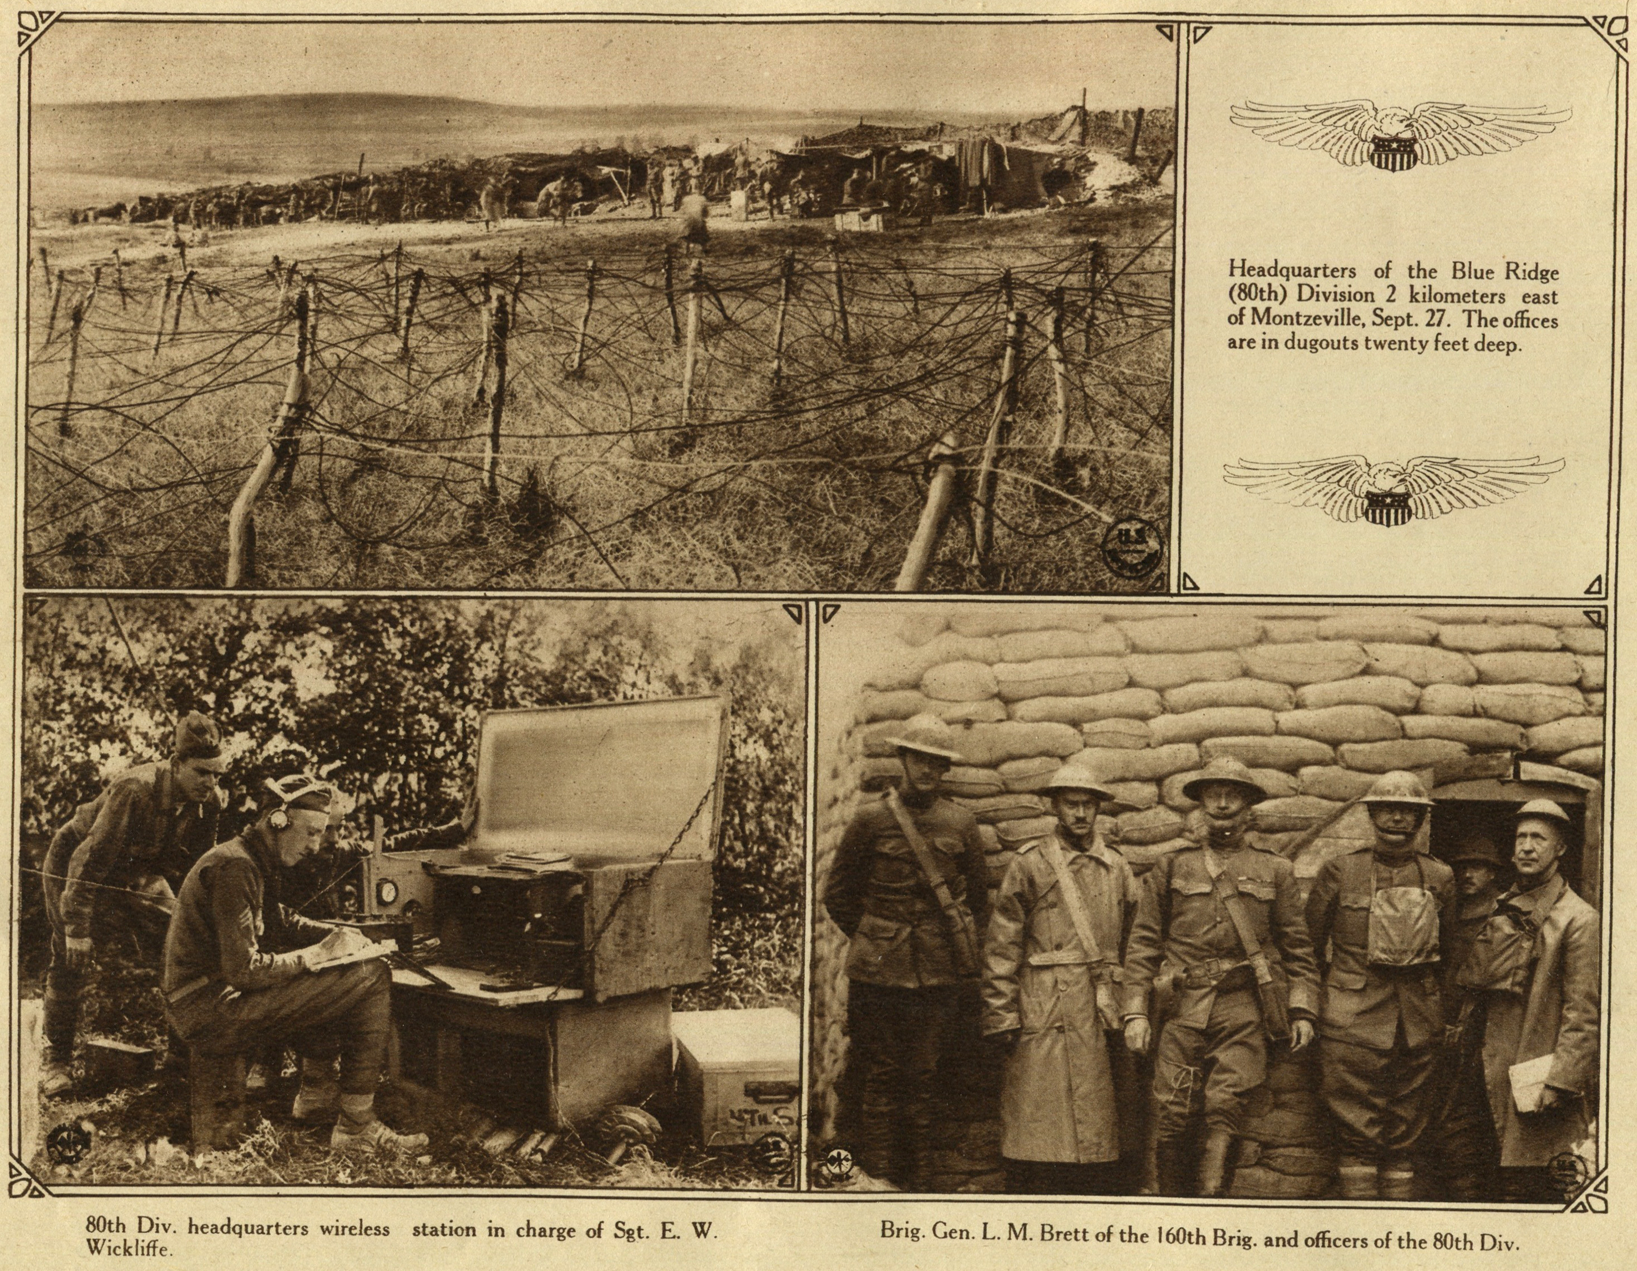
Radio

Slide 4
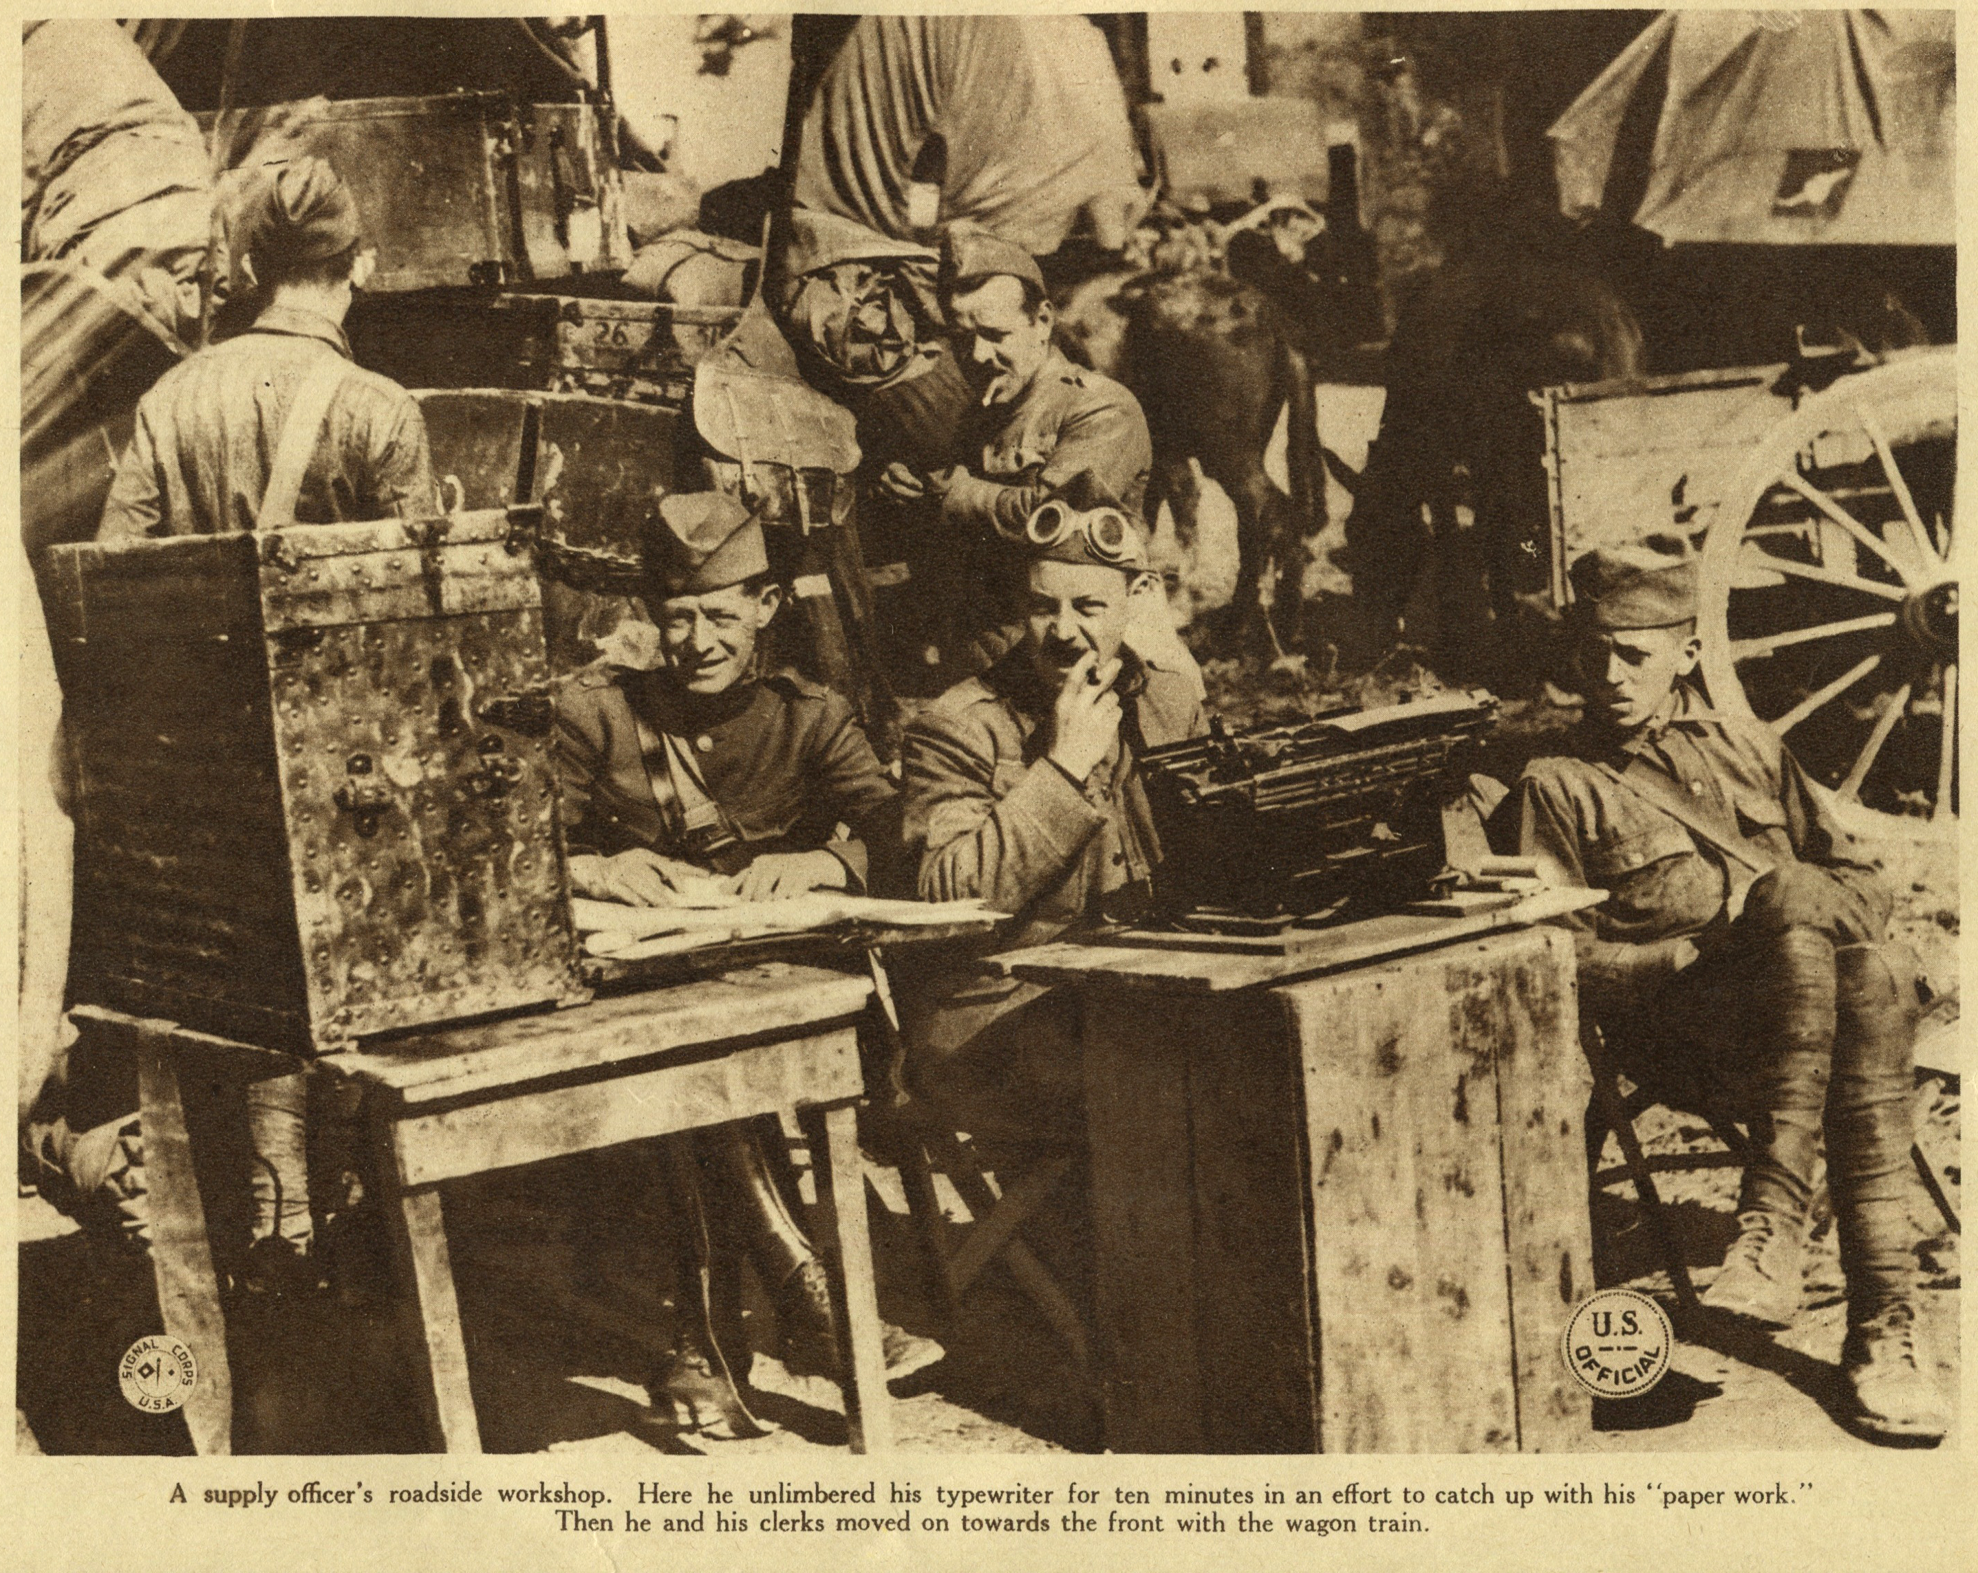
Typewriter

Slide 5
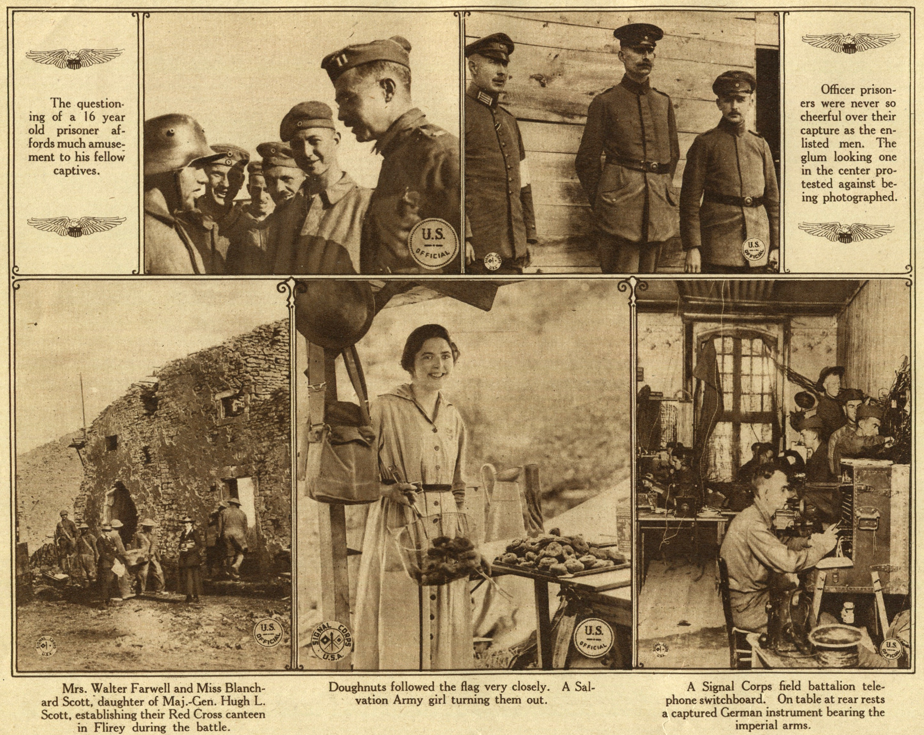
Switchboard

Slide 6
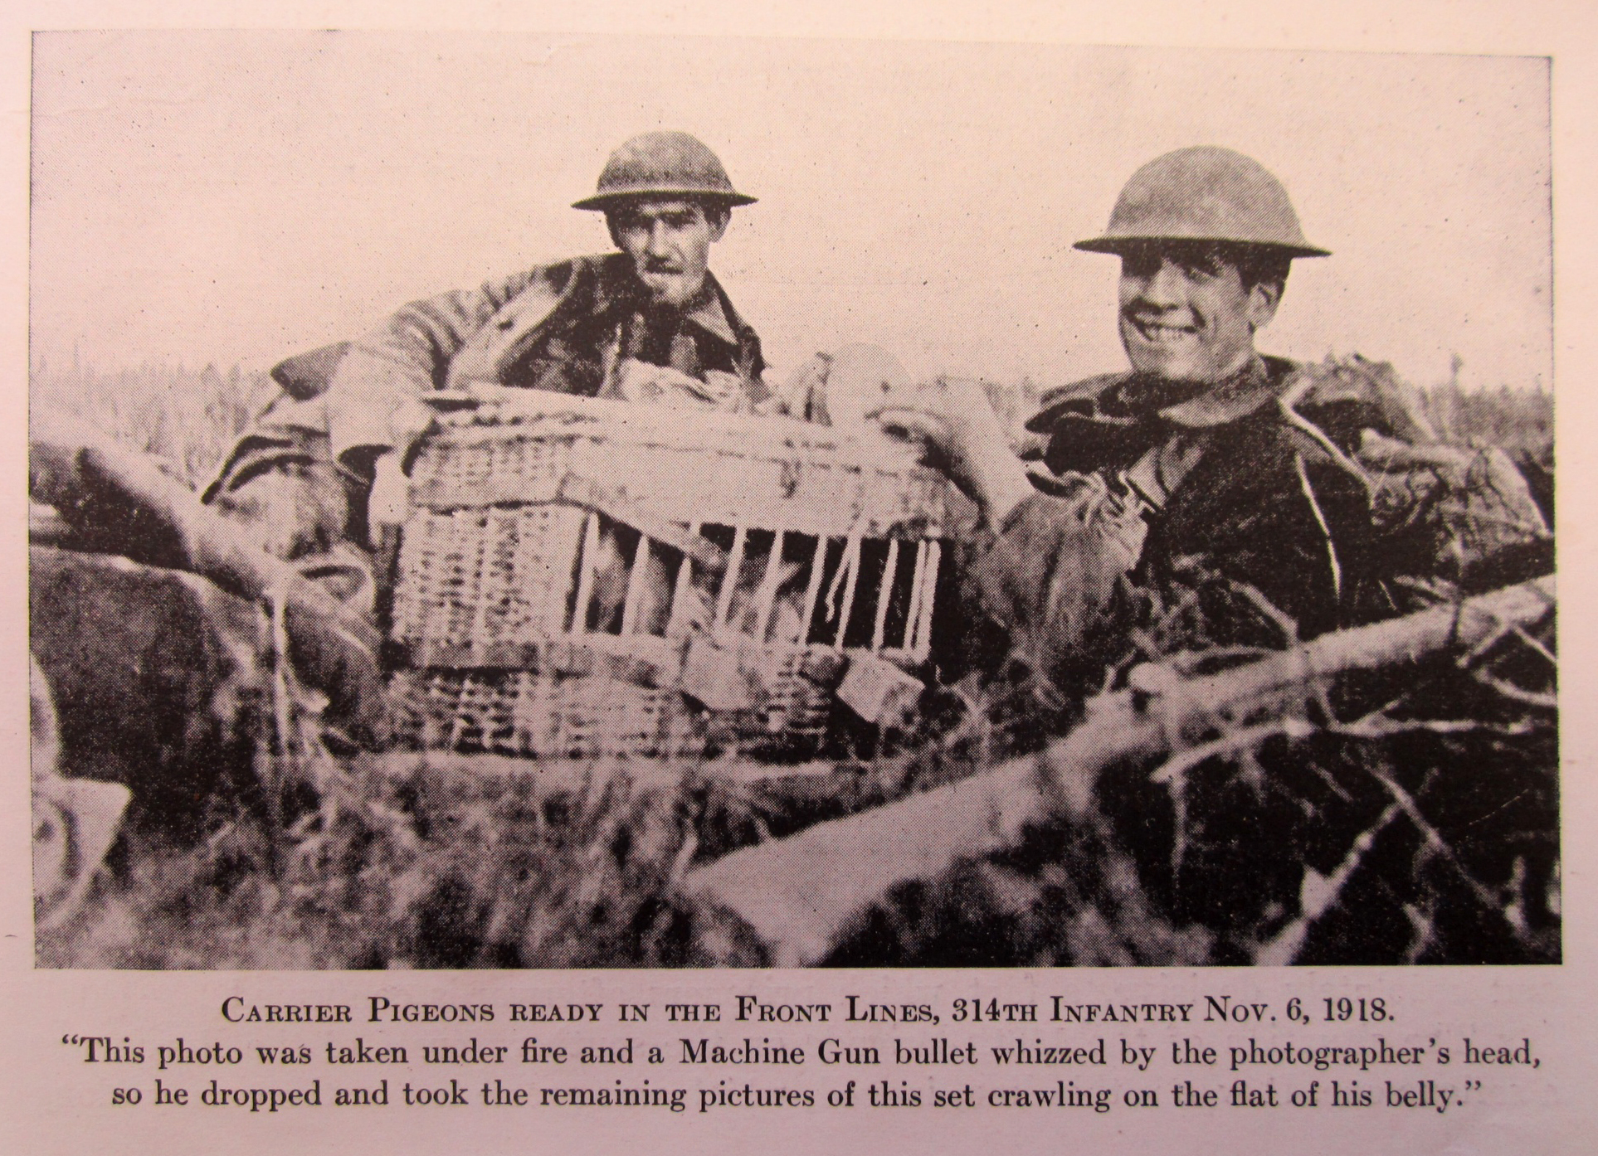
Pigeon

