Slide 1
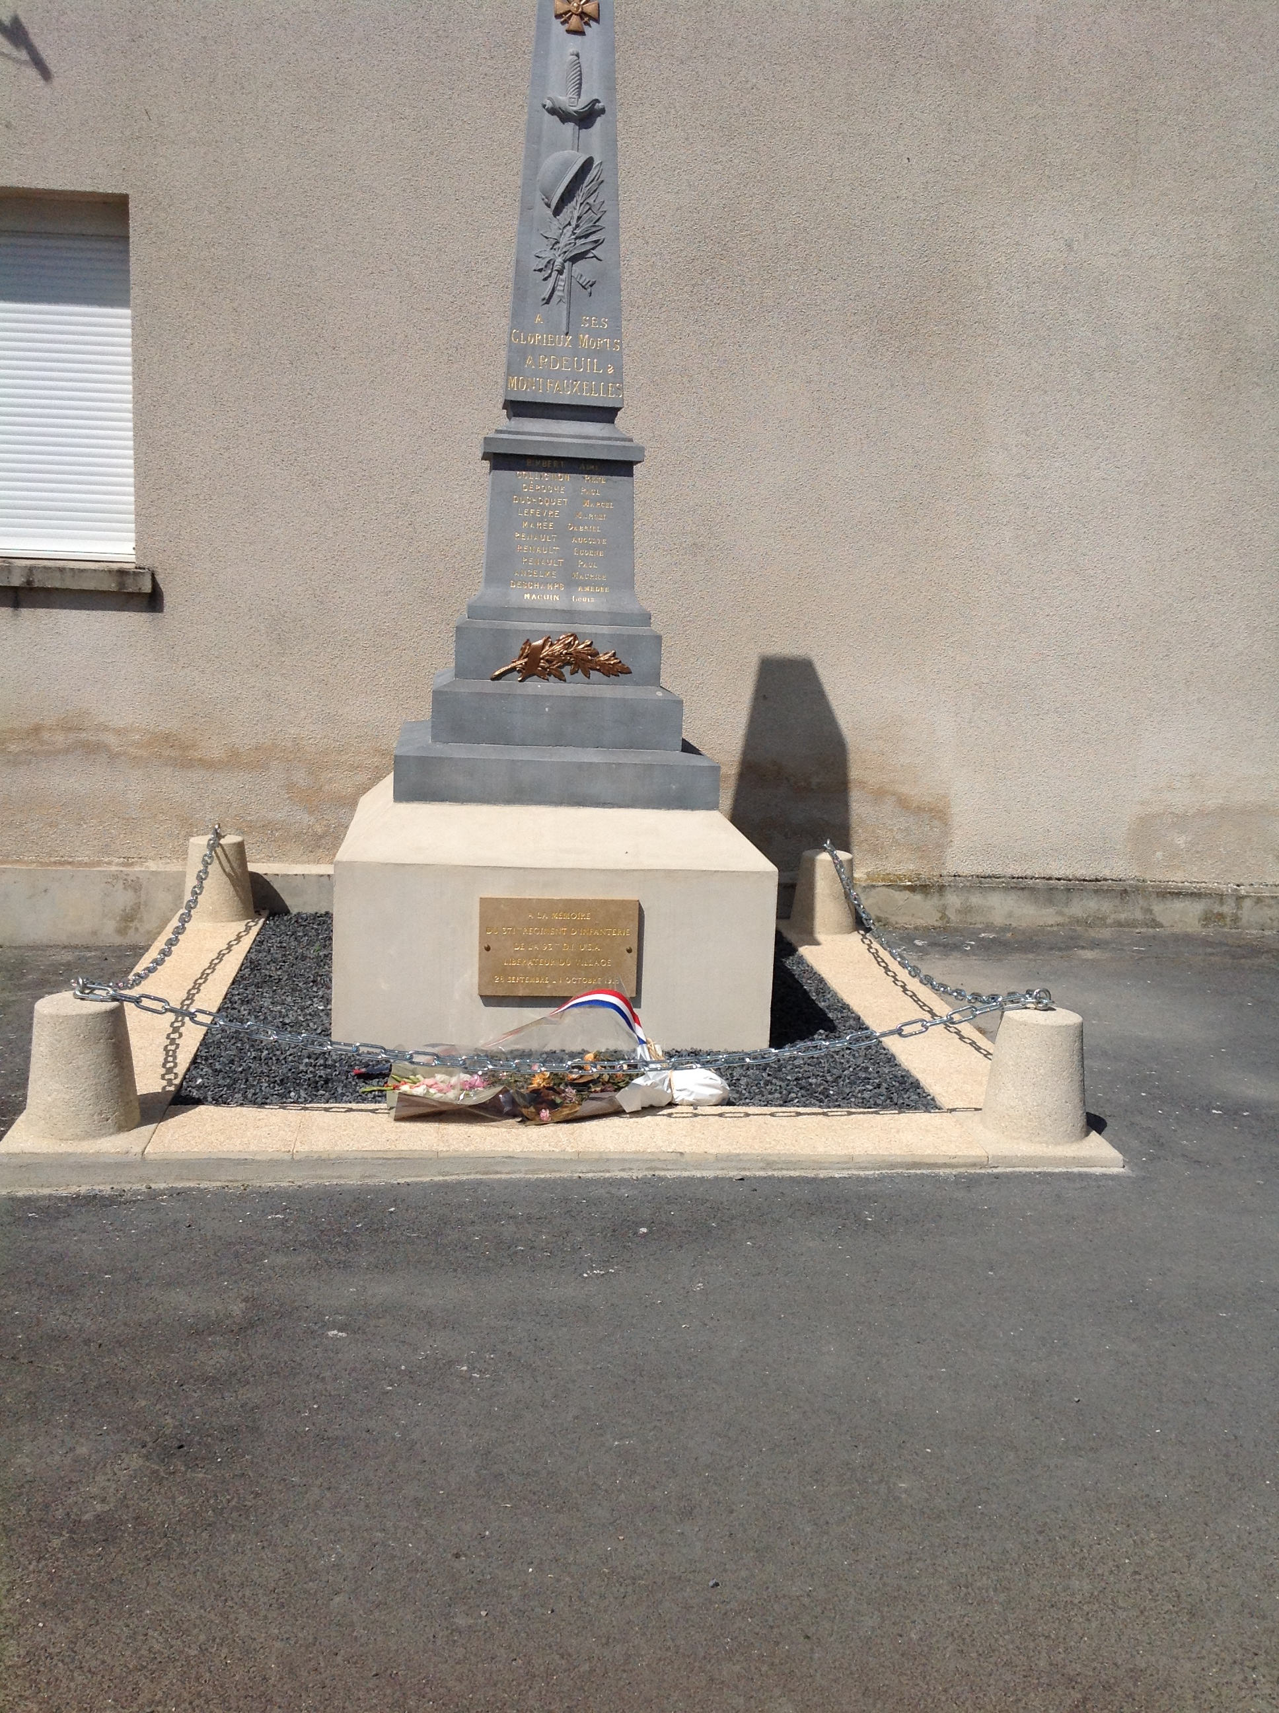
Notes:
Monument to 371st Infantry at Ardeuil-Montfauxelles

Slide 2
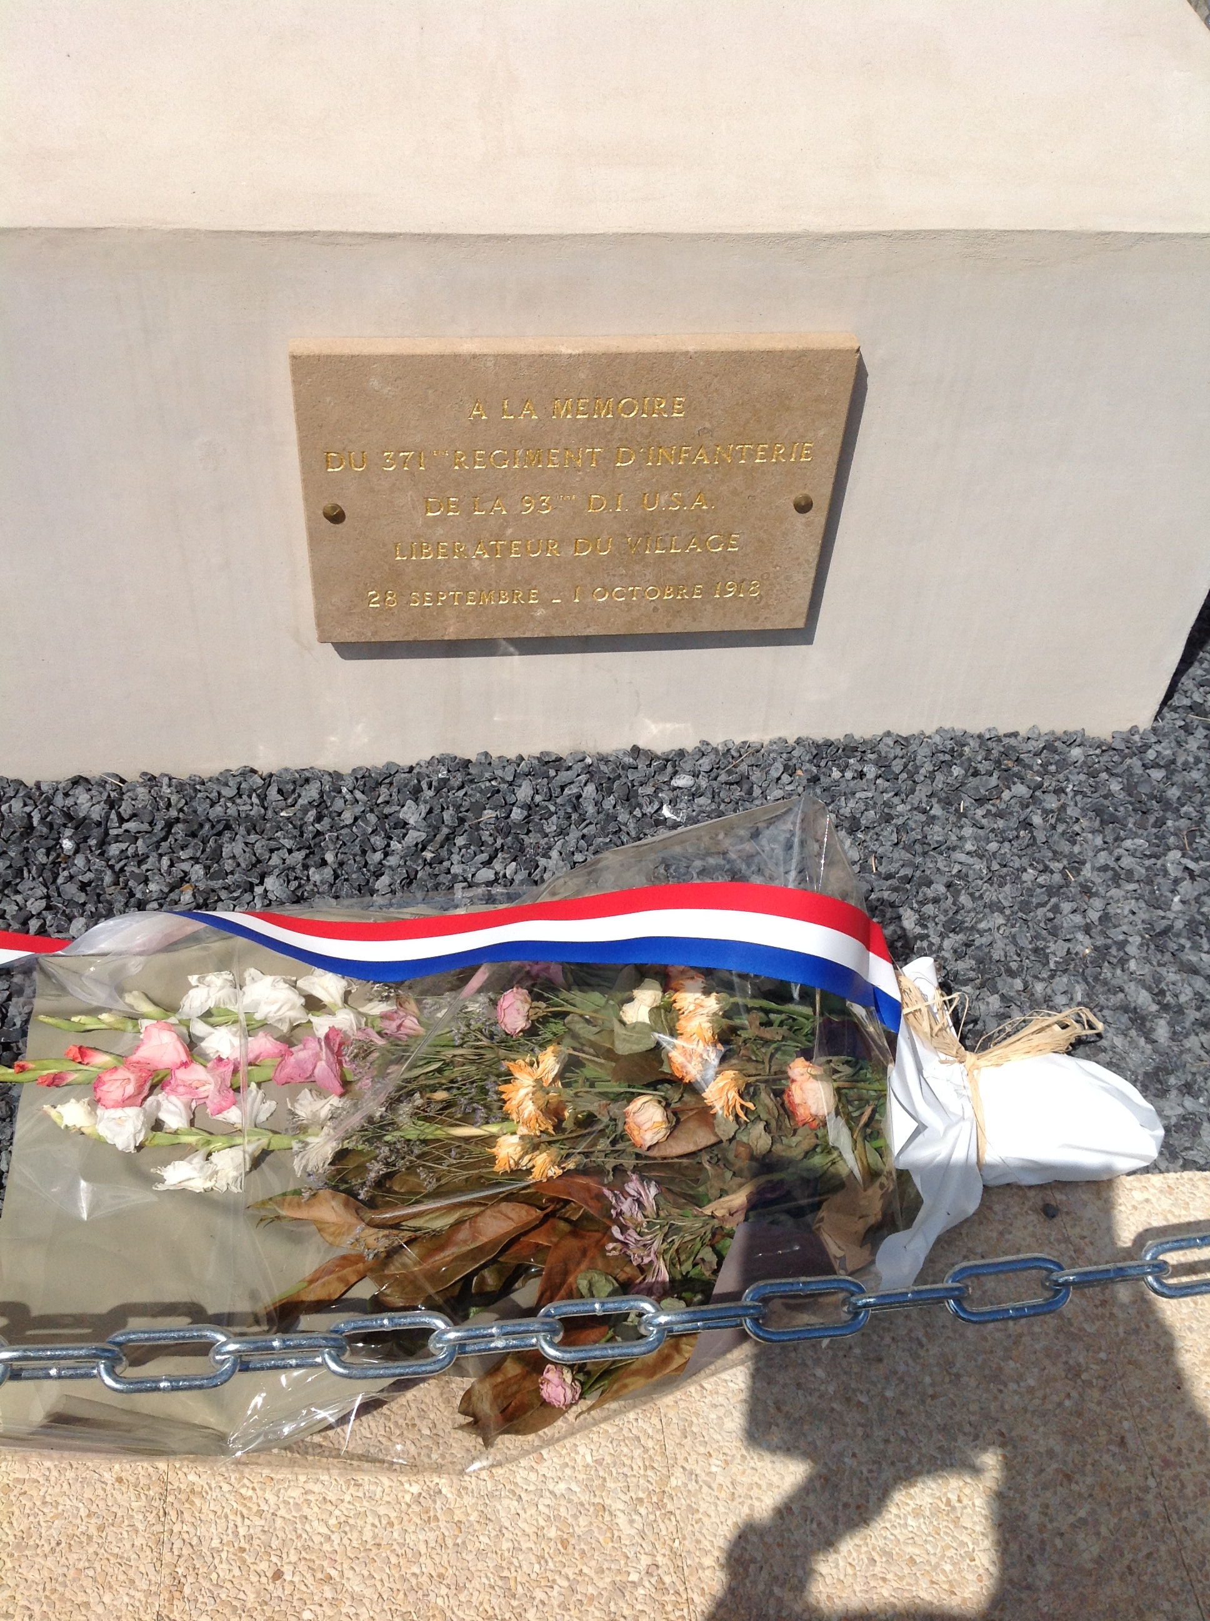
Notes:
Monument to 371st Infantry at Ardeuil-Montfauxelles

Slide 3
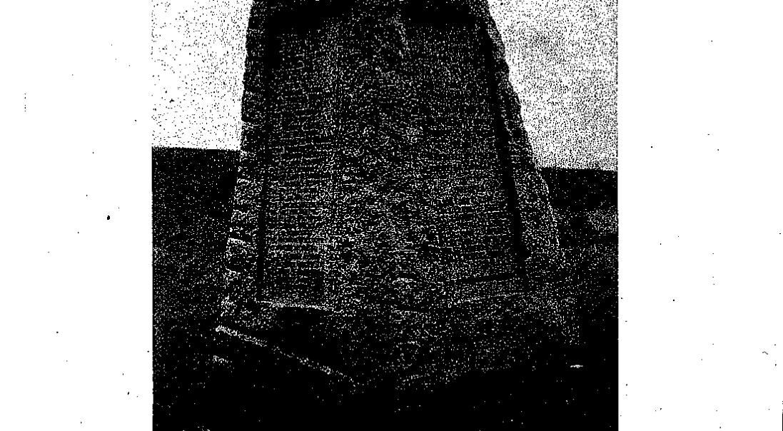
Notes:
Monument to 371st Infantry at Bussy Farm

Slide 4
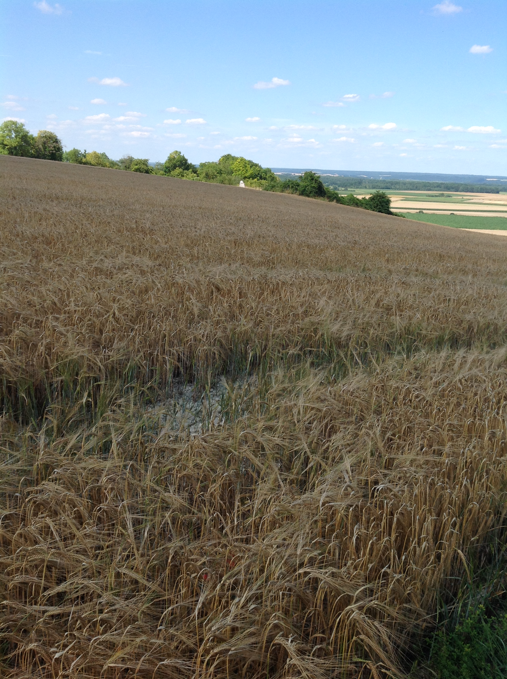
Notes:
Monument to 371st Infantry at Bussy Farm

Slide 5
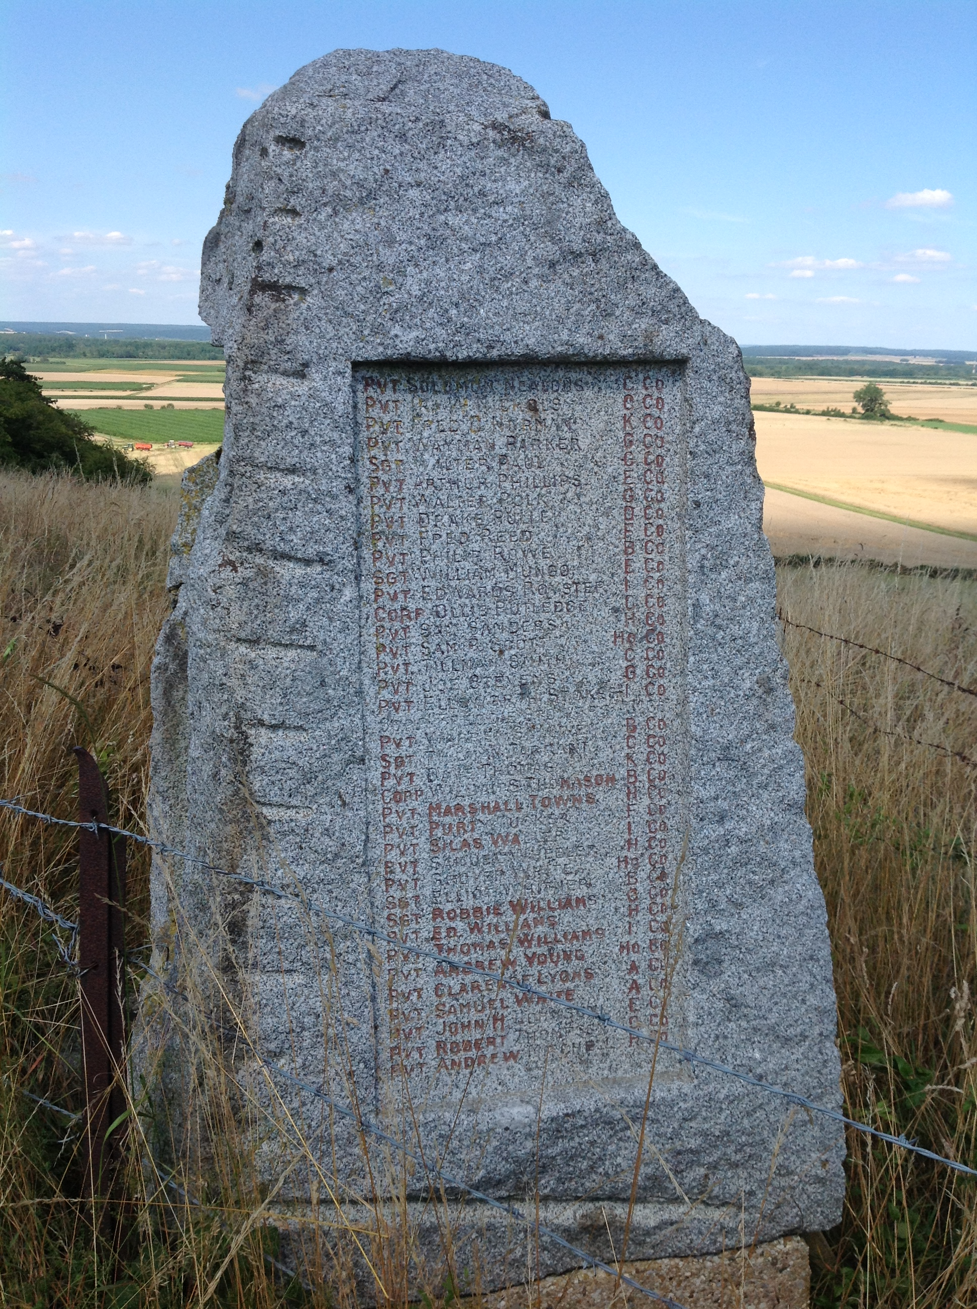
Notes:
Monument to 371st Infantry at Bussy Farm

Slide 6
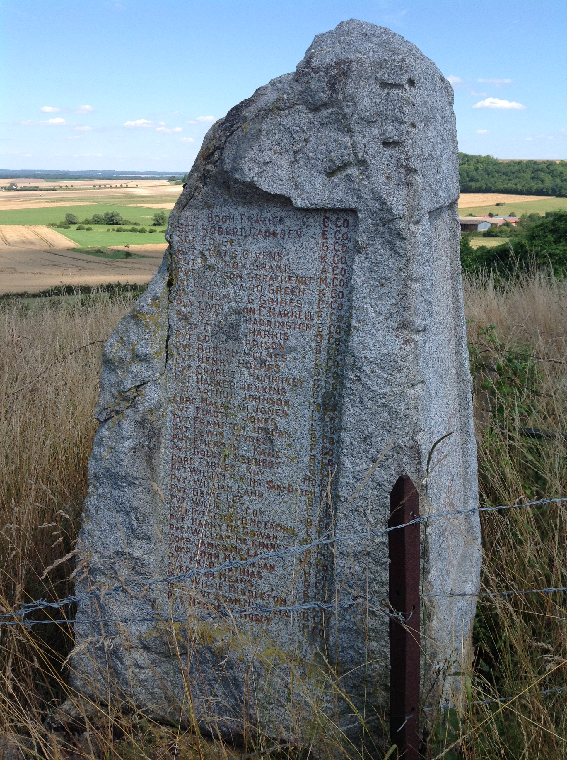
Notes:
Monument to 371st Infantry at Bussy Farm

Slide 7
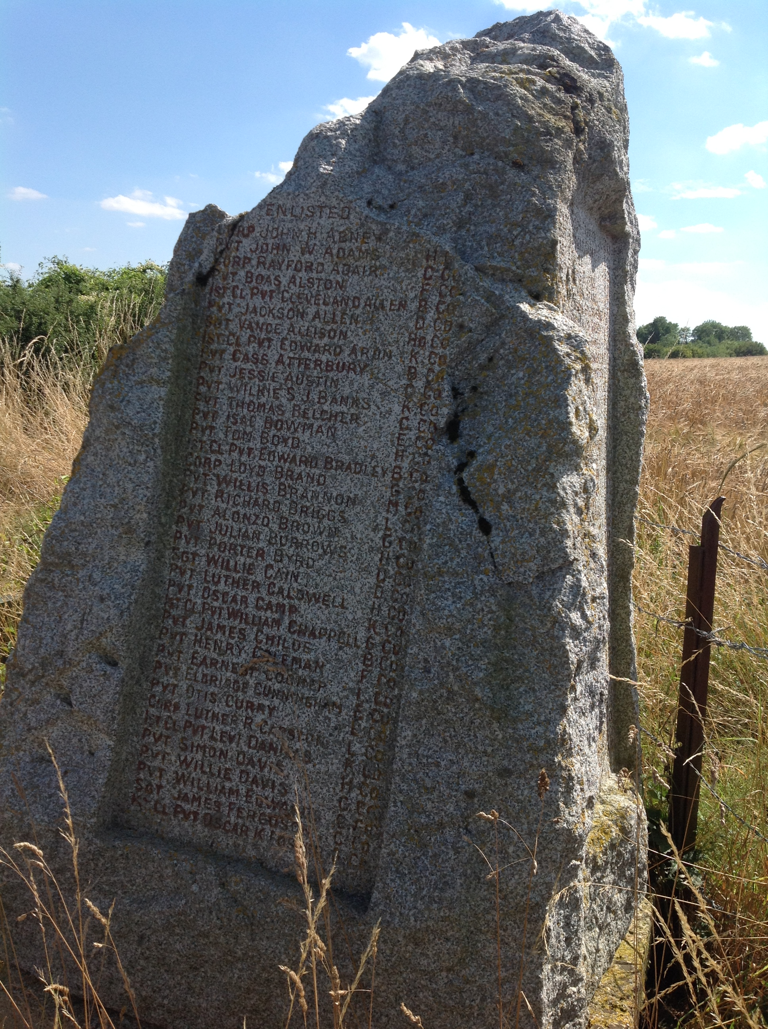
Notes:
Monument to 371st Infantry at Bussy Farm

Slide 8
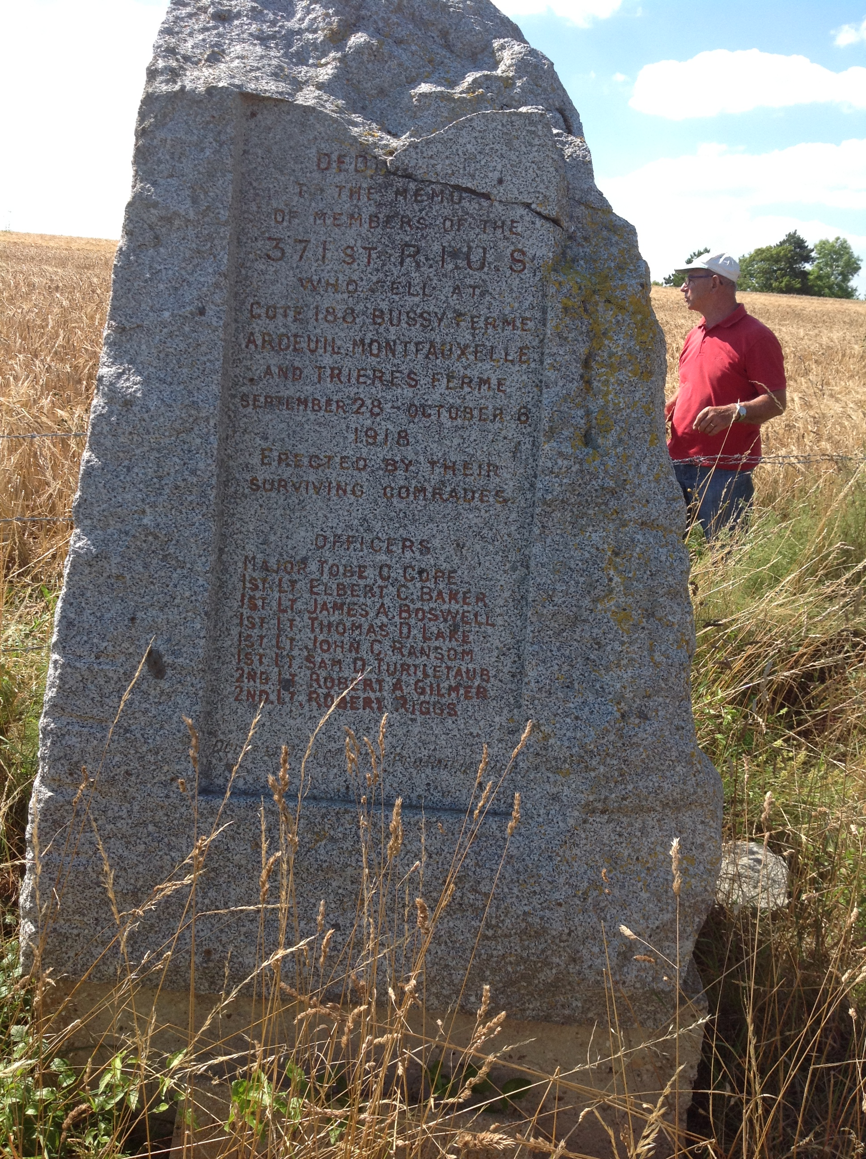
Notes:
Monument to 371st Infantry at Bussy Farm

Slide 9
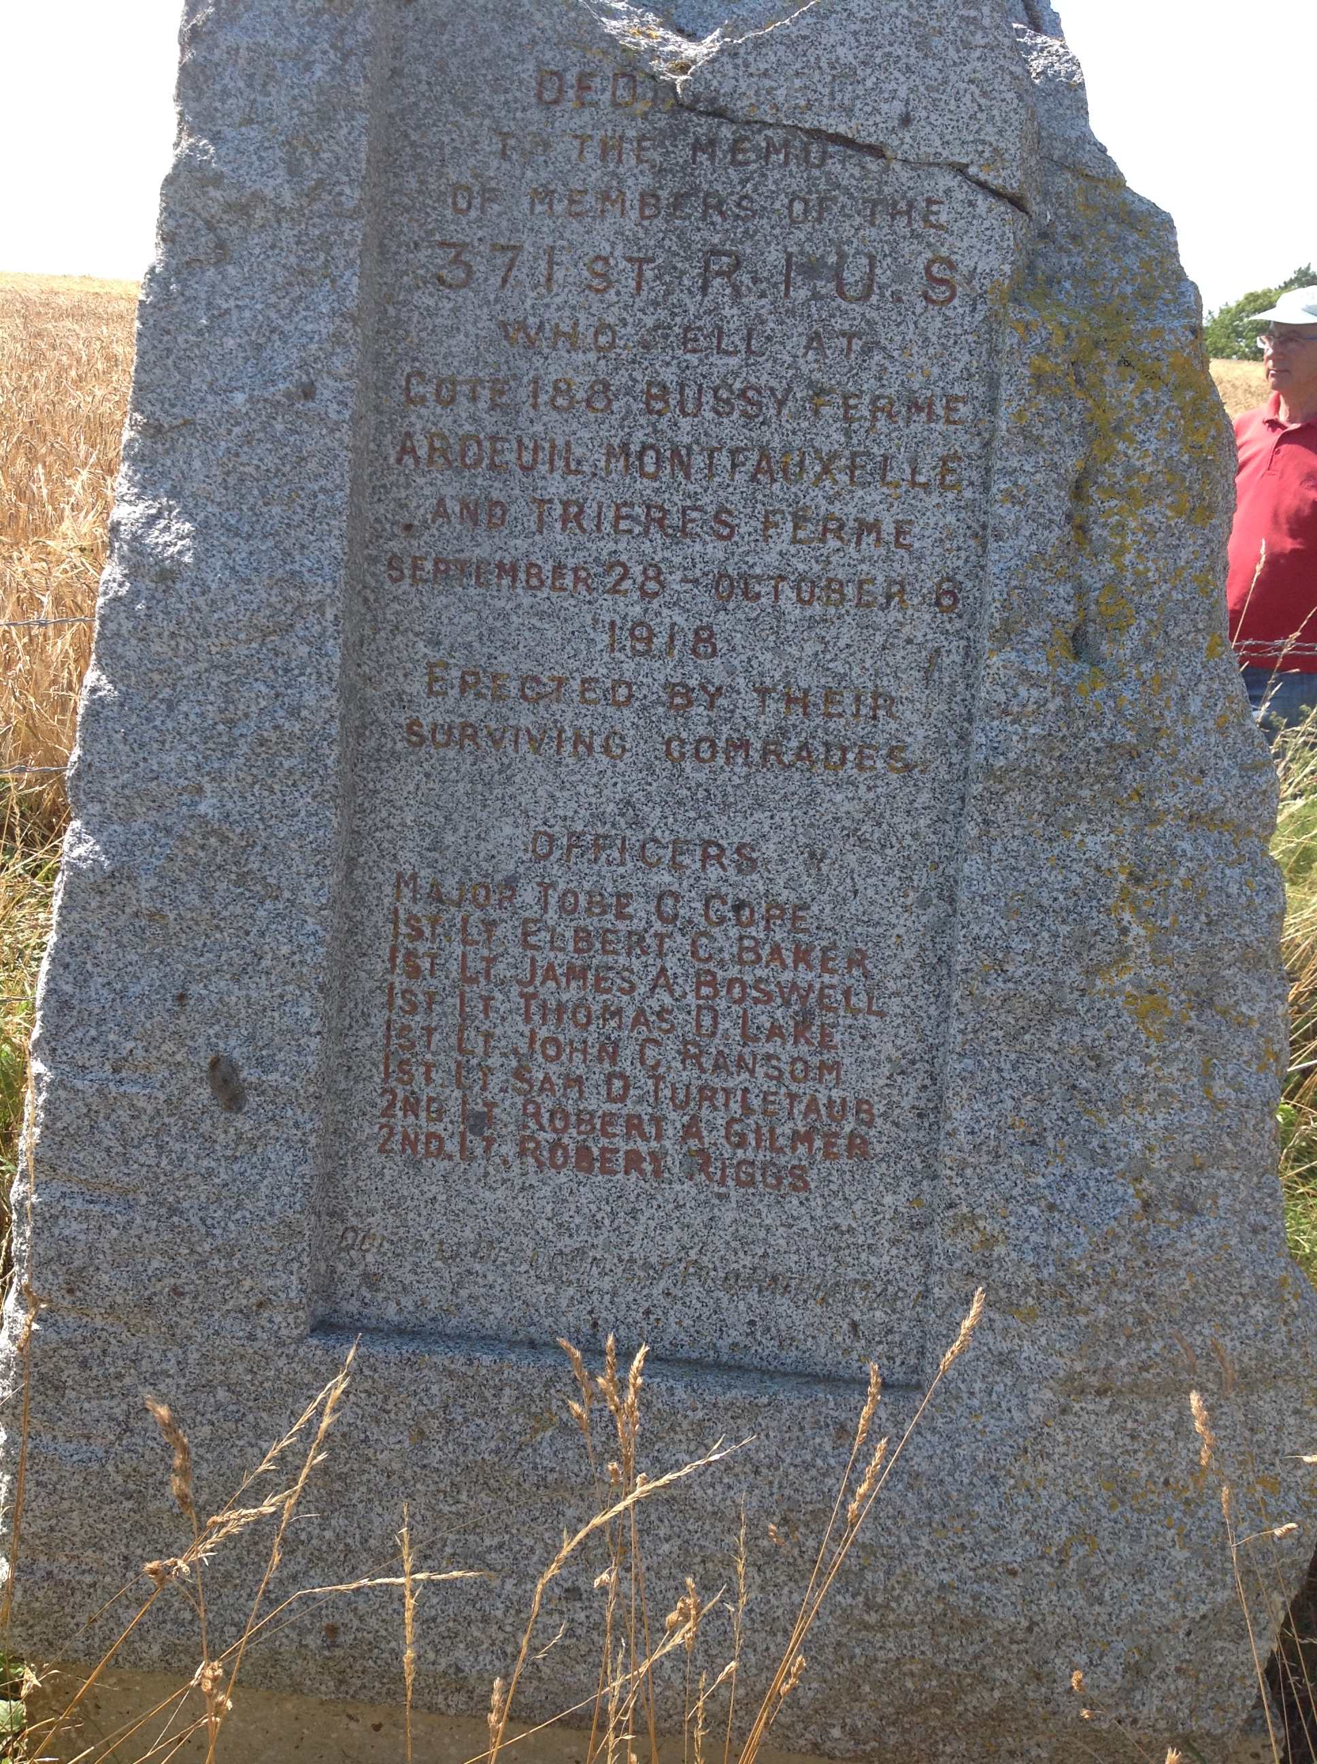
Notes:
Monument to 371st Infantry at Bussy Farm

Slide 10
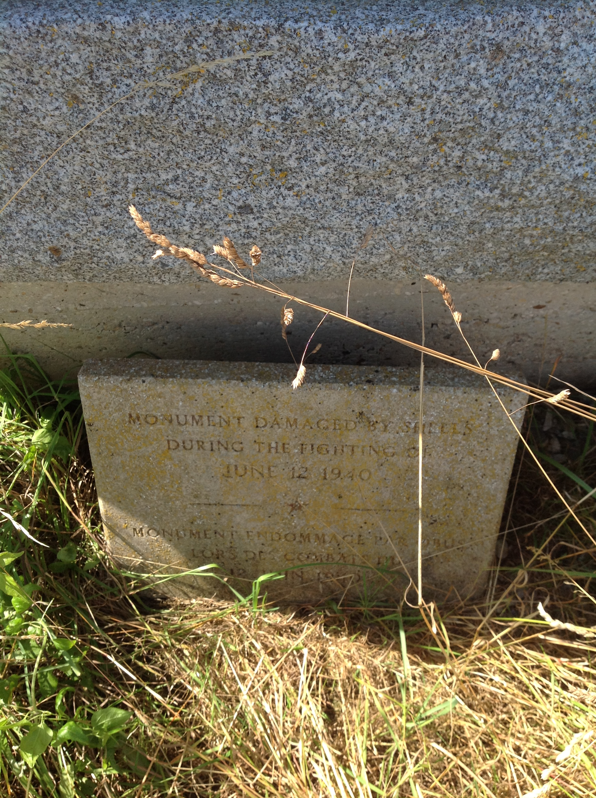
Notes:
Monument to 371st Infantry at Bussy Farm

Slide 11
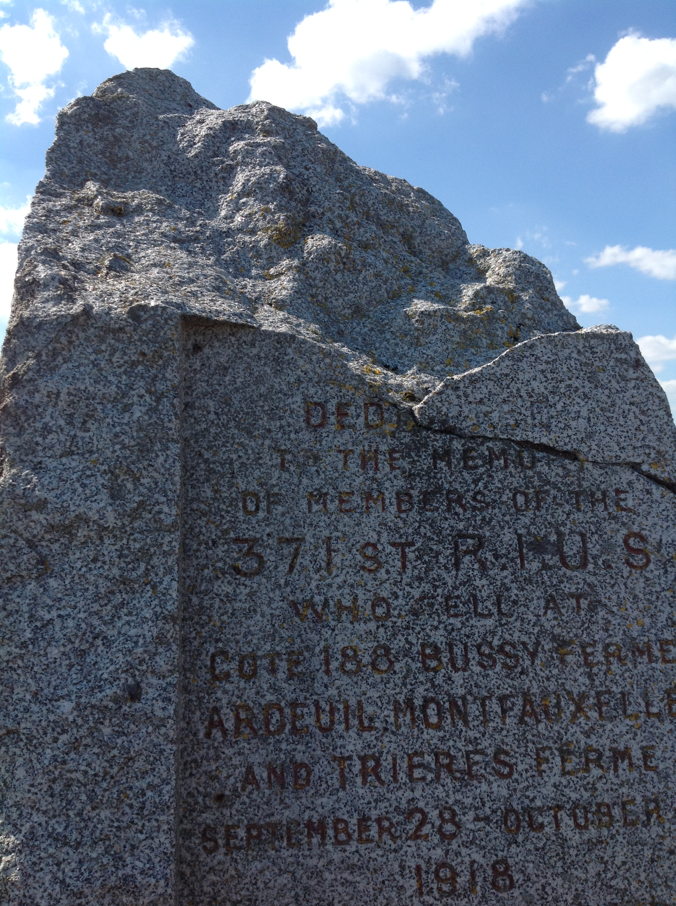
Notes:
Monument to 371st Infantry at Bussy Farm

Slide 12
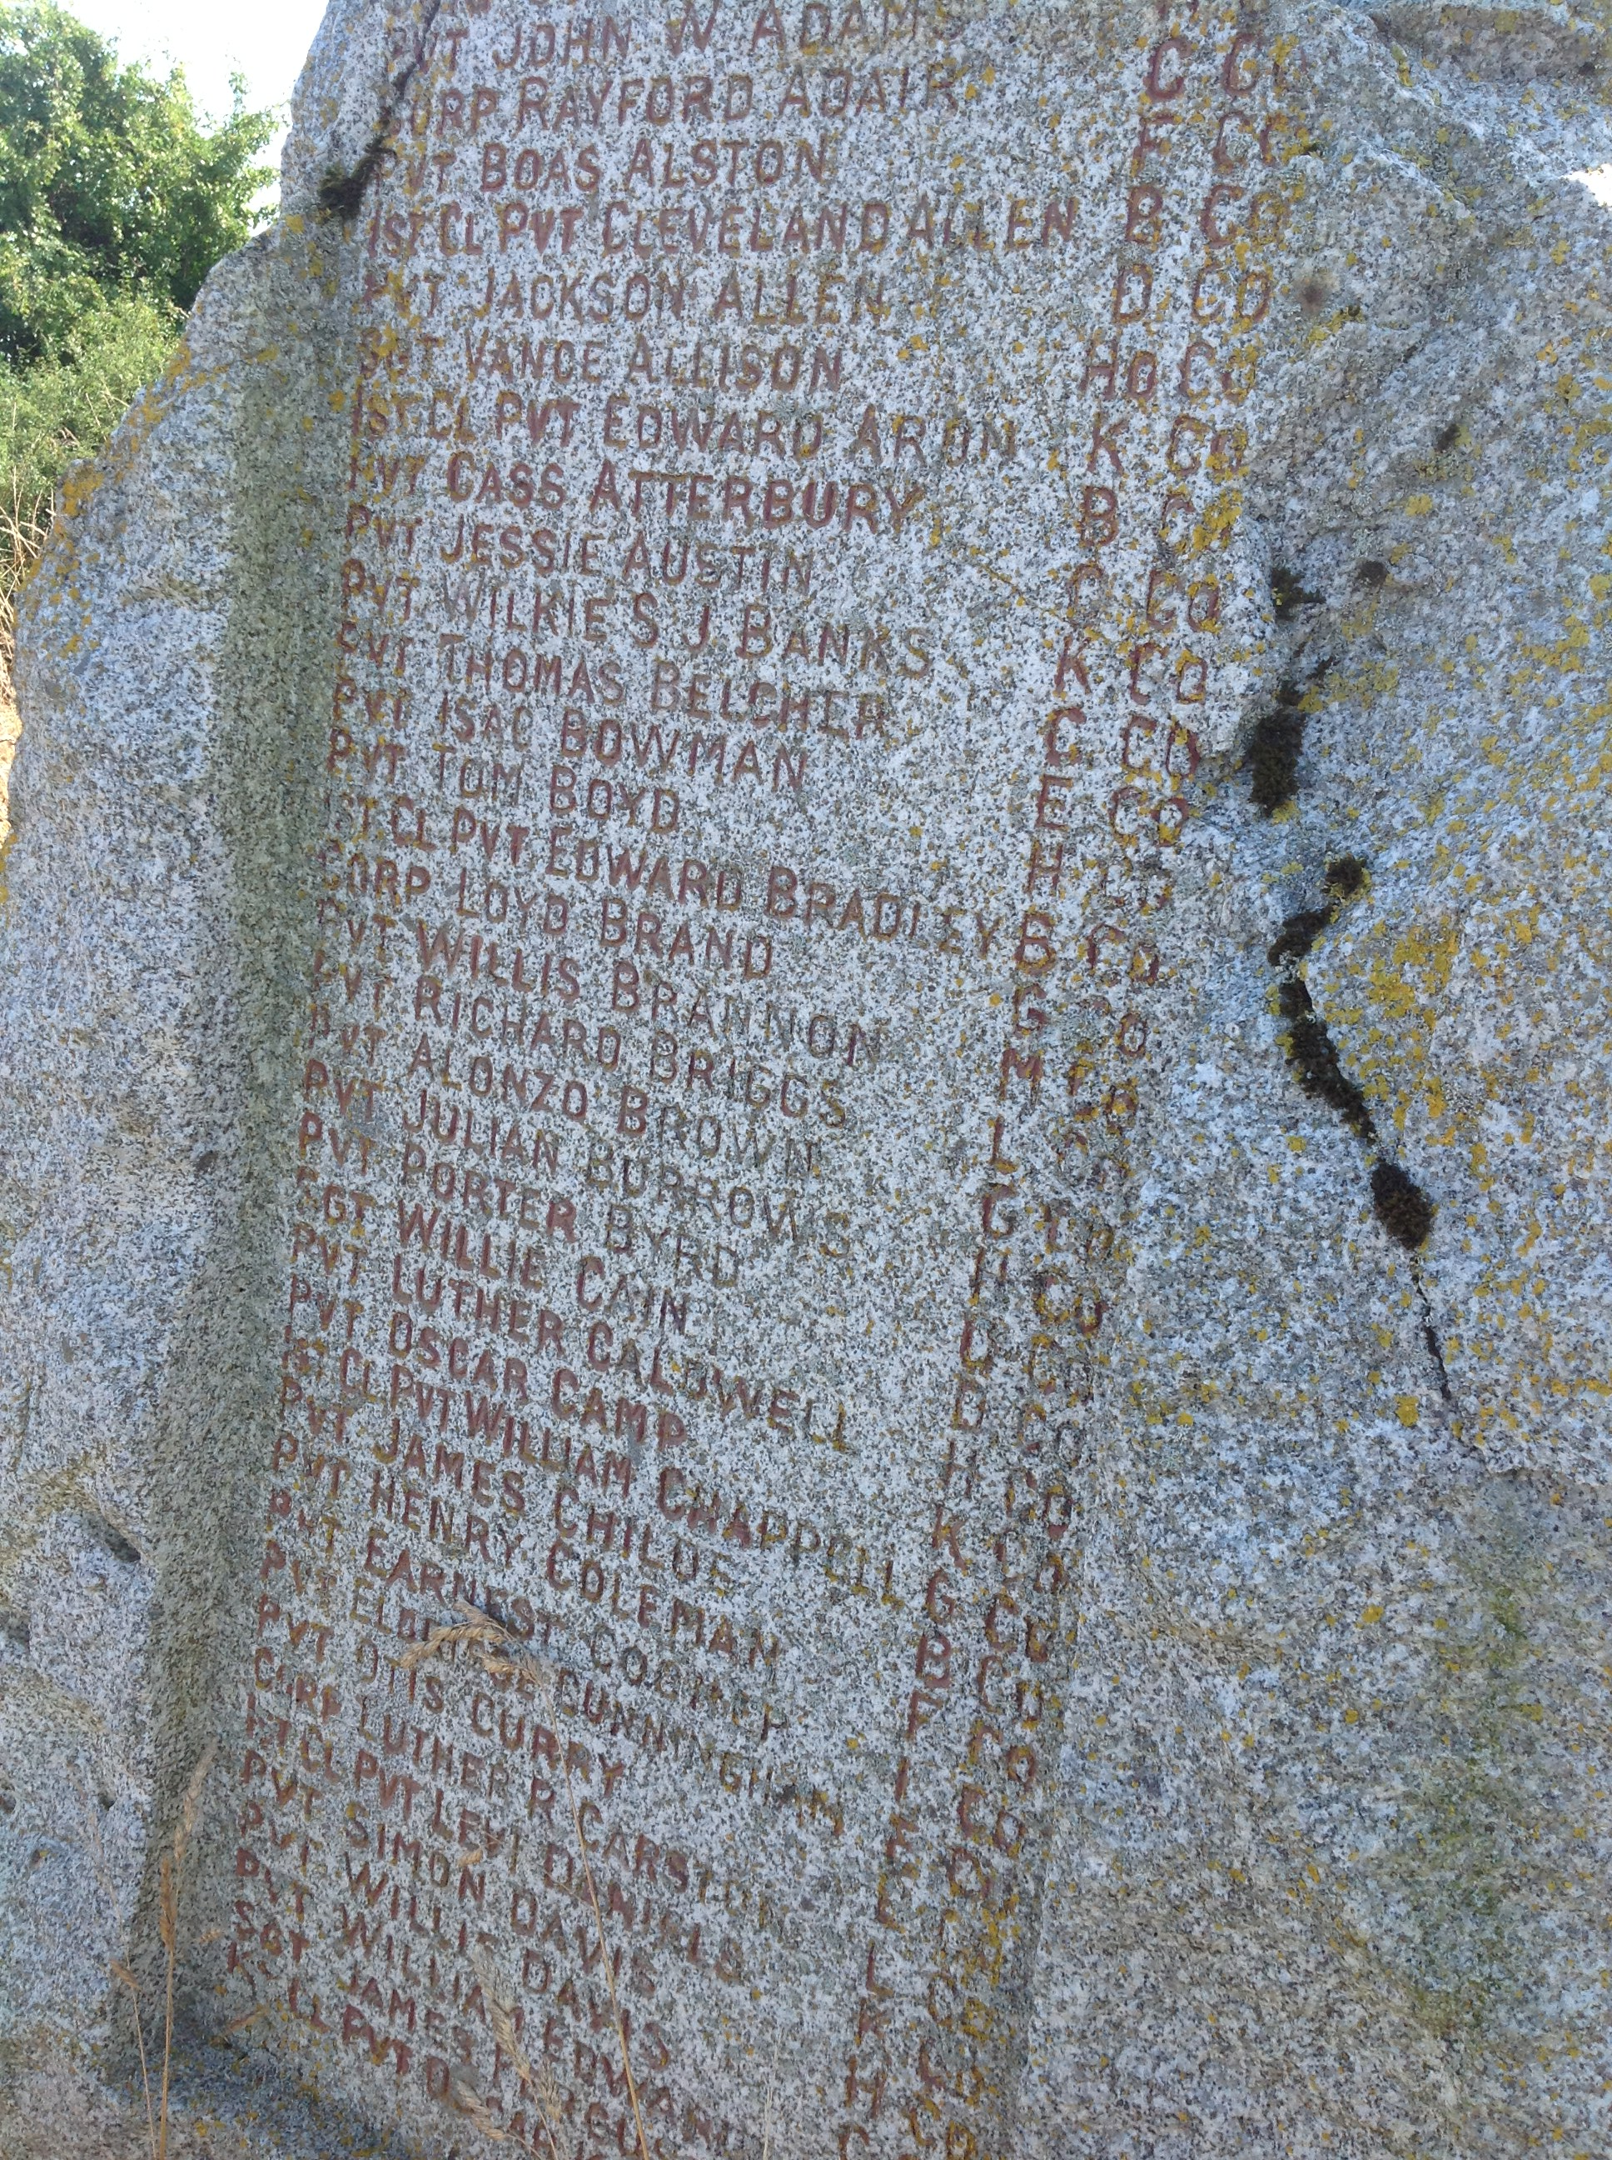
Notes:
Monument to 371st Infantry at Bussy Farm

Slide 13
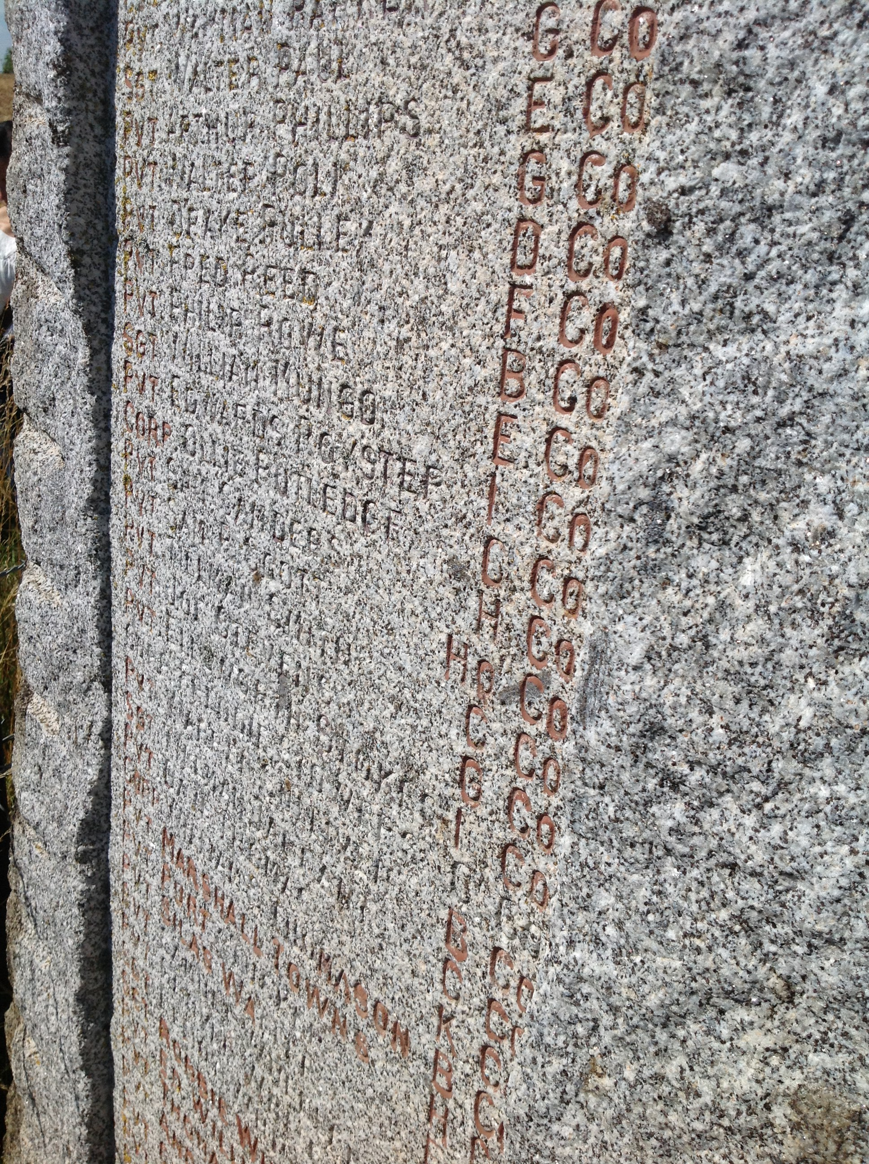
Notes:
Monument to 371st Infantry at Bussy Farm

Slide 14
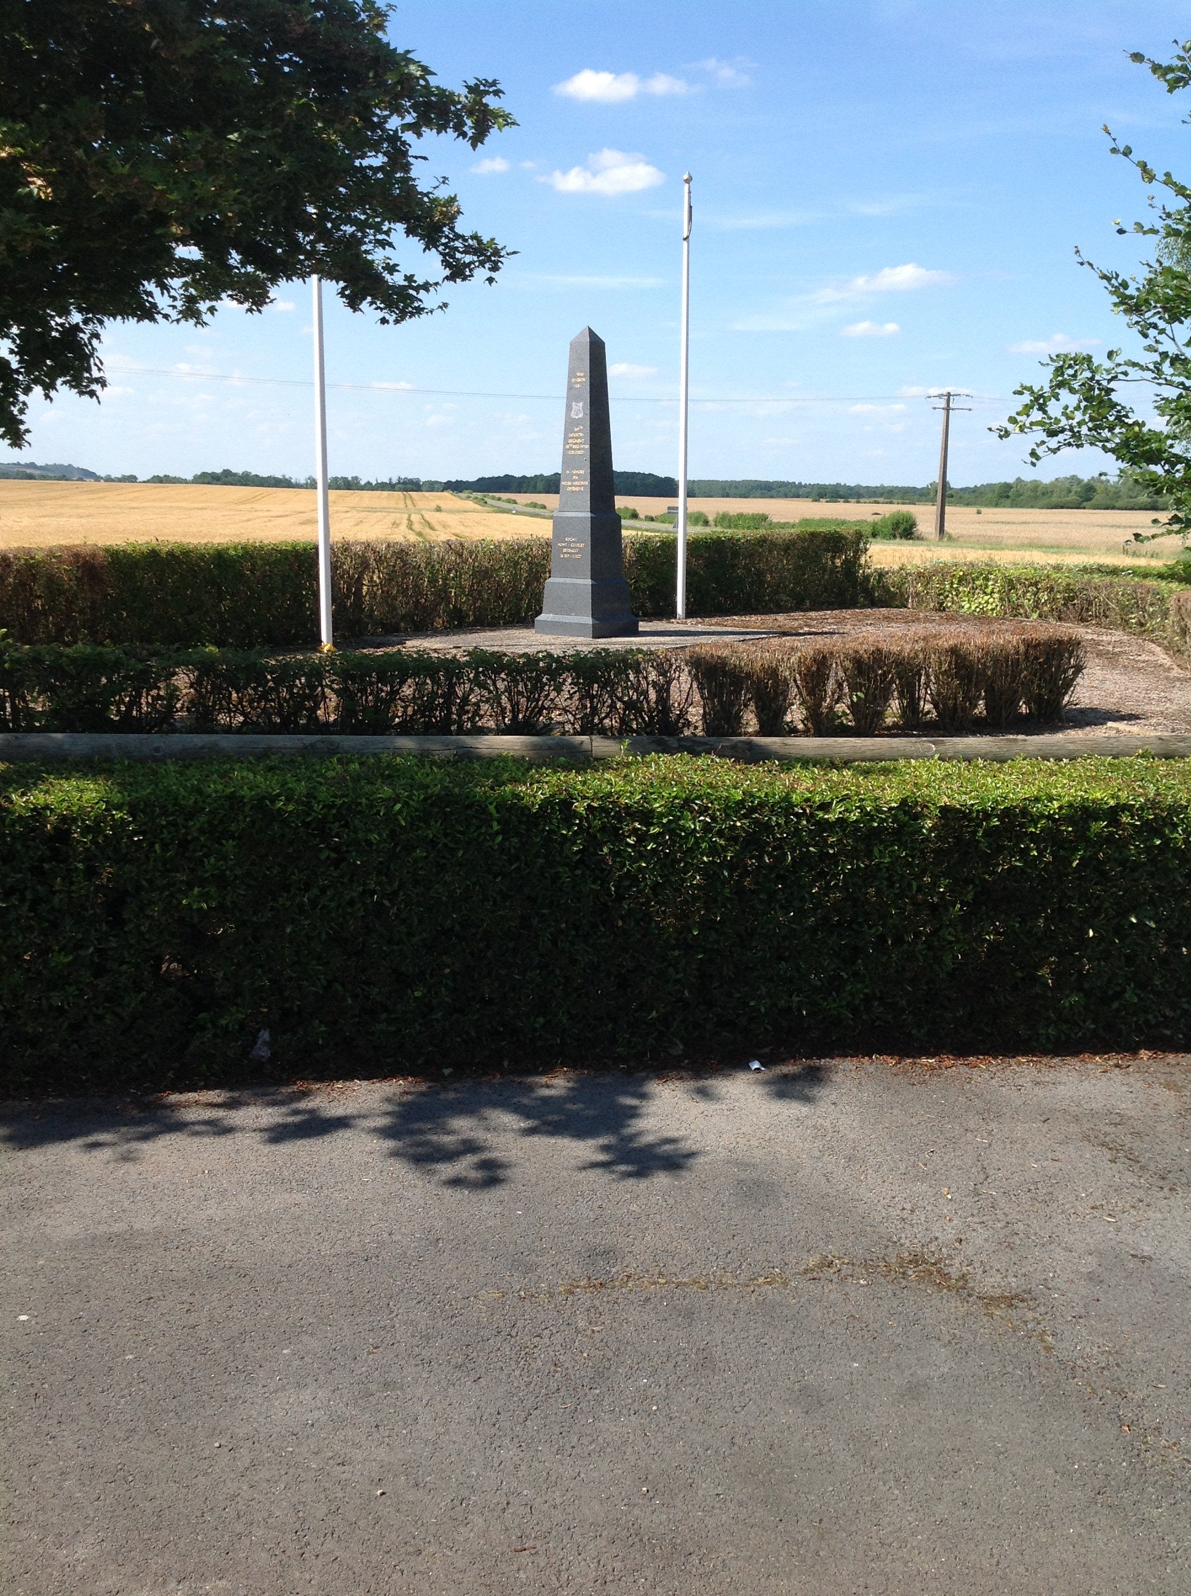
Notes:
Monument to 369th Infantry at Sechault

Slide 15
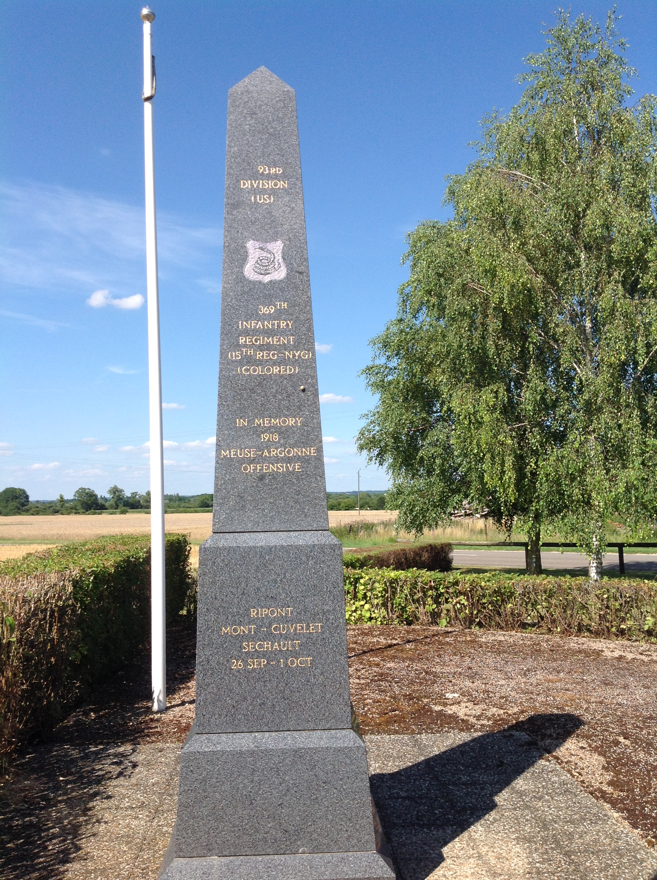
Notes:
Monument to 369th Infantry at Sechault

Slide 16
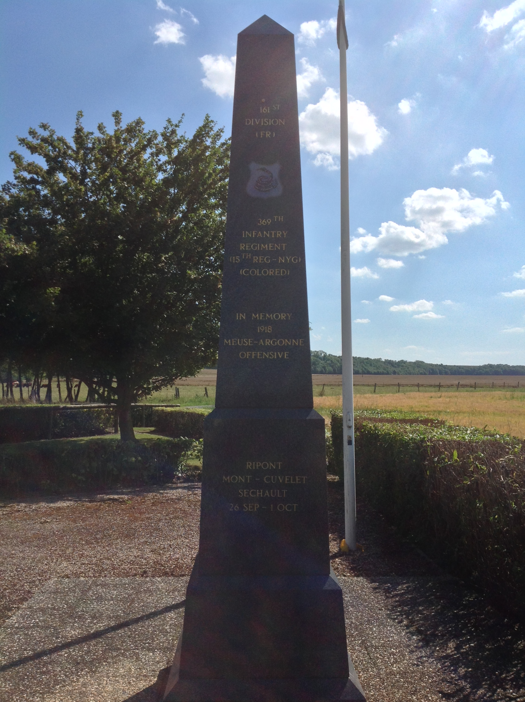
Notes:
Monument to 369th Infantry at Sechault

Slide 17
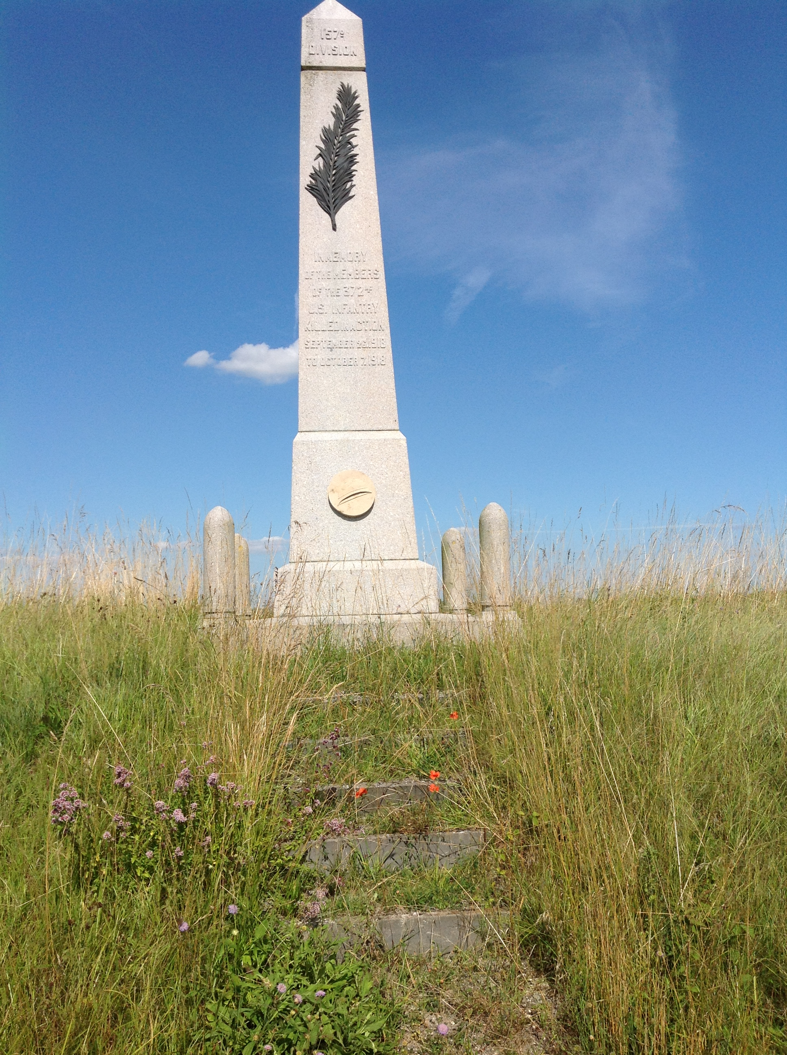
Notes:
Monument to the 372nd Infantry at Monthois

Slide 18
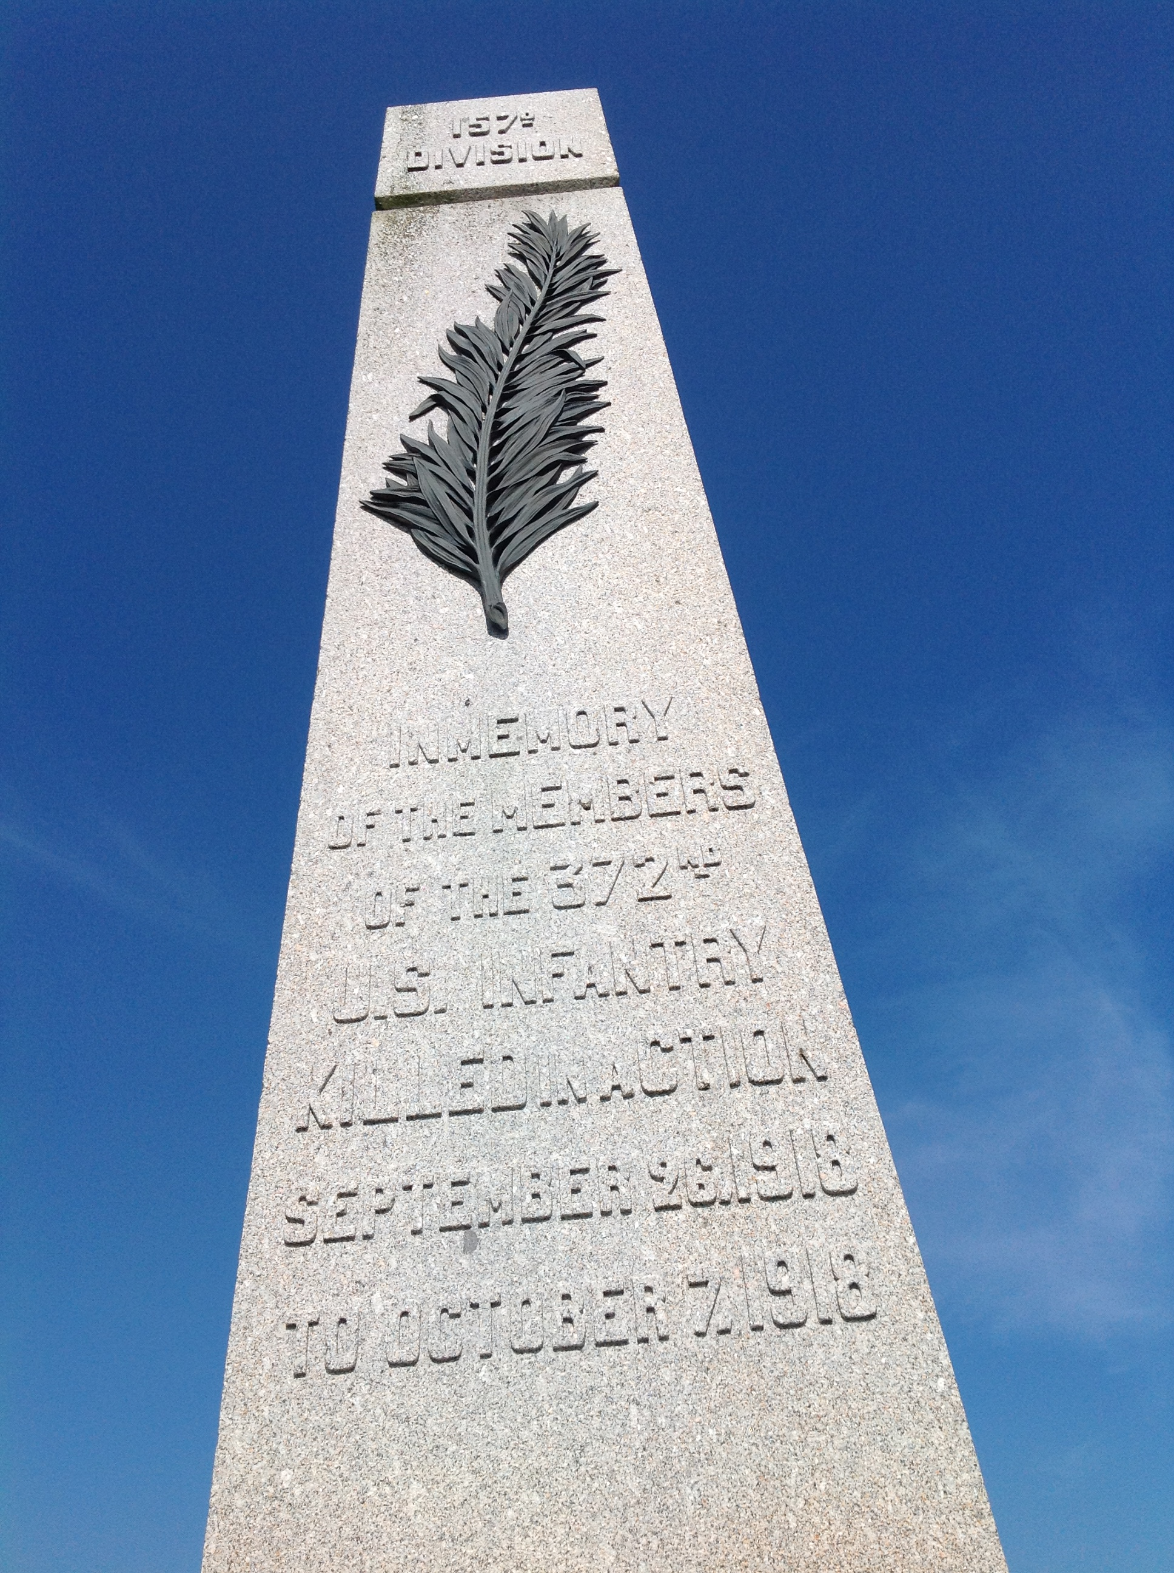
Notes:
Monument to the 372nd Infantry at Monthois

