Slide 1
Commemorating African American Soldiers in France
Monuments of World War I

Slide 2
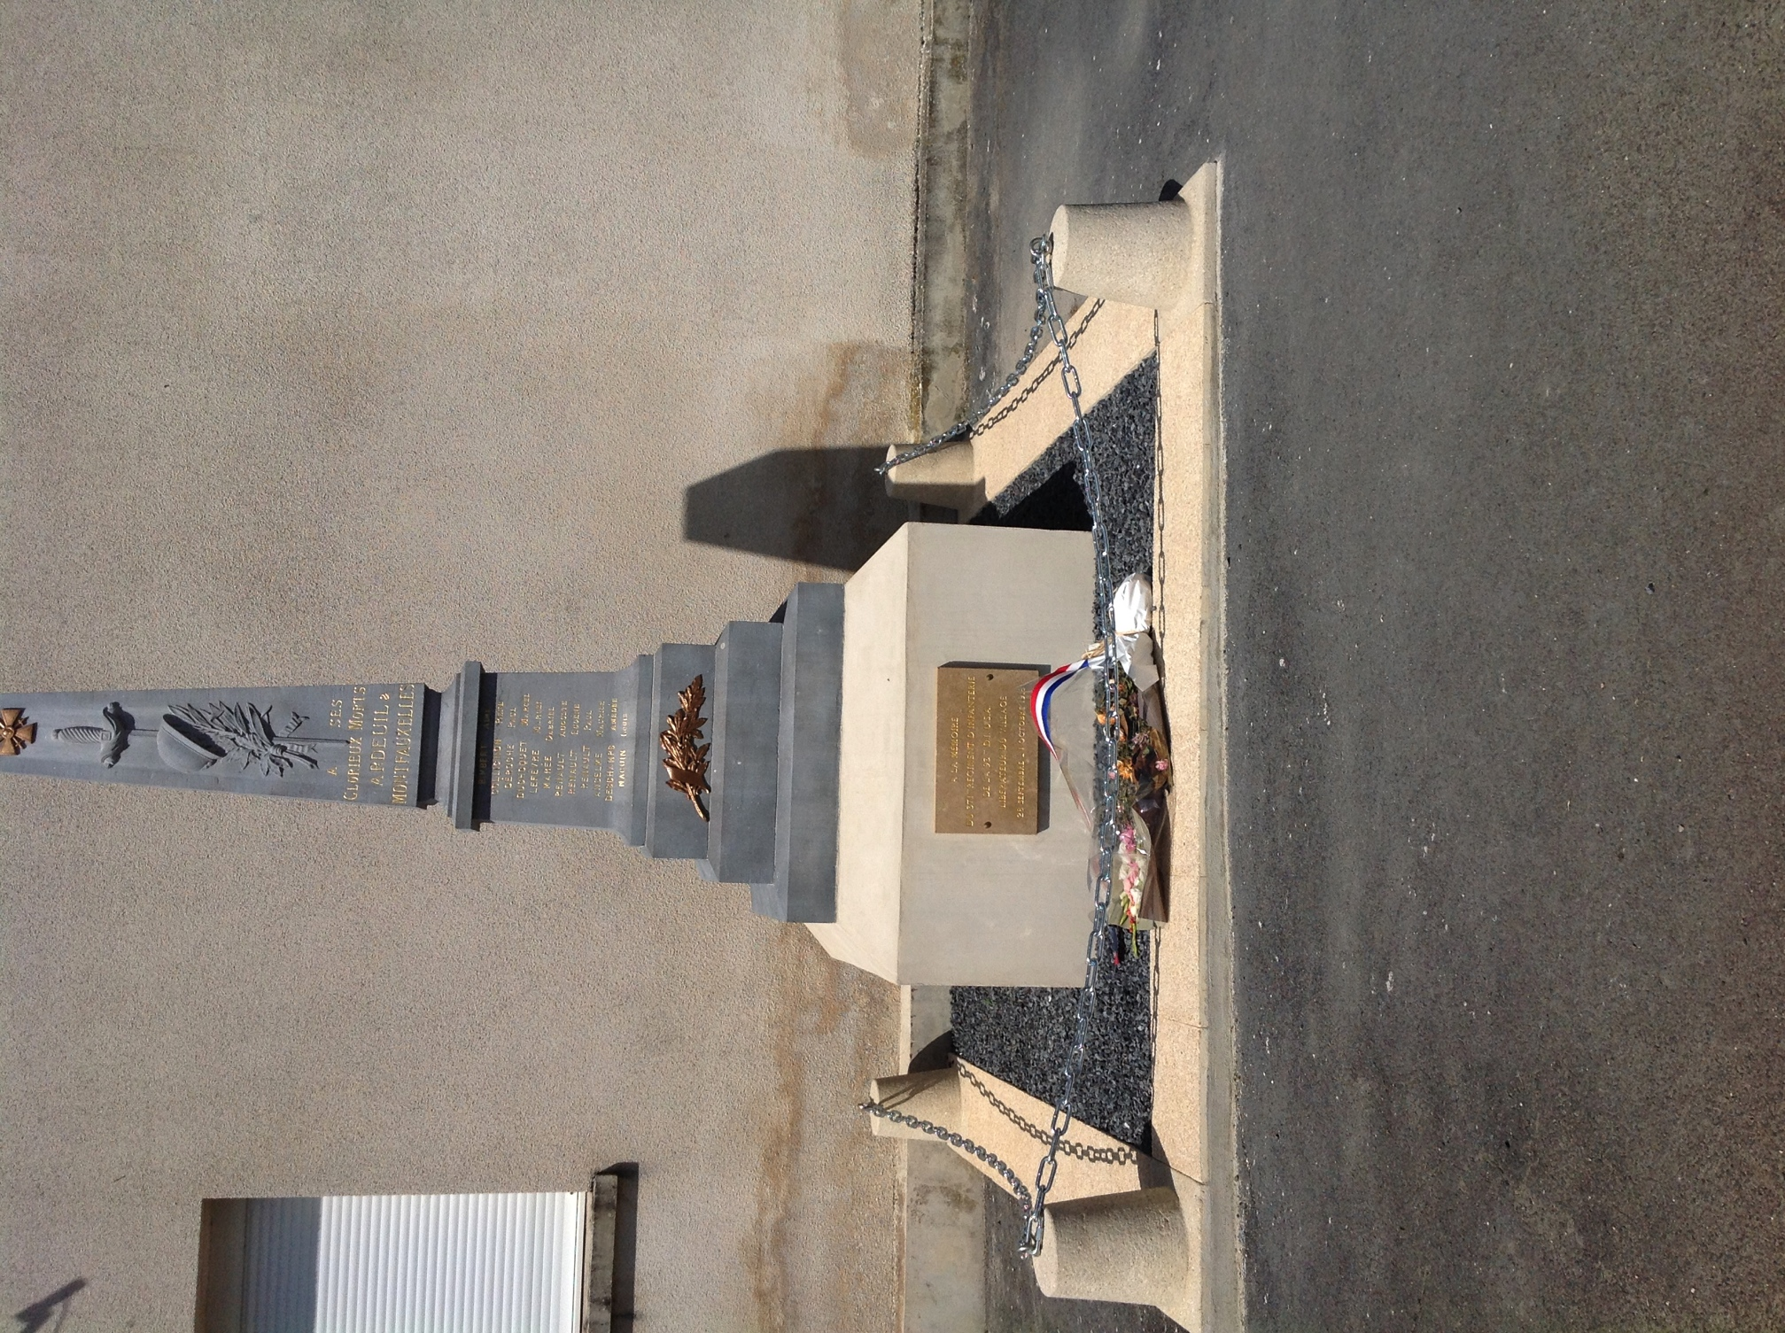
Monument to 371st Infantry at Ardeuil-Montfauxelles

Slide 3
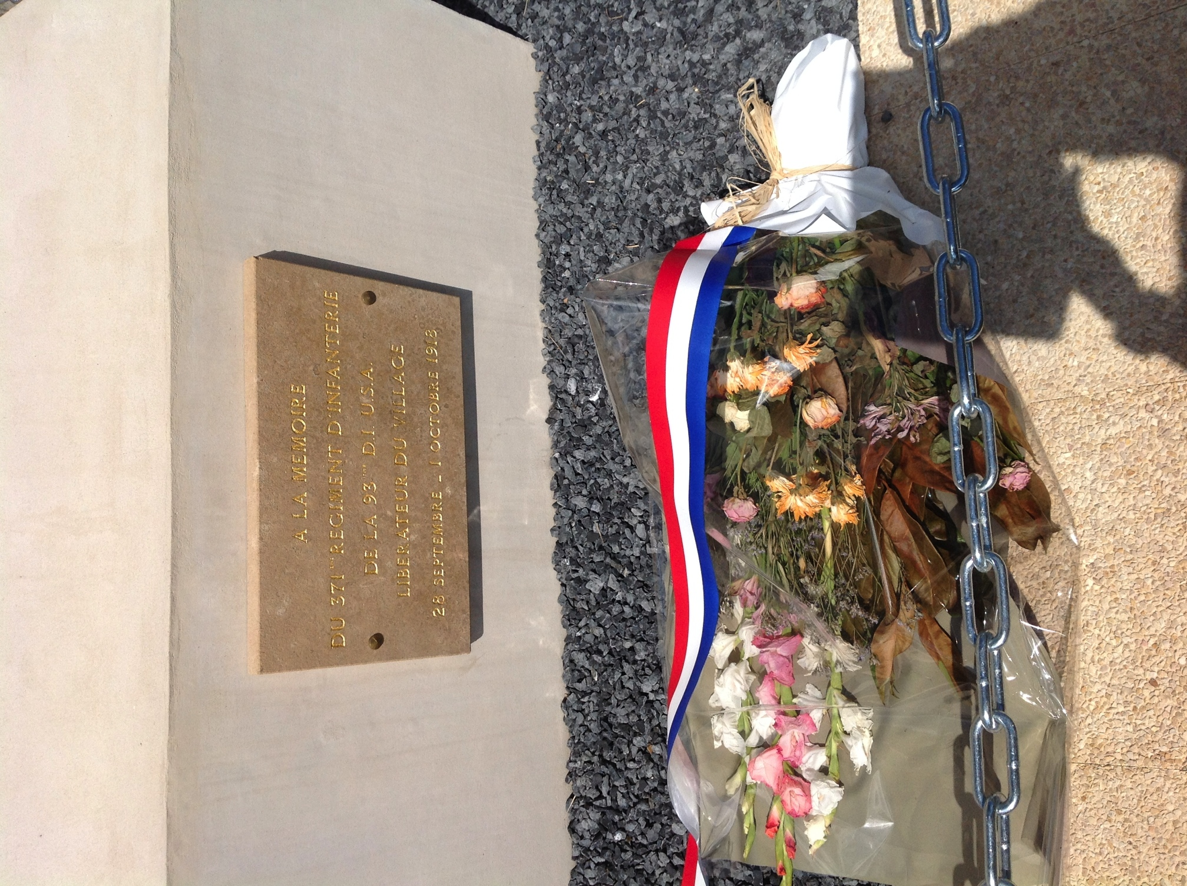
A Closer Look at the Inscription on the Monument
French Inscription:
“A La Memoire
Du 371st Regiment D’ Infanterie
De La 93rd D.I. USA
Liberateur Du Village
28 Septembre – 1 Octobre 1918”
English Translation:
“In Memory of
The 371st Infantry
Of the Regiment, 93rd
Division, USA
Liberator of the Village
September 28 –
October 1, 1918”

Slide 4
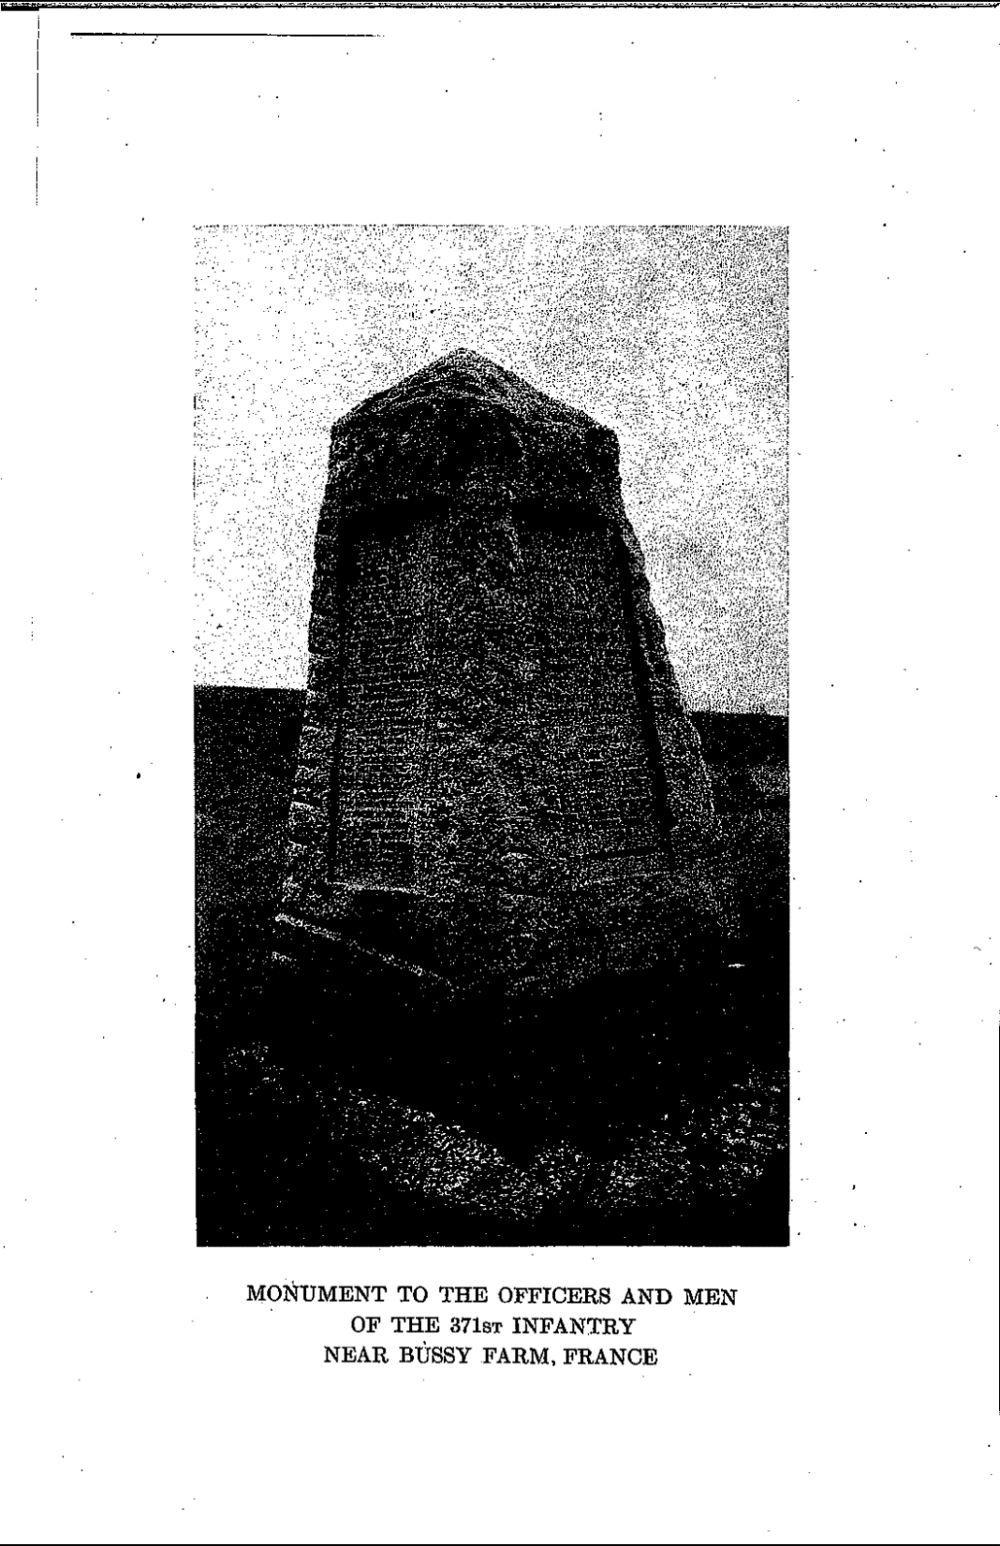
Monument to 371st Infantry at Bussy Farm (Pre-1940)
Label reads: “Monument to the Officers
And Men of the 371st Infantry
Near Bussy Farm, France
Source: Haywood, C. (1928). Negro Cambat
Troops in the World War: The Story of the 371st
Infantry. Worcester, MA: Commonwealth Press.

Slide 5
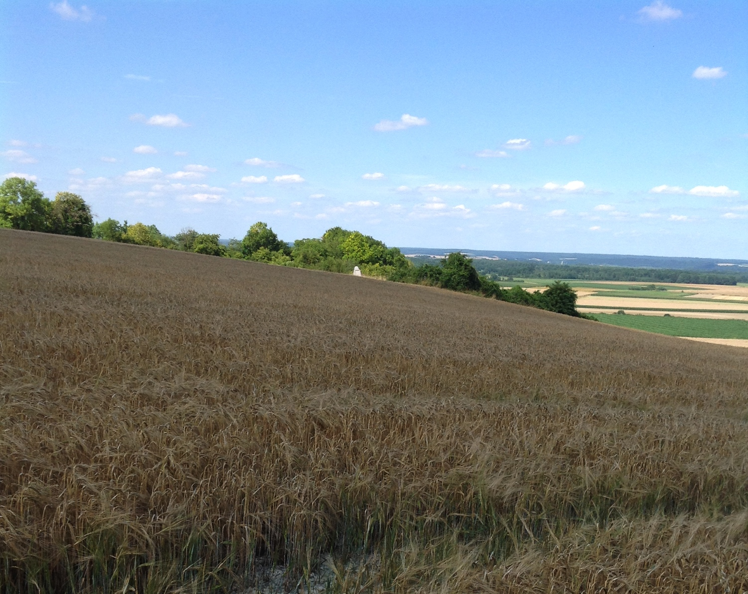
Monument to 371st Infantry at Bussy Farm (Post-1940)
➔

Slide 6
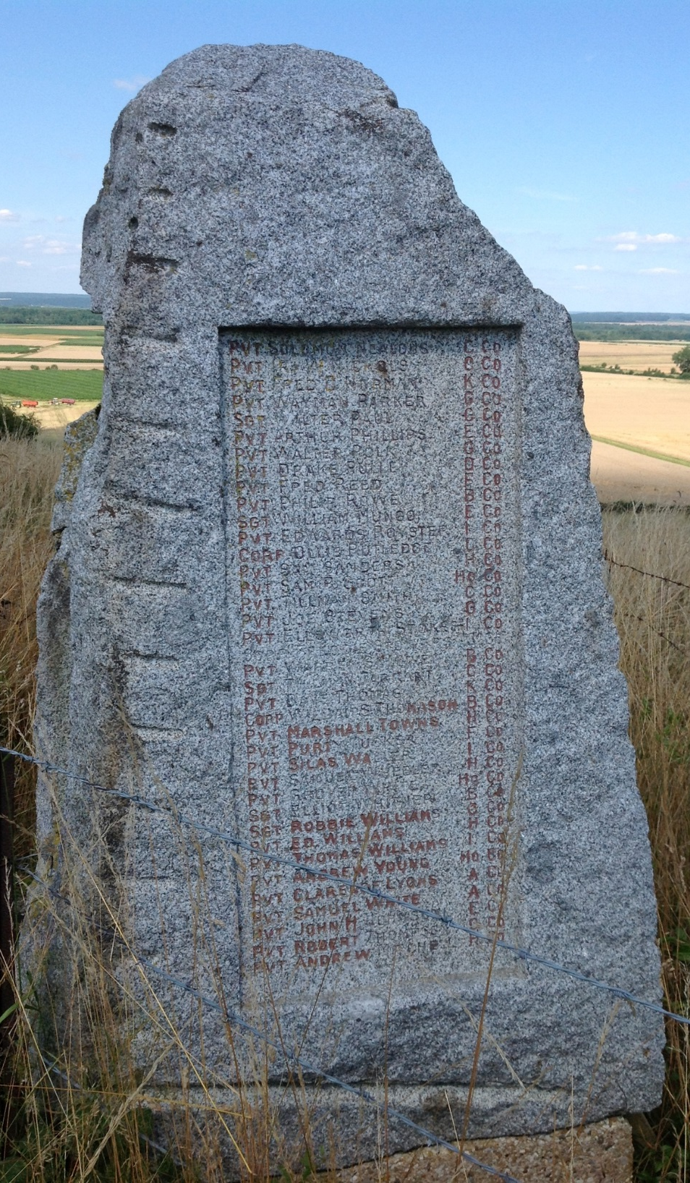
Monument to 371st Infantry at Bussy Farm (Post-1940)

Slide 7
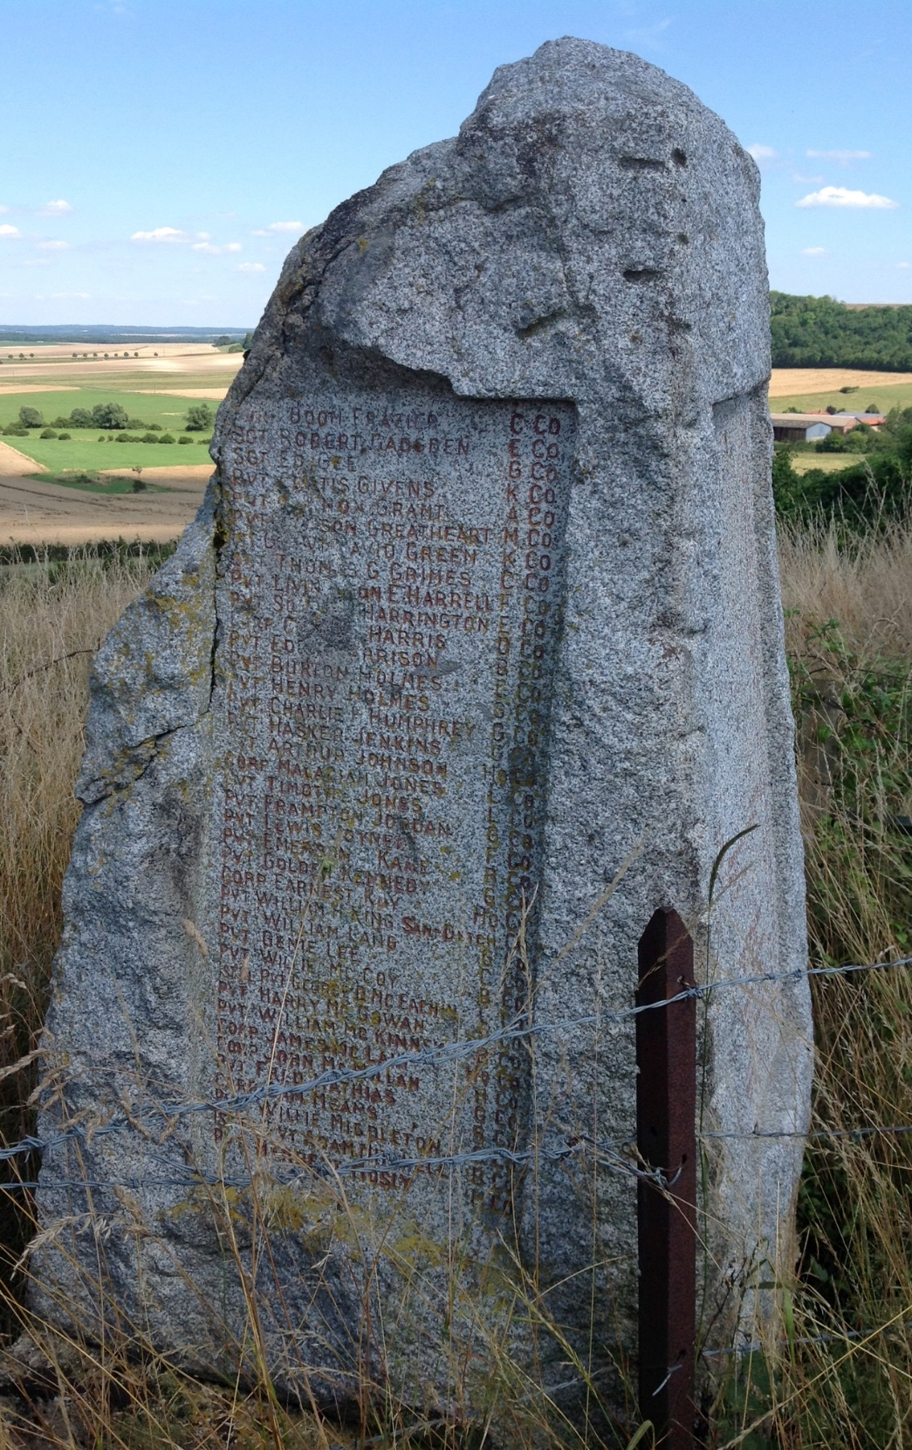
Monument to 371st Infantry at Bussy Farm (Post-1940)

Slide 8
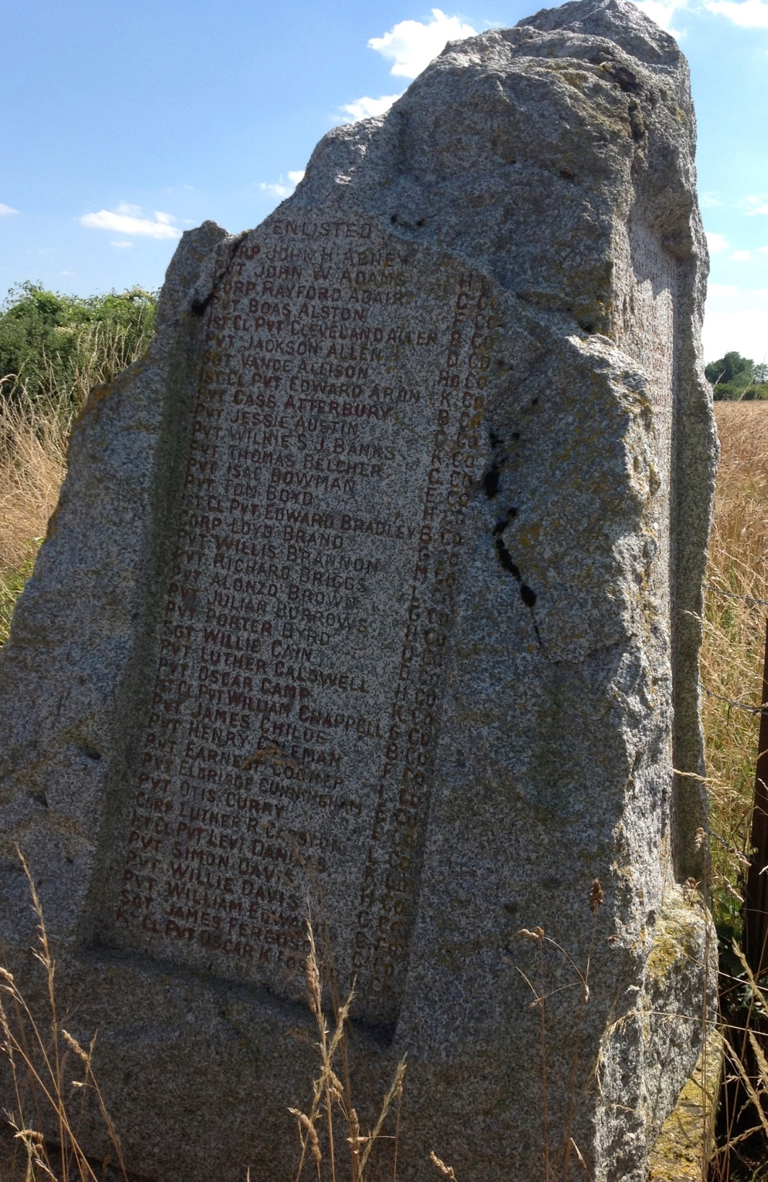
Monument to 371st Infantry at Bussy Farm (Post-1940)

Slide 9
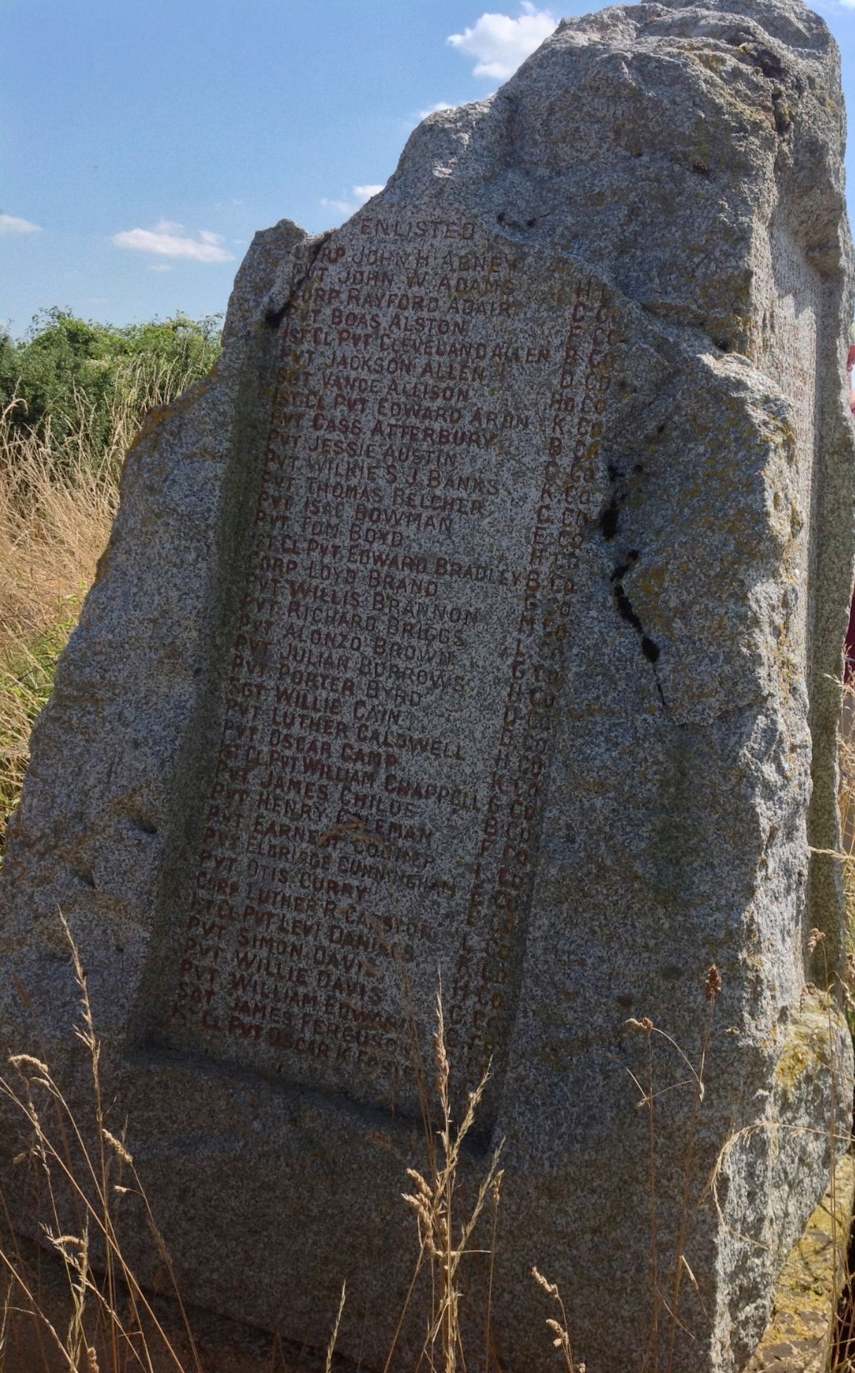
Monument to 371st Infantry at Bussy Farm (Post-1940)

Slide 10
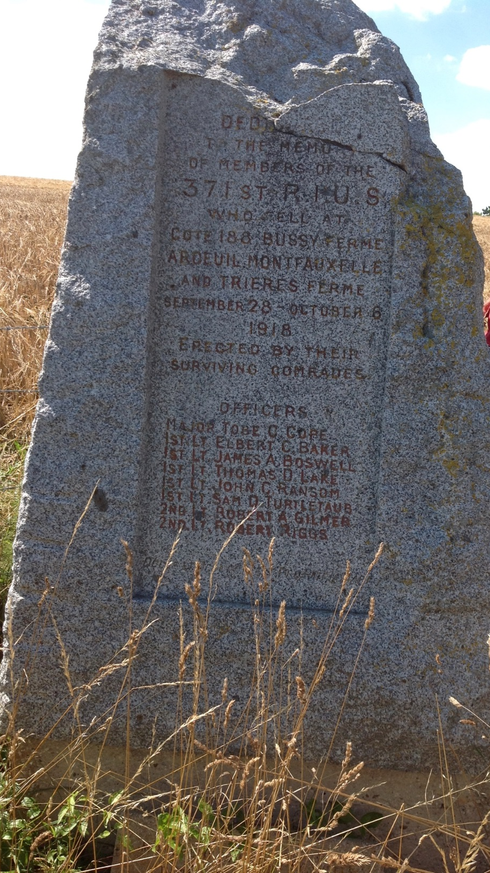
Monument to 371st Infantry at Bussy Farm (Post-1940)

Slide 11
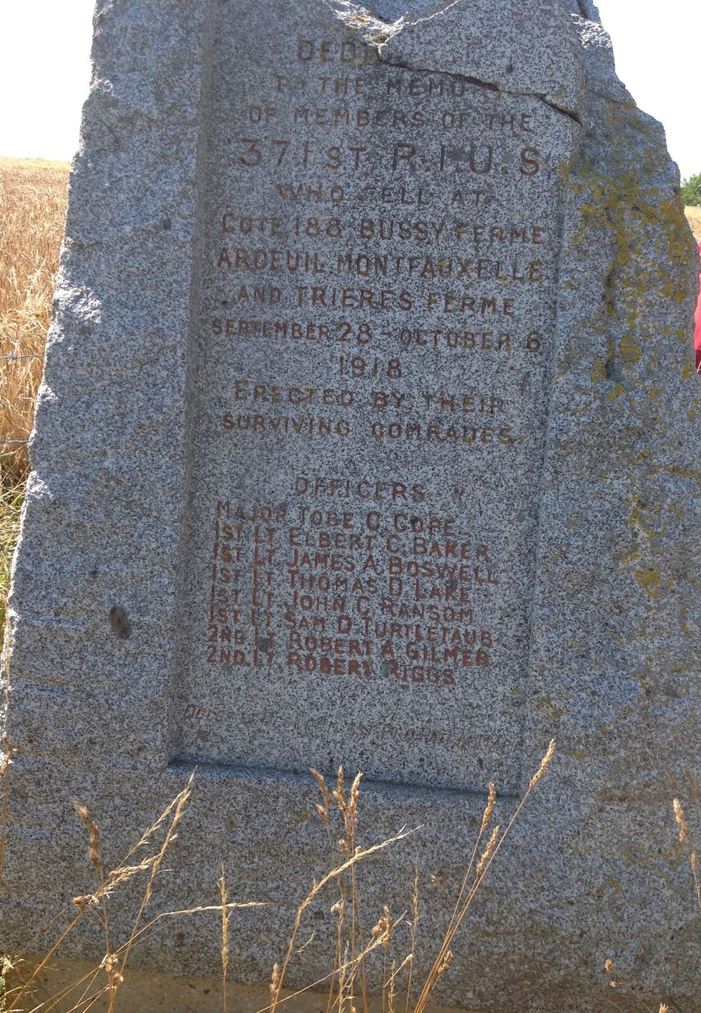
Monument to 371st Infantry at Bussy Farm (Post-1940)

Slide 12
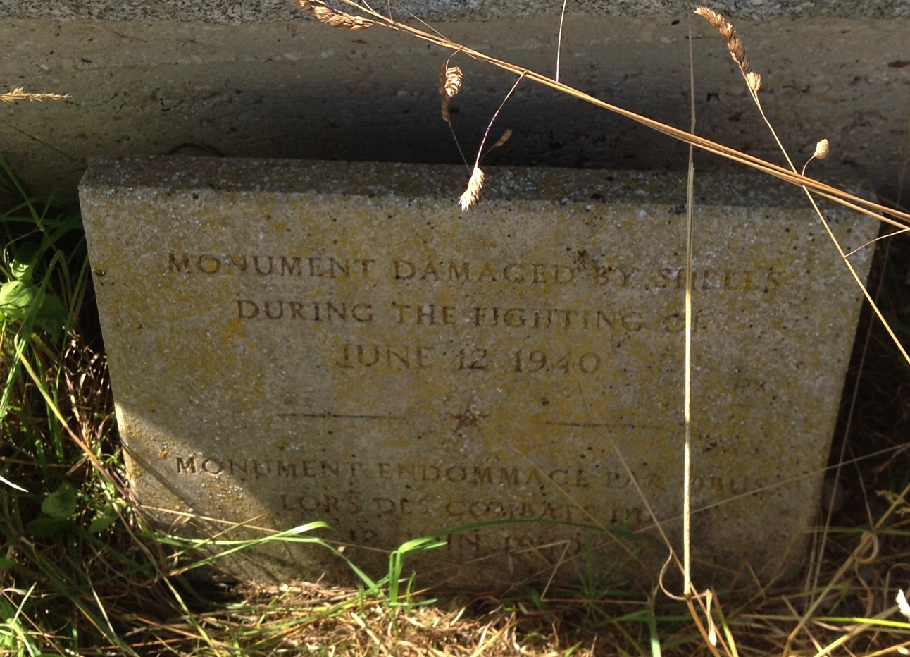
Monument to 371st Infantry at Bussy Farm (Post-1940)
English Inscription:
“Monument Damaged
By Shells During the
Fighting on
June 12, 1940”

Slide 13
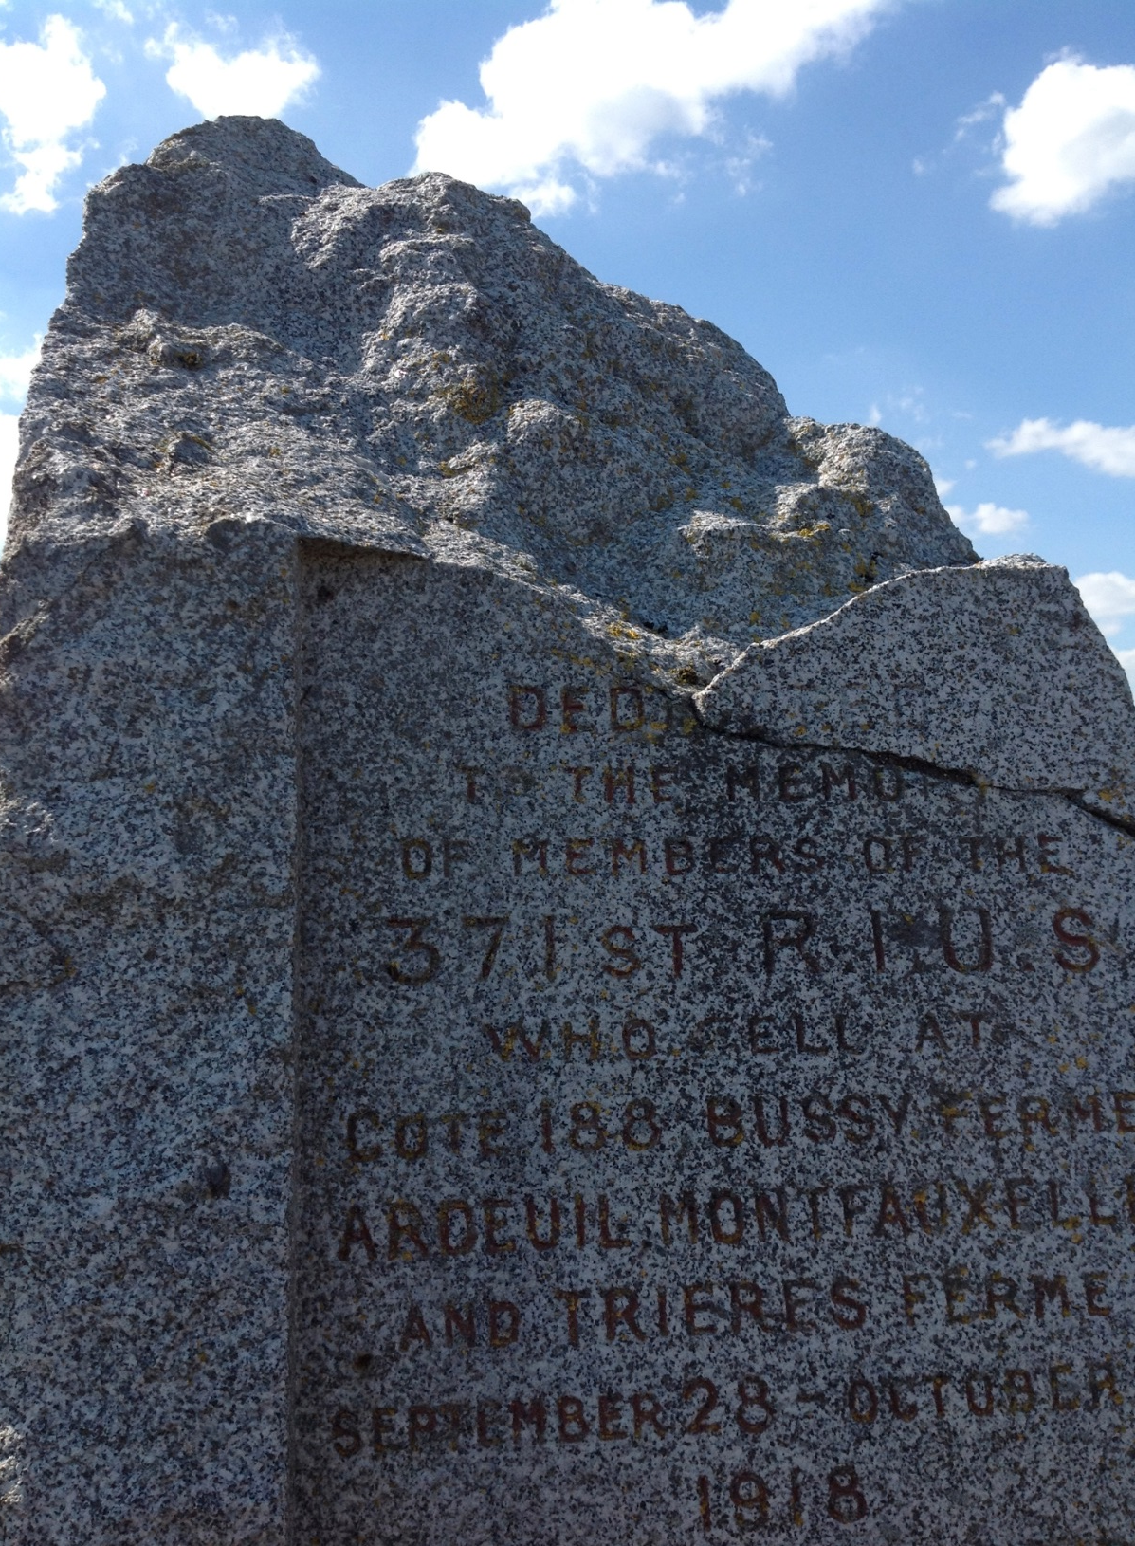
Monument to 371st Infantry at Bussy Farm (Post-1940)

Slide 14
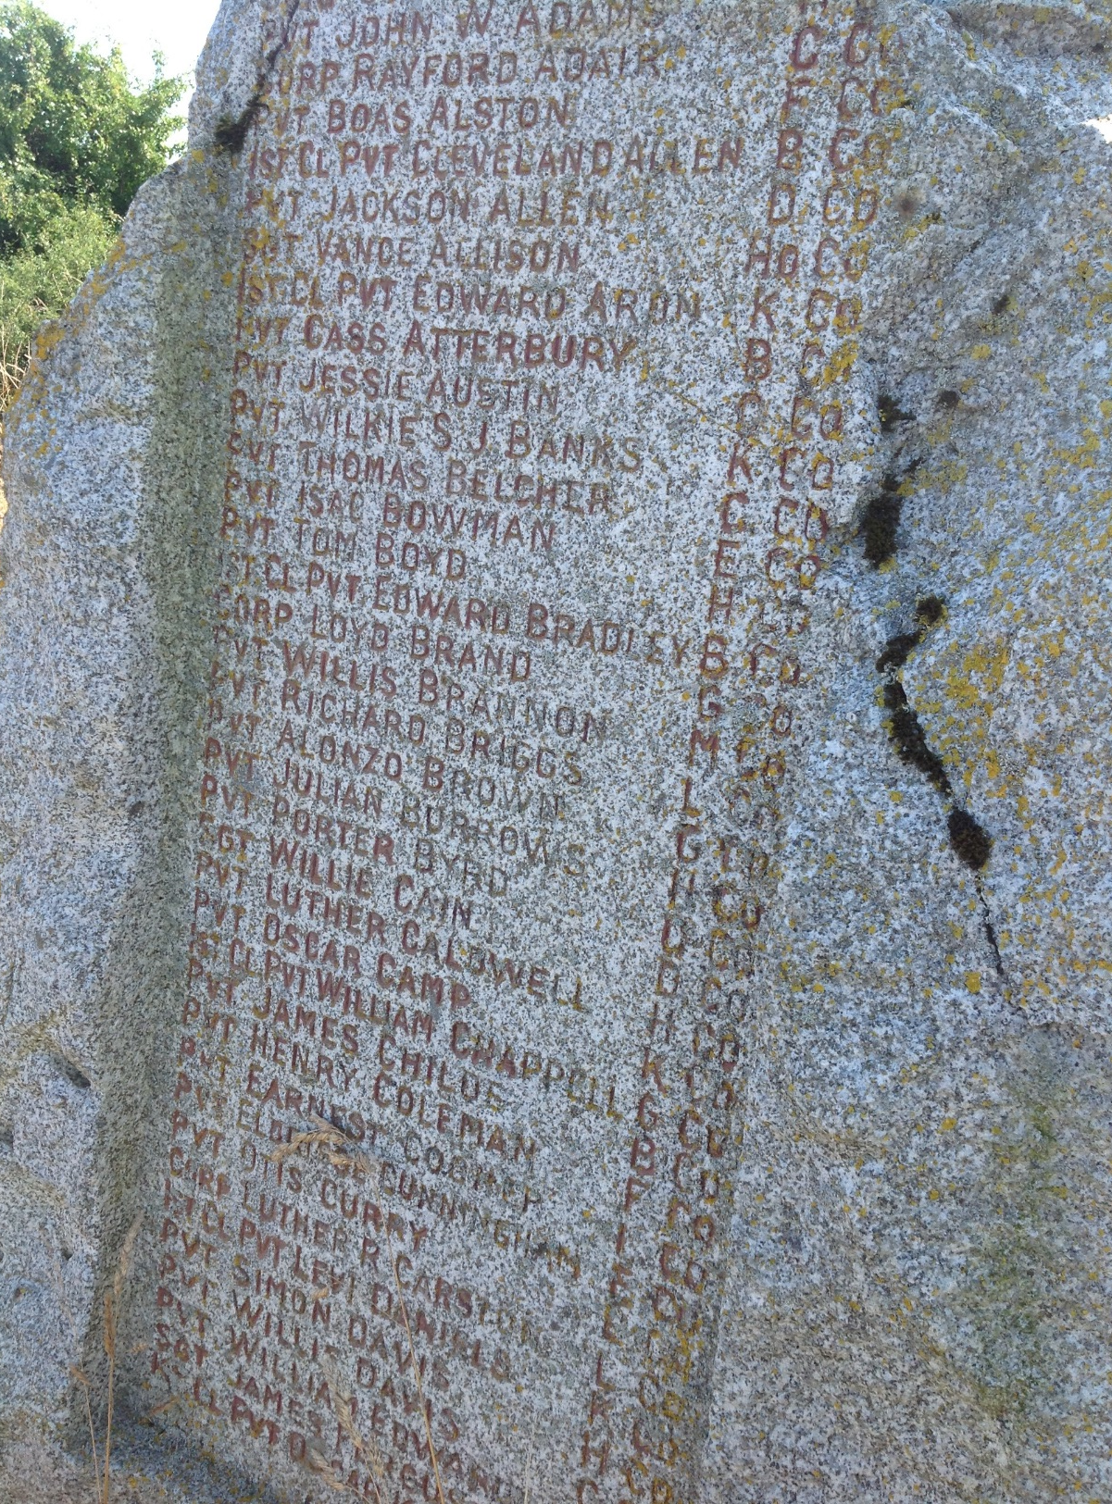
Monument to 371st Infantry at Bussy Farm (Post-1940)

Slide 15
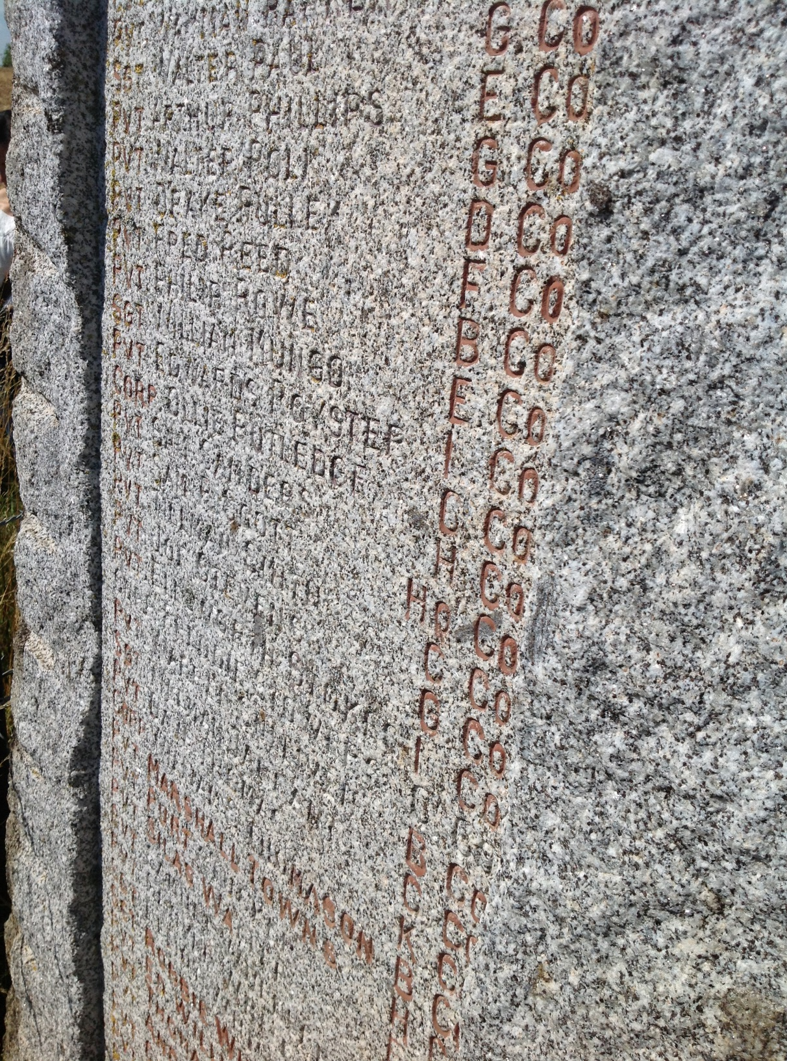
Monument to 371st Infantry at Bussy Farm (Post-1940)
Can you find Freddie Stowers on this list? Hint: He is in C Company.

Slide 16
Monument to 371st Infantry at Bussy Farm (Post-1940)
Although his name is faded here, his name will never fade from the nation’s memory as a Medal of Honor recipient.
Can you find Freddie Stowers on this list? Hint: He is in C Company.

Slide 17
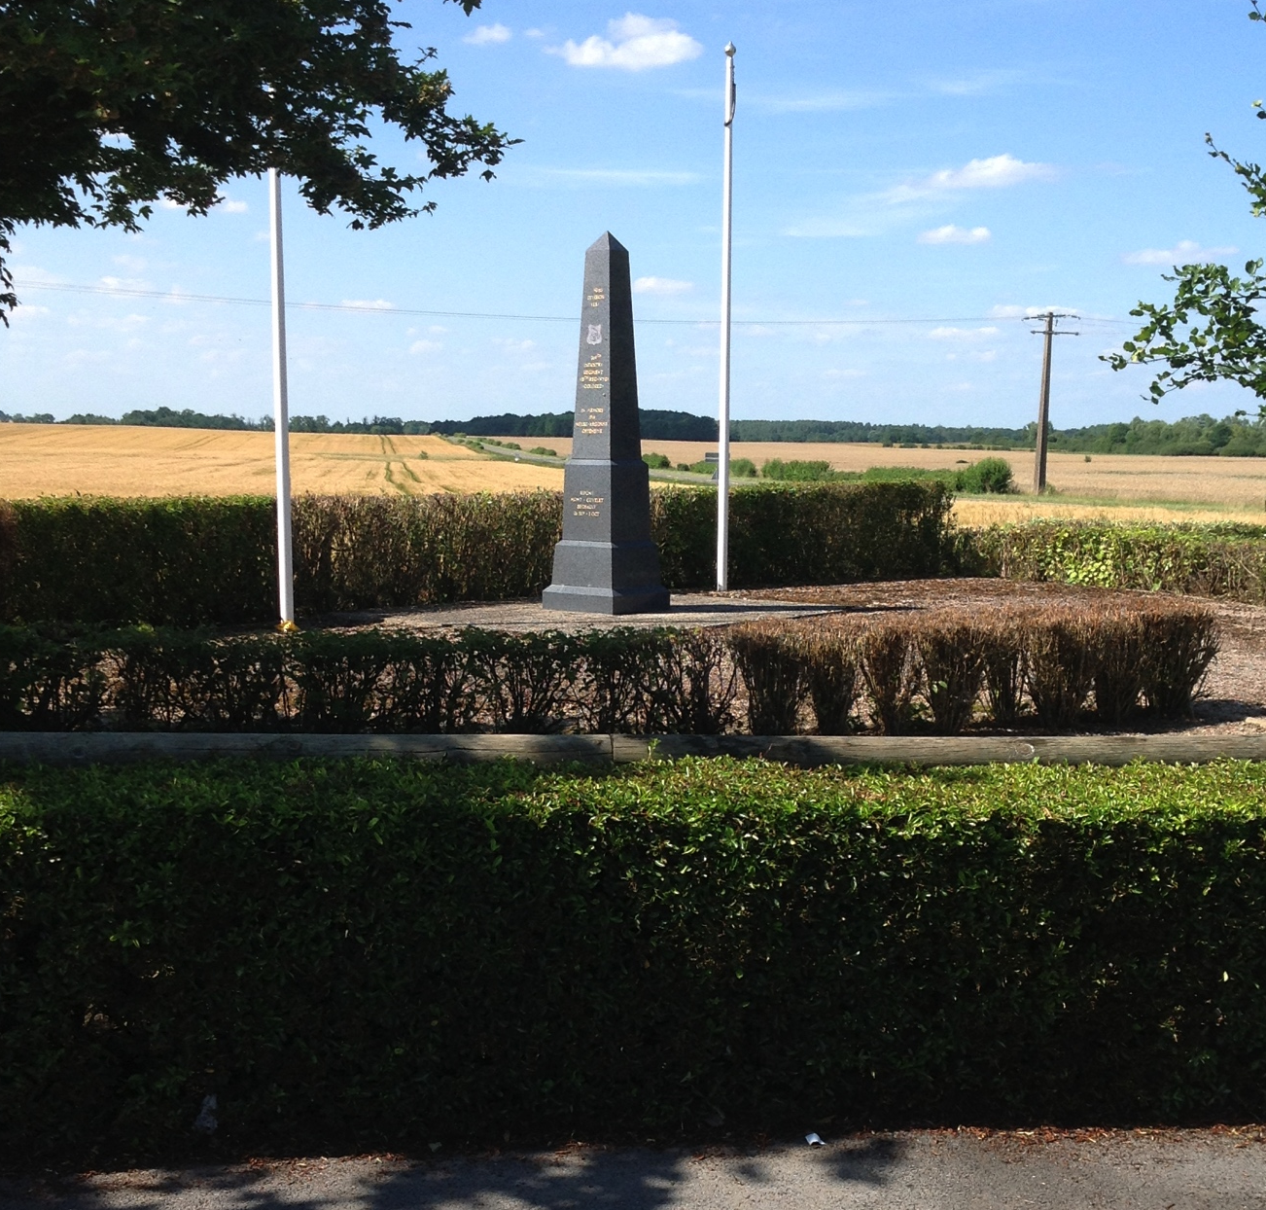
Monument to 369th Infantry at Sechault

Slide 18
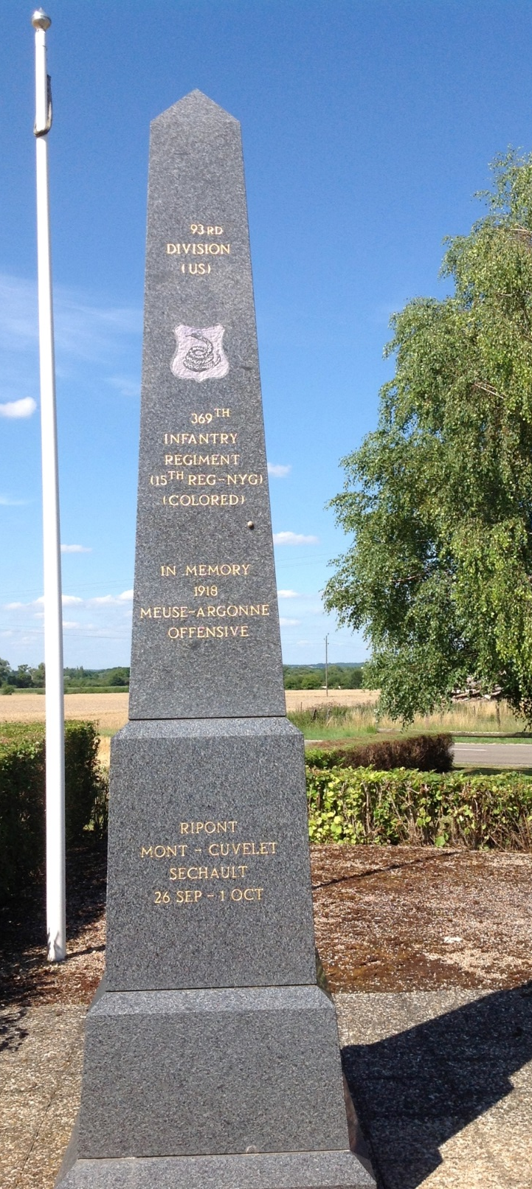
Monument to 369th Infantry at Sechault
Inscription Reads:
“93rd Division US
[Image of Rattlesnake]
369th Infantry
(15th Reg-NYG)
(Colored)
In Memory
1918
Meuse-Argonne
Offensive
Ripont
Mont-Cuvelet
Sechault
26 Sep – 1 Oct”

Slide 19
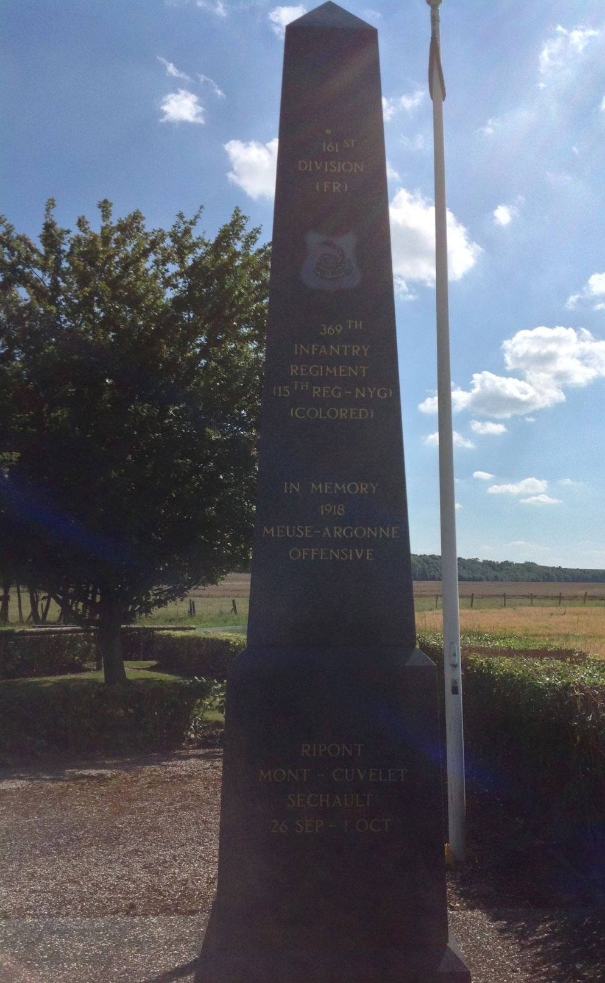
Monument to 369th Infantry at Sechault
Inscription Reads:
“93rd Division US
[Image of Rattlesnake]
369th Infantry
(15th Reg-NYG)
(Colored)
In Memory
1918
Meuse-Argonne
Offensive
Ripont
Mont-Cuvelet
Sechault
26 Sep – 1 Oct”

Slide 20
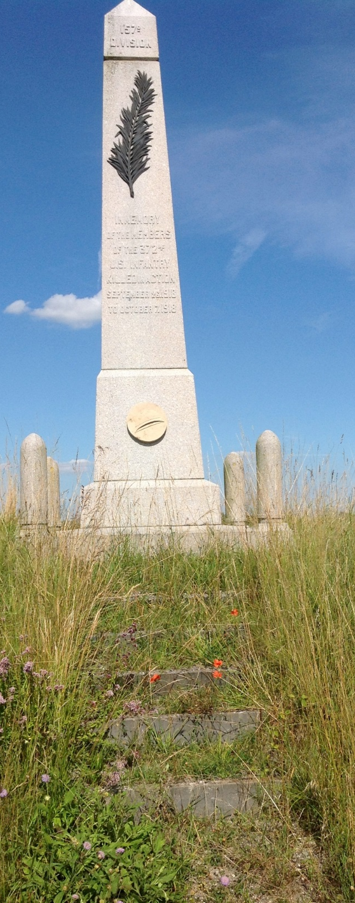
Monument to 372nd Infantry at Monthois
Inscription Reads:
“157th Division
In Memory
of the Members
of the 372nd
U. S. Infantry
Killed in Action
September 26, 1918
To October 7, 1918”

Slide 21
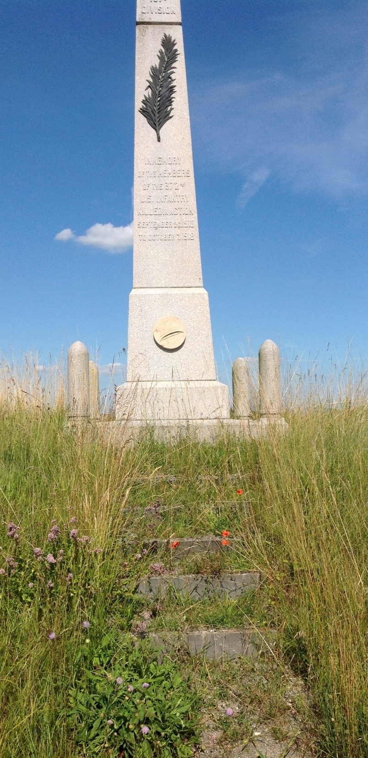
Monument to 372nd Infantry at Monthois
Inscription Reads:
“157th Division
In Memory
of the Members
of the 372nd
U. S. Infantry
Killed in Action
September 26, 1918
To October 7, 1918”

Slide 22
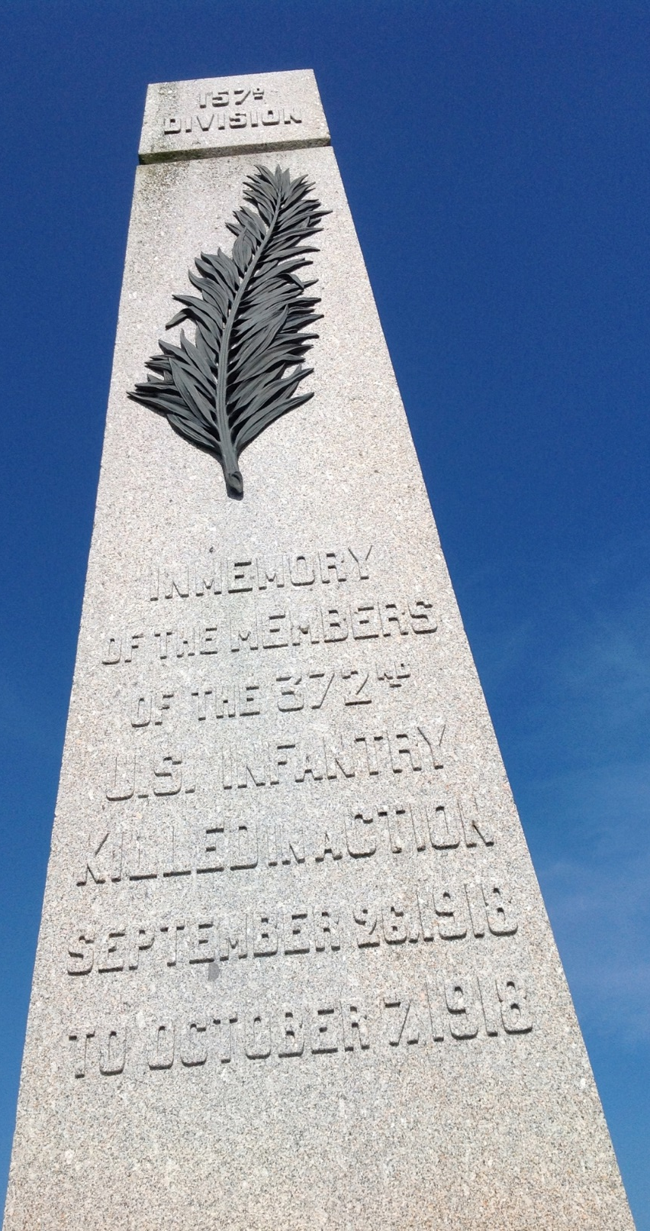
Monument to 372nd Infantry at Monthois
Inscription Reads:
“157th Division
In Memory
of the Members
of the 372nd
U. S. Infantry
Killed in Action
September 26, 1918
To October 7, 1918”

