Slide 1
Section 5, Gallery 3
Troops Arrive in England

Slide 2
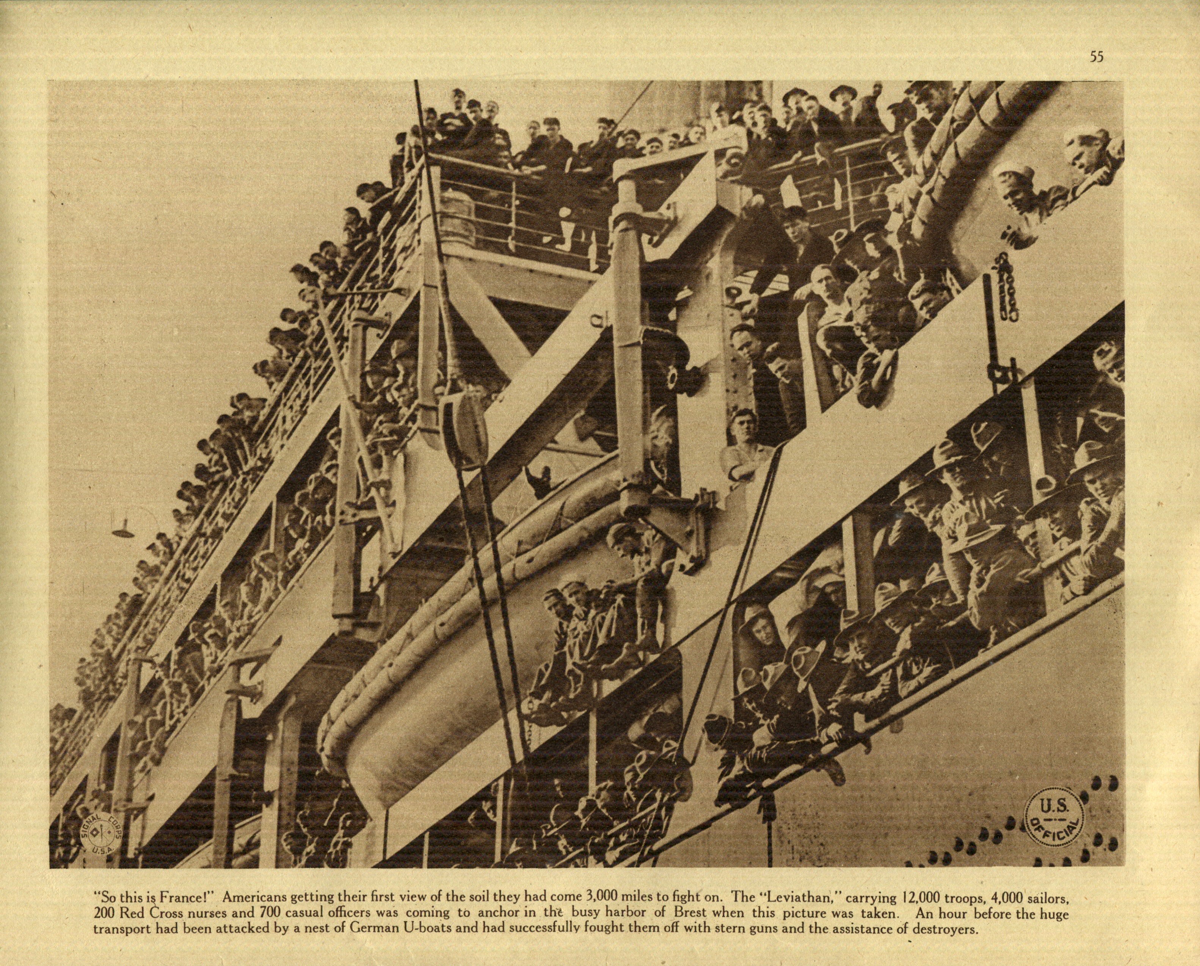
Soldiers Arrive in France for the First Time

Slide 3
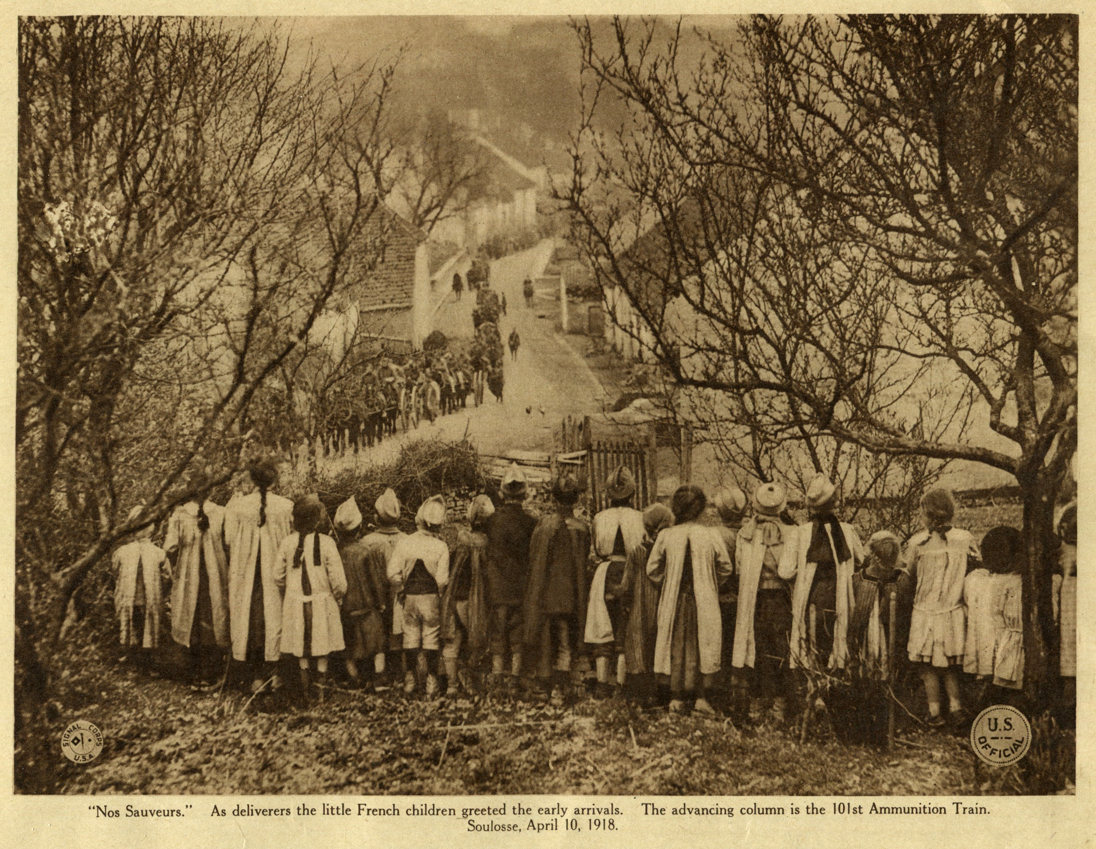
Soldiers Arrive in France

Slide 4
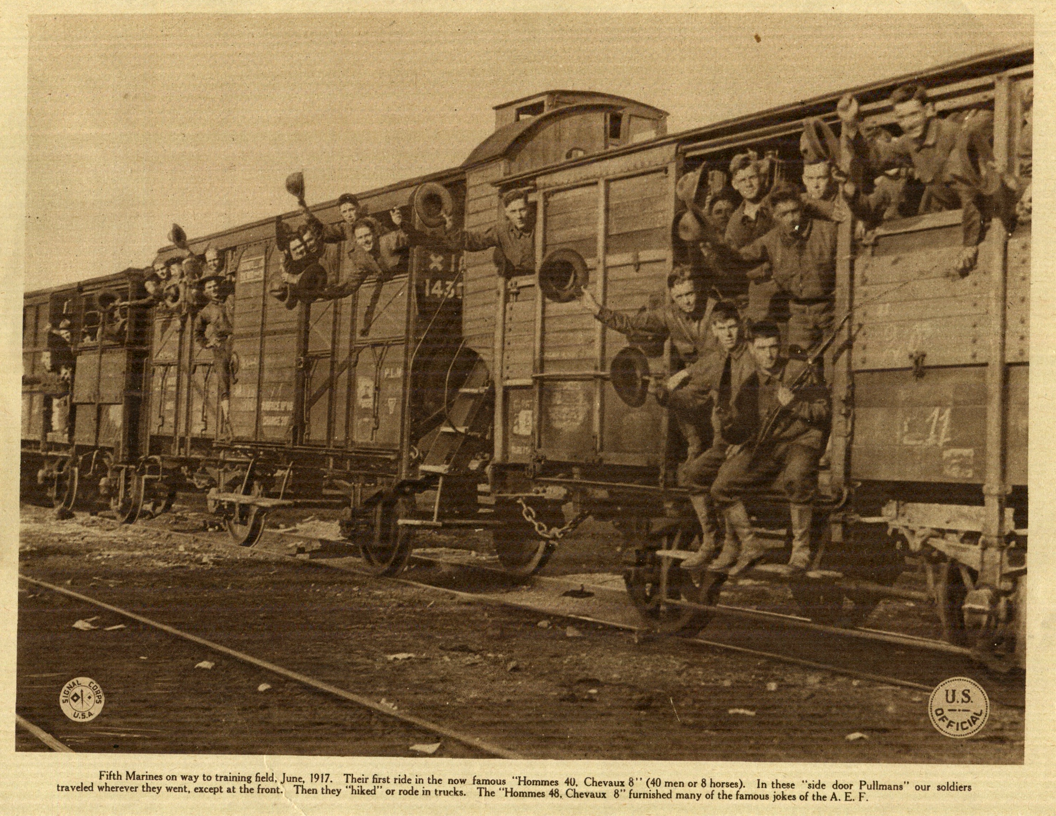
Soldiers On Train

Slide 5
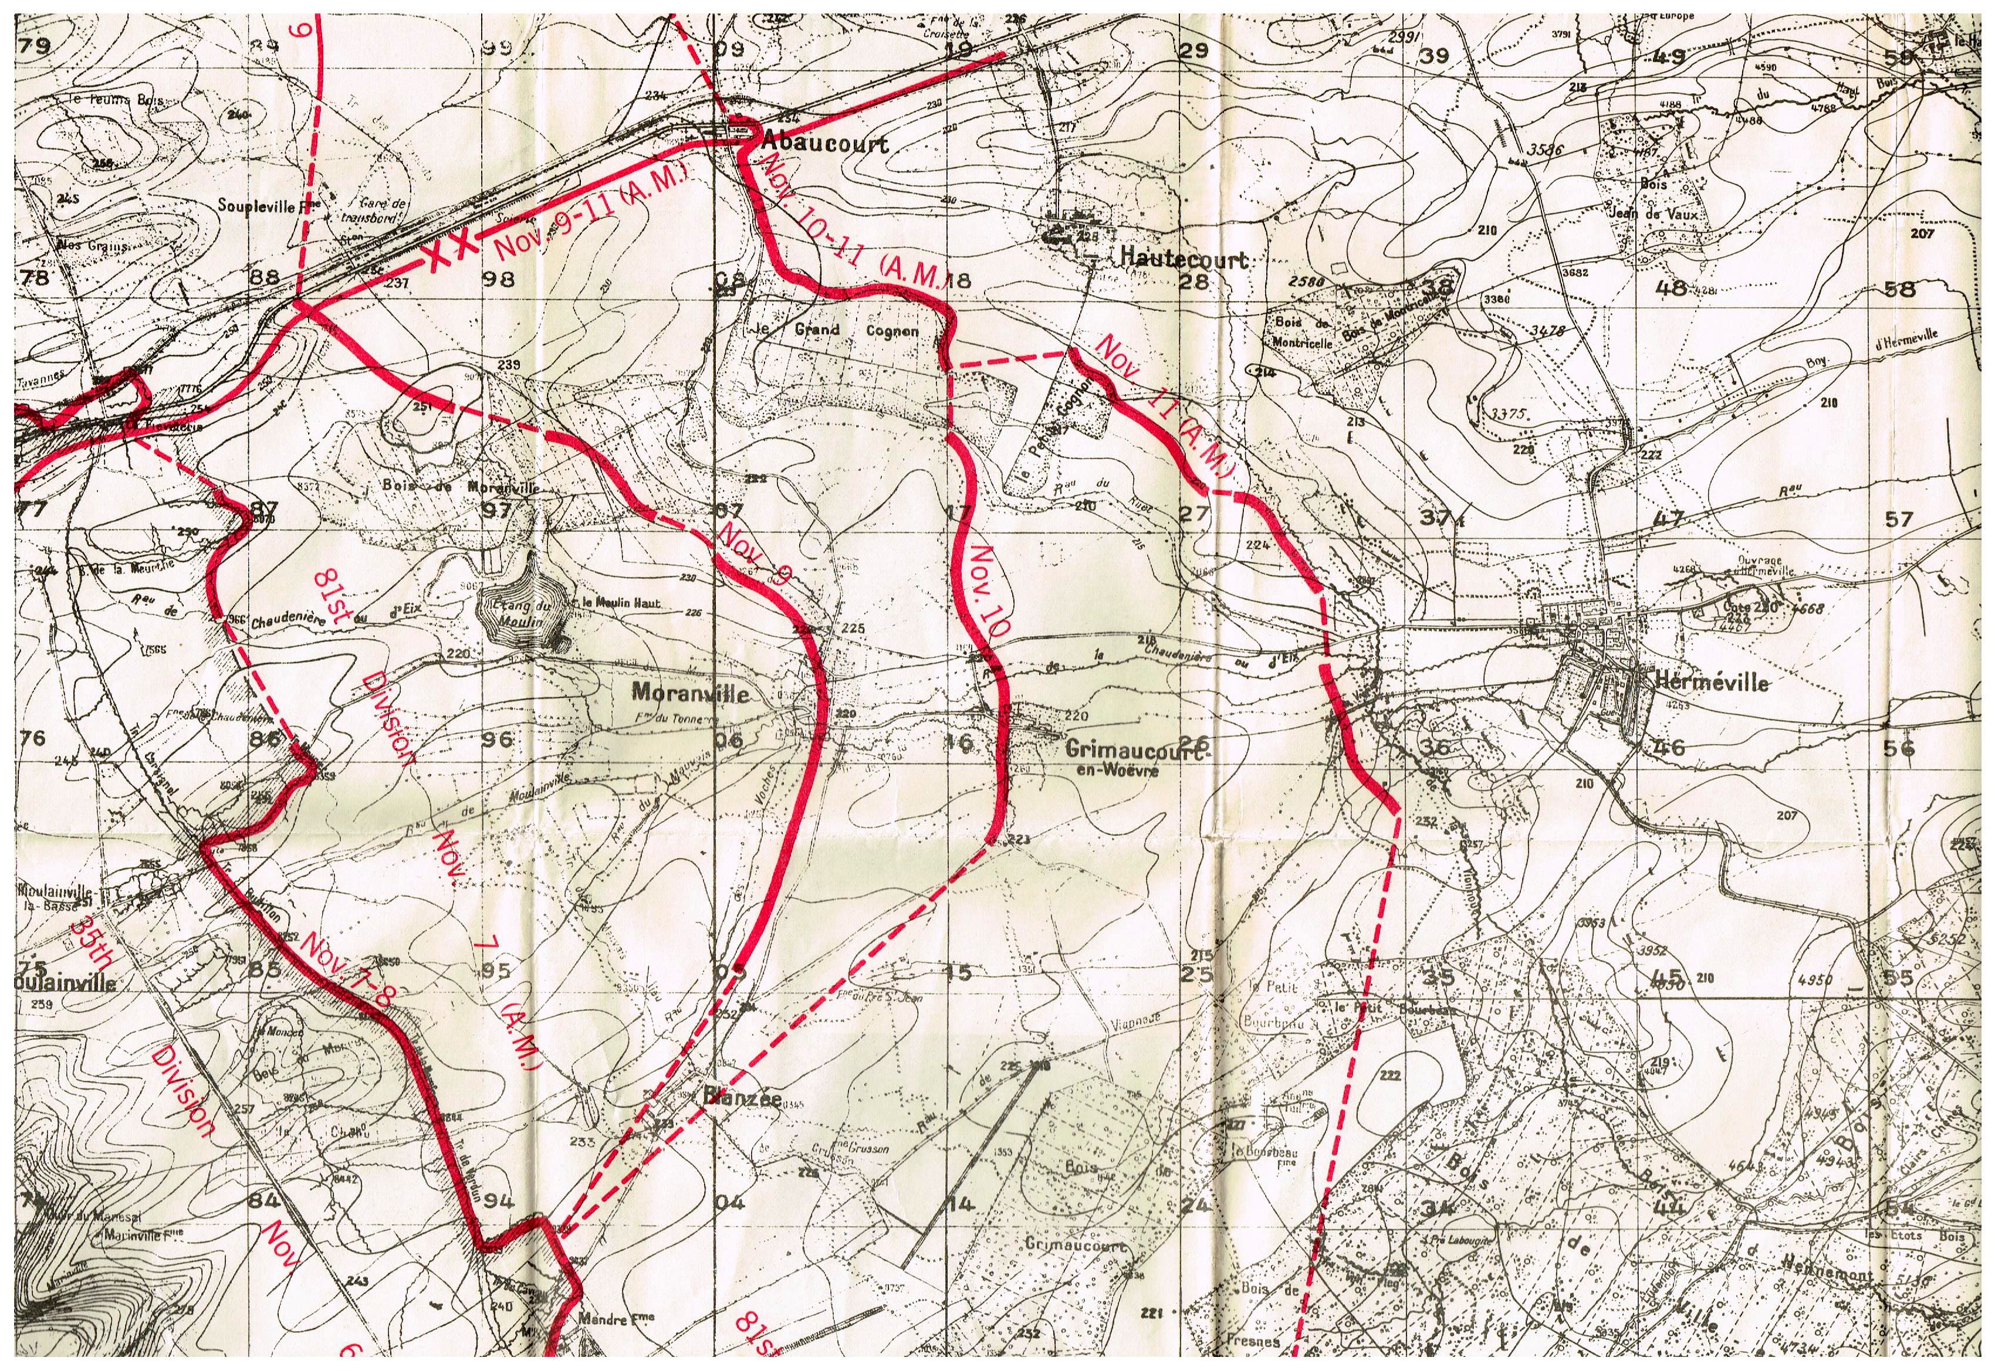
81st Division Map

Slide 6
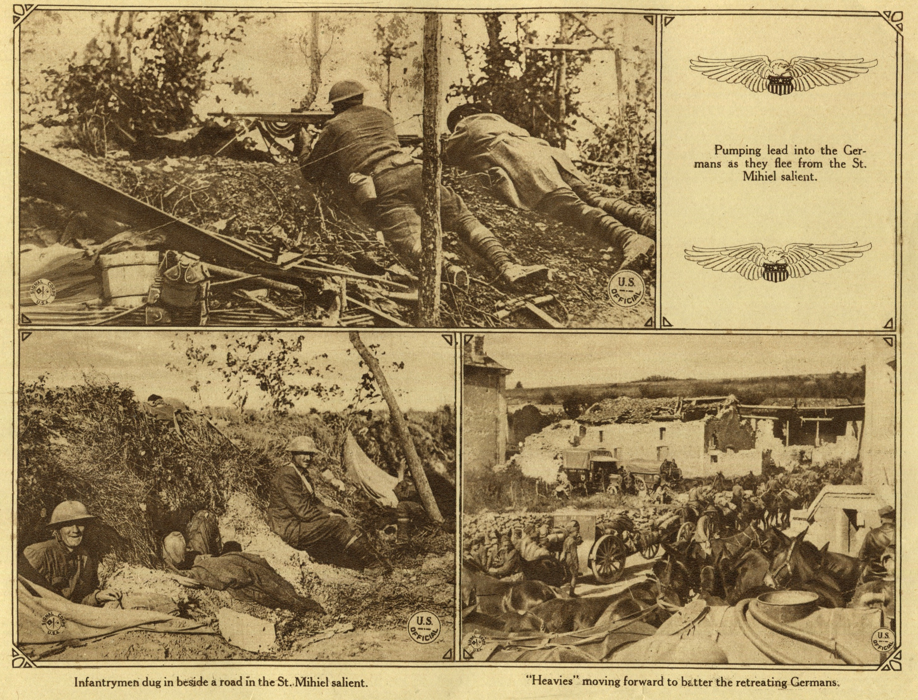
St. Mihiel Trenches

Slide 7
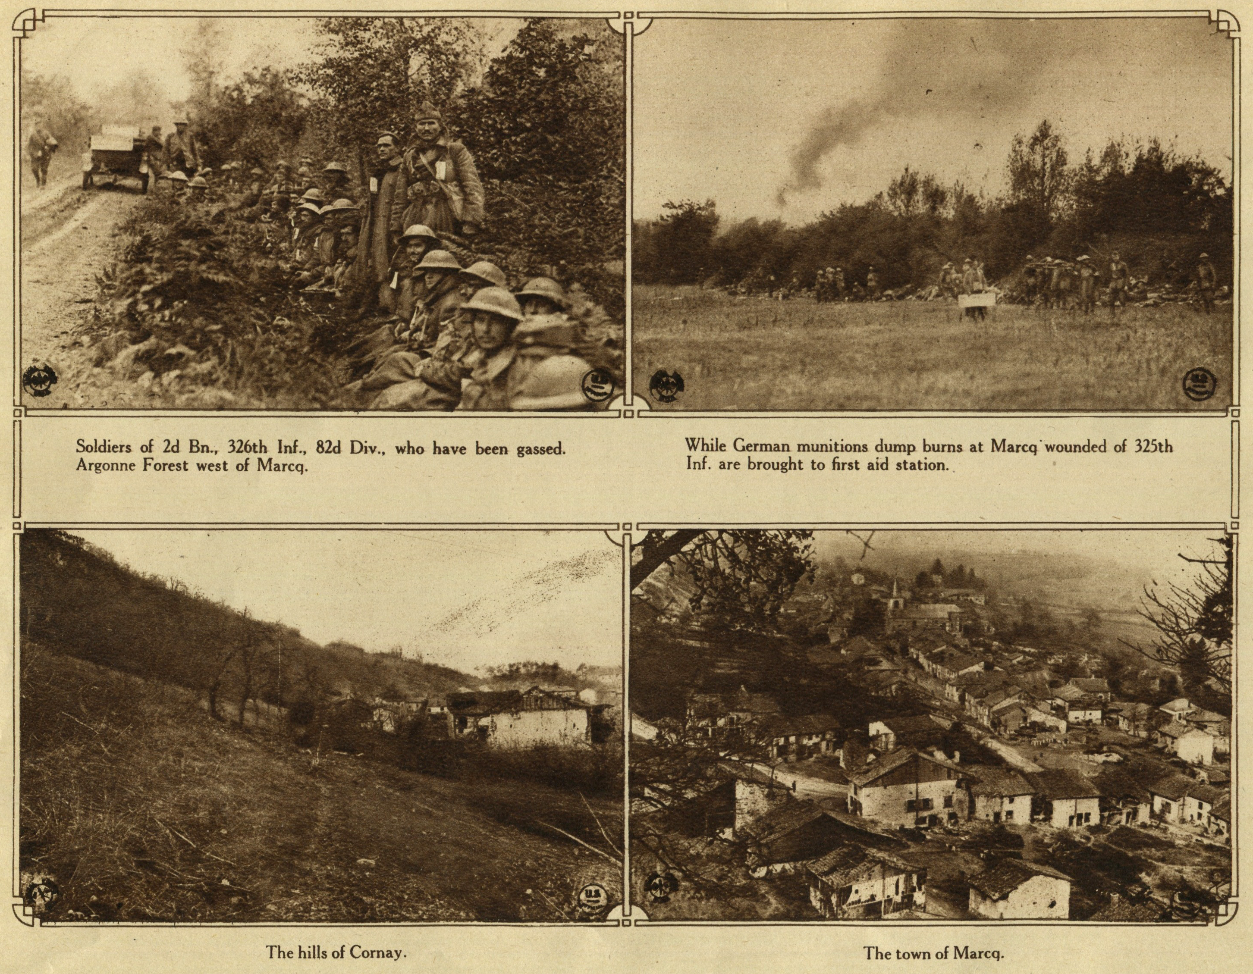
81st Division in the Argonne Forest

Slide 8
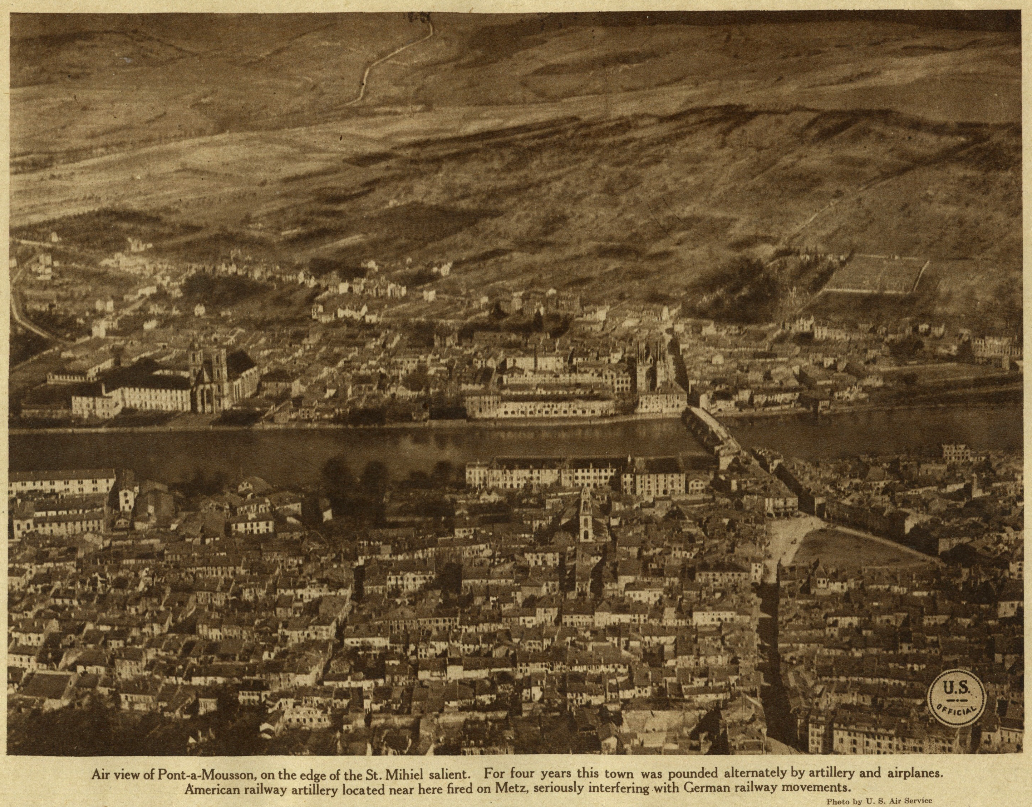
St. Mihiel Combat Field

Slide 9
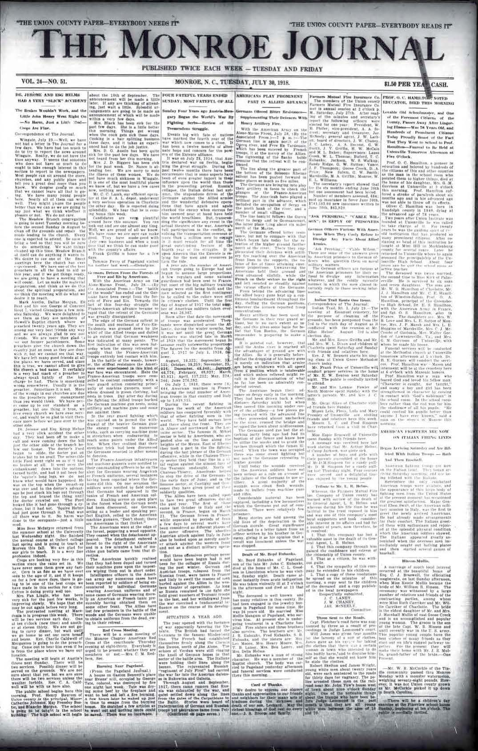
Monroe Journal, July 30, 1918 - Report on Americans

Slide 10
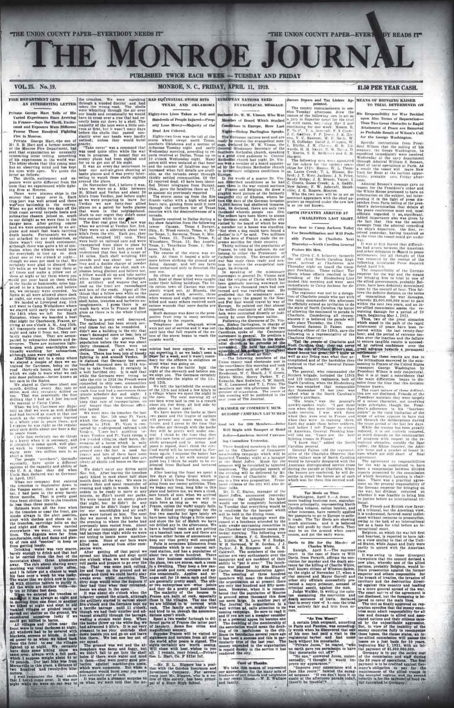
Monroe Journal, Friday, February 11, 1919 - Summary

