Slide 1
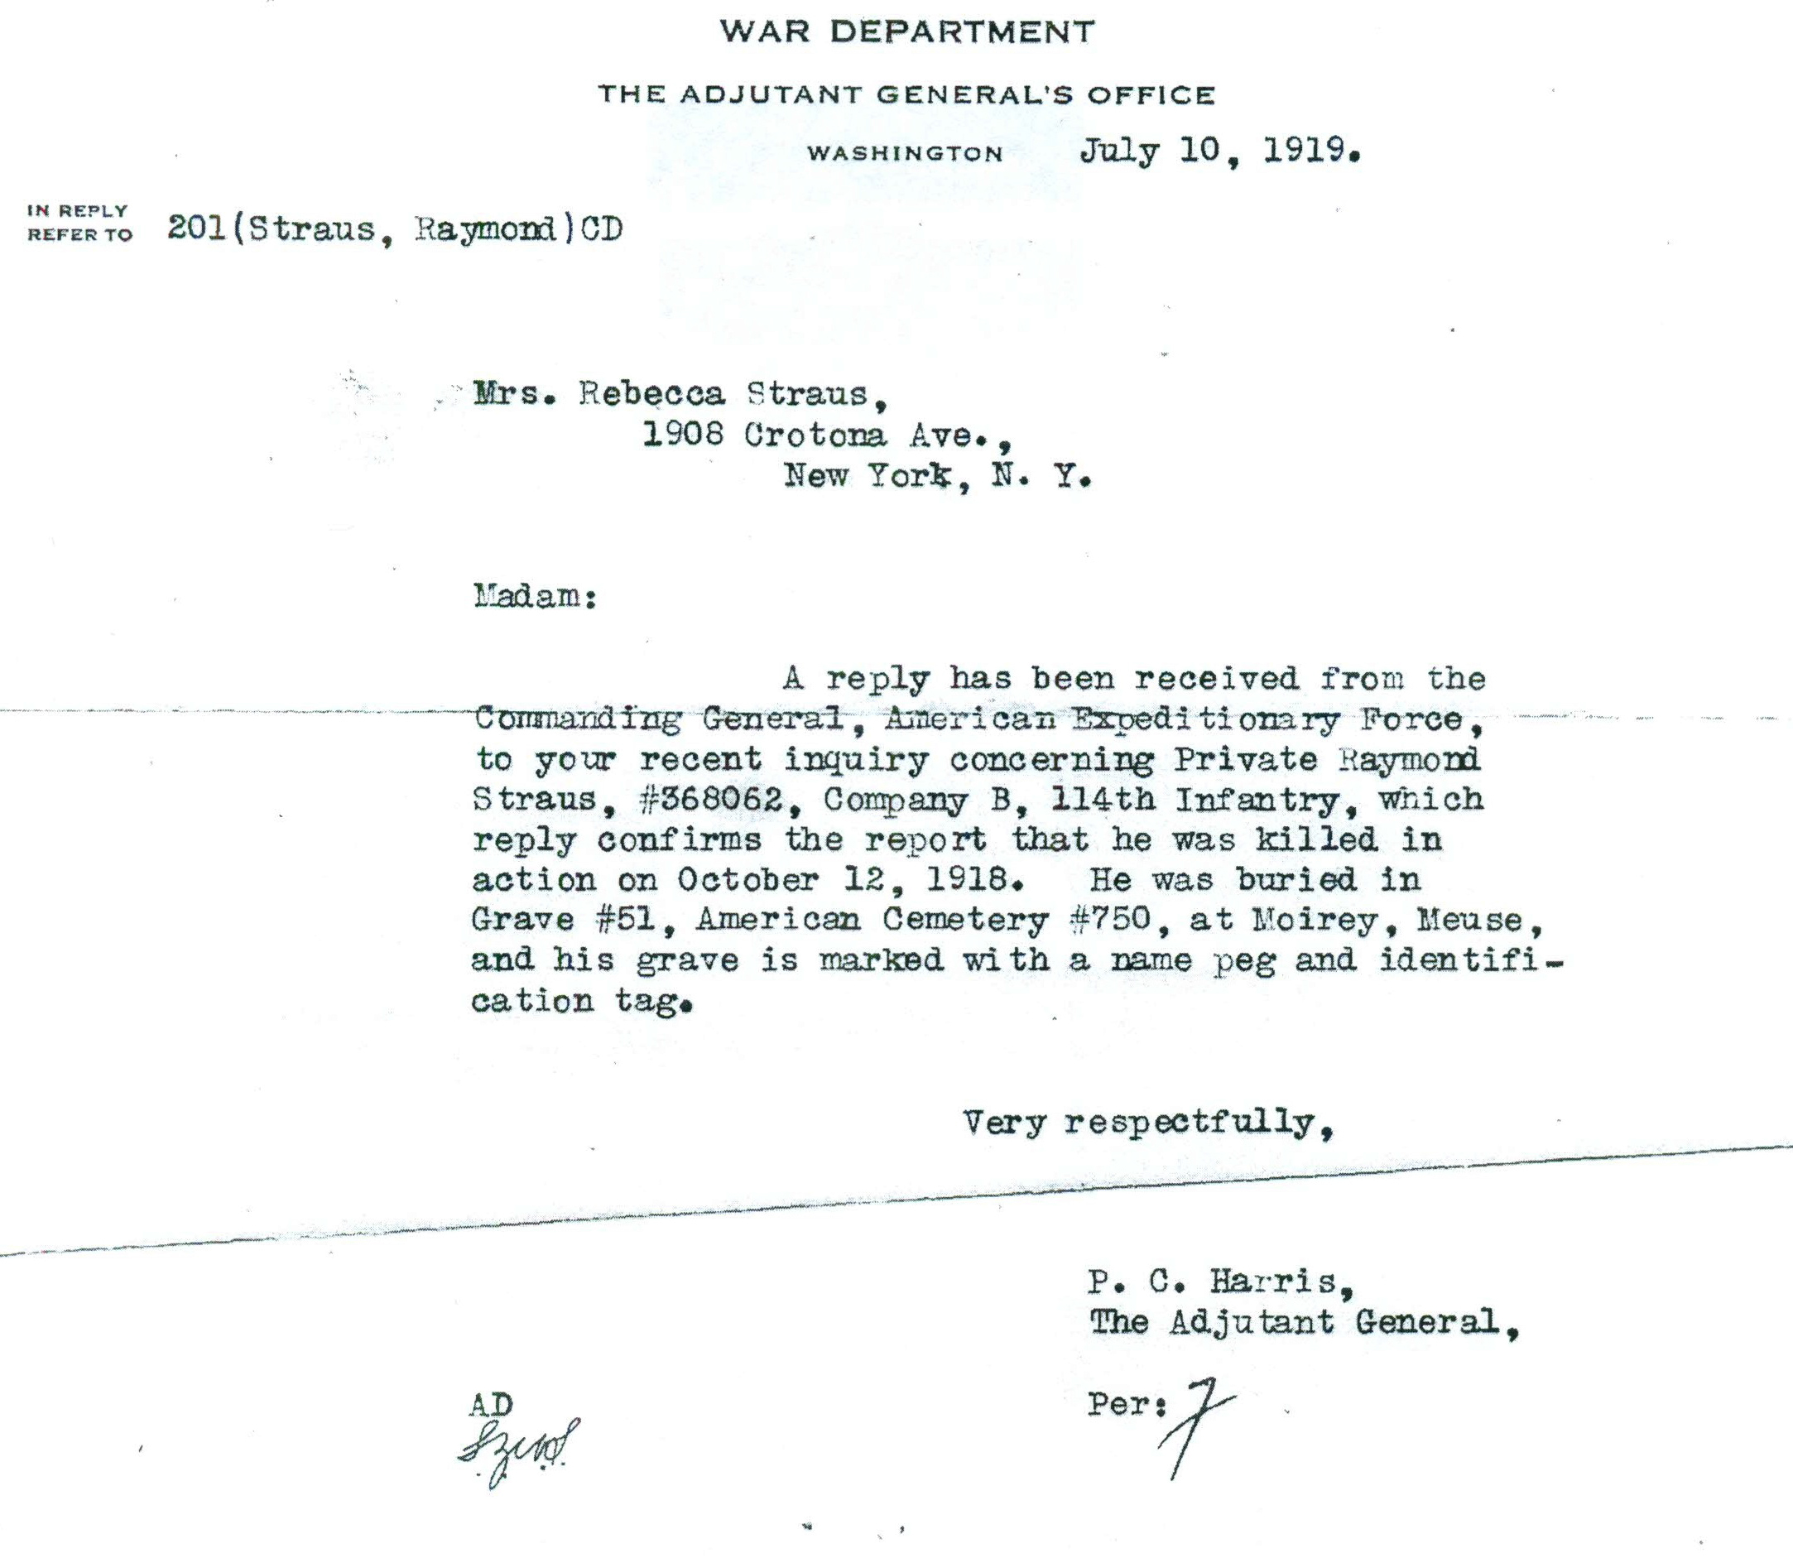
Initial temporary grave letter for Raymond Straus from the War Department. National World War One museum, Kansas City.

Slide 2
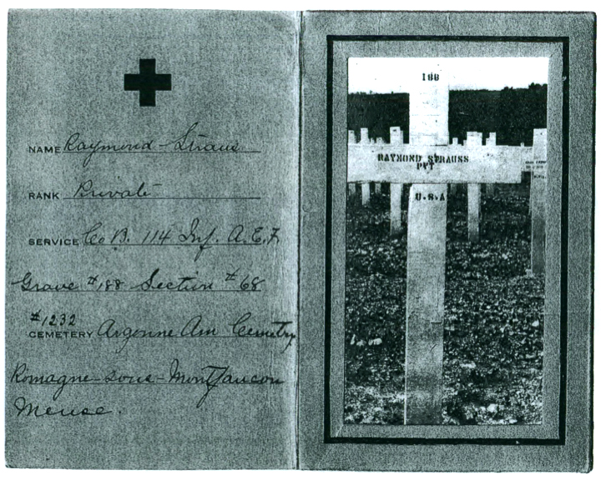
Subsequent notification and picture of Raymond Straus’ re-internment at the Meuse-Argonne cemetery at Romagne. National World War One museum, Kansas City. Grave site of Raymond Straus in 1930

Slide 3
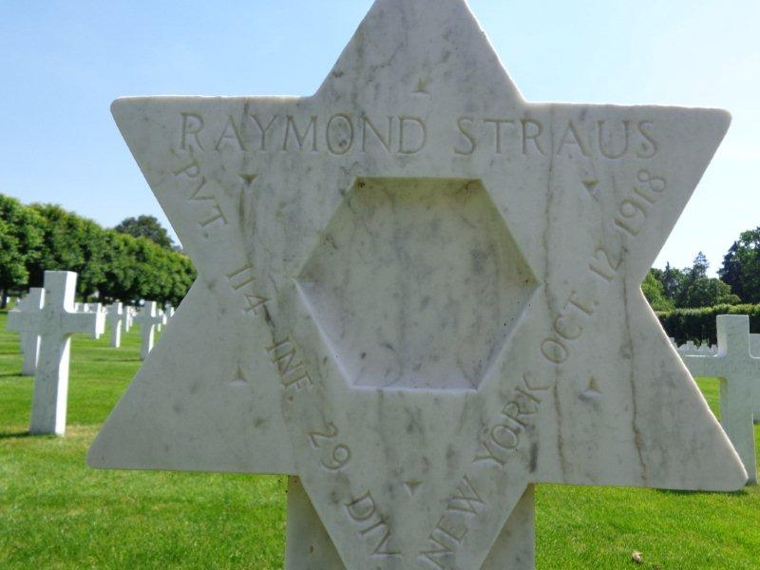
Grave site of Raymond Straus today. The cross of his temporary grave has been changed to a Jewish star of David.

Slide 4
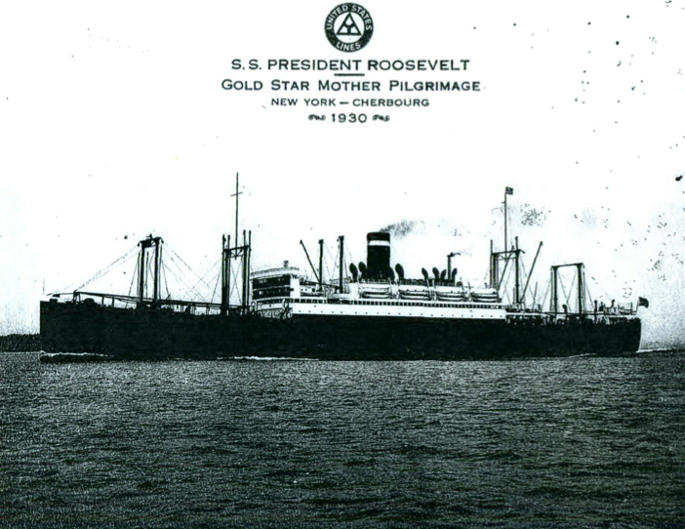
Details of his mother Rebecca’s pilgrimage in 1930: transatlantic crossing in style on the SS Roosevelt. National World War One museum, Kansas City.

Slide 5
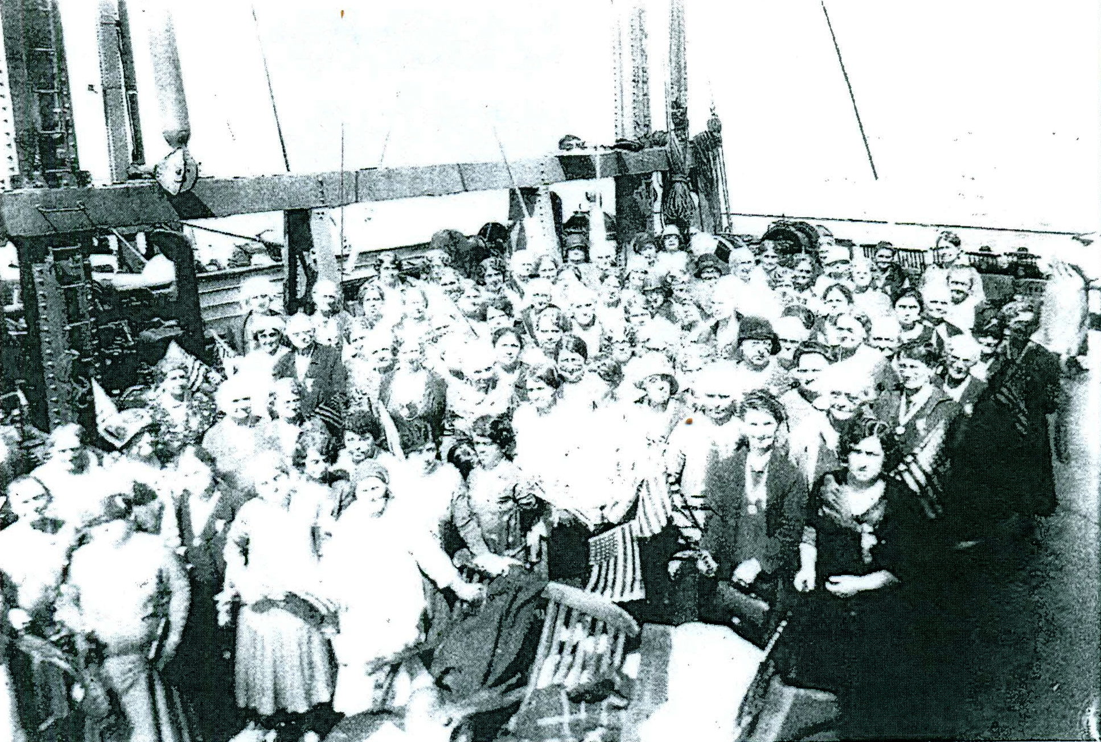
Details of his mother Rebecca’s pilgrimage in 1930: Gold Star Mothers Group on the deck on the ship. National World War One museum, Kansas City.

Slide 6
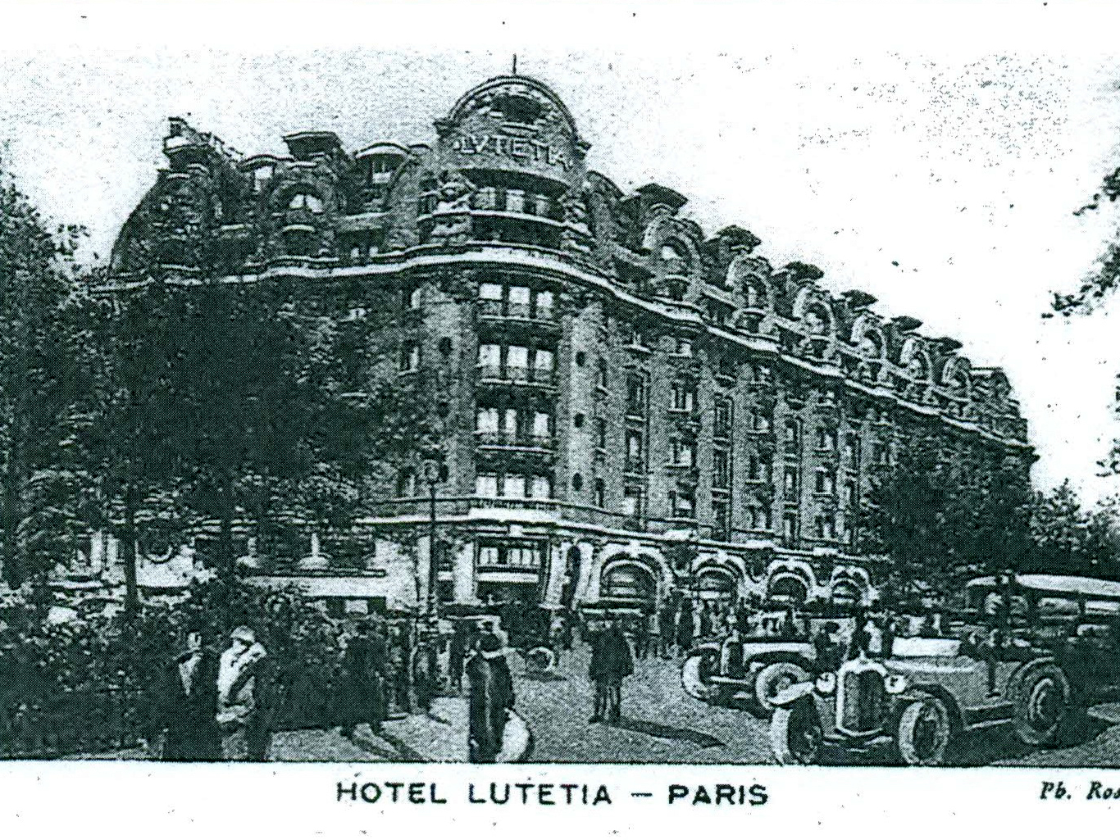
The hotel the Gold Star Mothers stayed at in Paris. National World War One museum, Kansas City.

